Slide 1
American River Flow Standard
A Site-Specific Example
Tom Gohring
3/19/14

Slide 2
Overview
Background
Compare / Contrast
Next Steps
Ideal Ecological Flow
DSP Hybrid Approach
American River Flow Standard

Slide 3
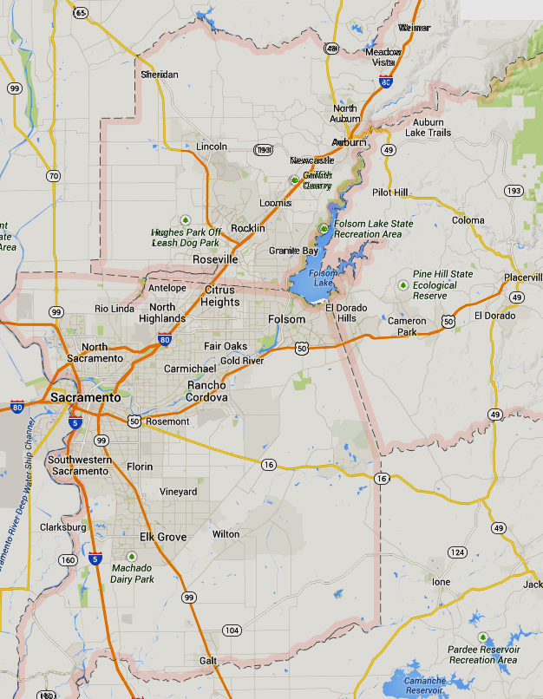
Sacramento Region
Placer County
Lower American River
Cities:
Sacramento
Roseville
Folsom
Rancho Cordova
Communities:
Carmichael
Granite Bay
Citrus Heights
Fair Oaks
Rio Linda
El Dorado County
Sacramento County

Slide 4
The Water Forum Agreement
Truce Among 4 Caucuses
Water
Public
Business
Environmental
Notes:
WFA is based on two co-equal objectives. These objectives are met through implementation of 6 program elements that are dependent on each other, and are intended to be implemented simultaneously. Both co-equal objectives are met in tandem, consequently stakeholders benefit together.
The WFA is not legally binding. Based on an MOU. But because it provides benefit to all parties it has become morally binding.
WFSE was wisely included by stakeholders to ensure implementation of the program elements and to provide assurance through a system of annual reports that the elements were in fact being implemented. Water forum staff are a direct result of the 7th element, WFSE.

Slide 5
The Water Forum Agreement
2 Objectives & 7 Elements
Reliable Water Supply to 2030
Protect the lower American River
Increased Diversions
Dry Year Actions
Groundwater Management
Water Conservation
Habitat Management
Improved Flow Standard
Water Forum Successor Effort
Notes:
WFA is based on two co-equal objectives. These objectives are met through implementation of 6 program elements that are dependent on each other, and are intended to be implemented simultaneously. Both co-equal objectives are met in tandem, consequently stakeholders benefit together.
The WFA is not legally binding. Based on an MOU. But because it provides benefit to all parties it has become morally binding.
WFSE was wisely included by stakeholders to ensure implementation of the program elements and to provide assurance through a system of annual reports that the elements were in fact being implemented. Water forum staff are a direct result of the 7th element, WFSE.

Slide 6
As Viewed by Purveyors

Slide 7
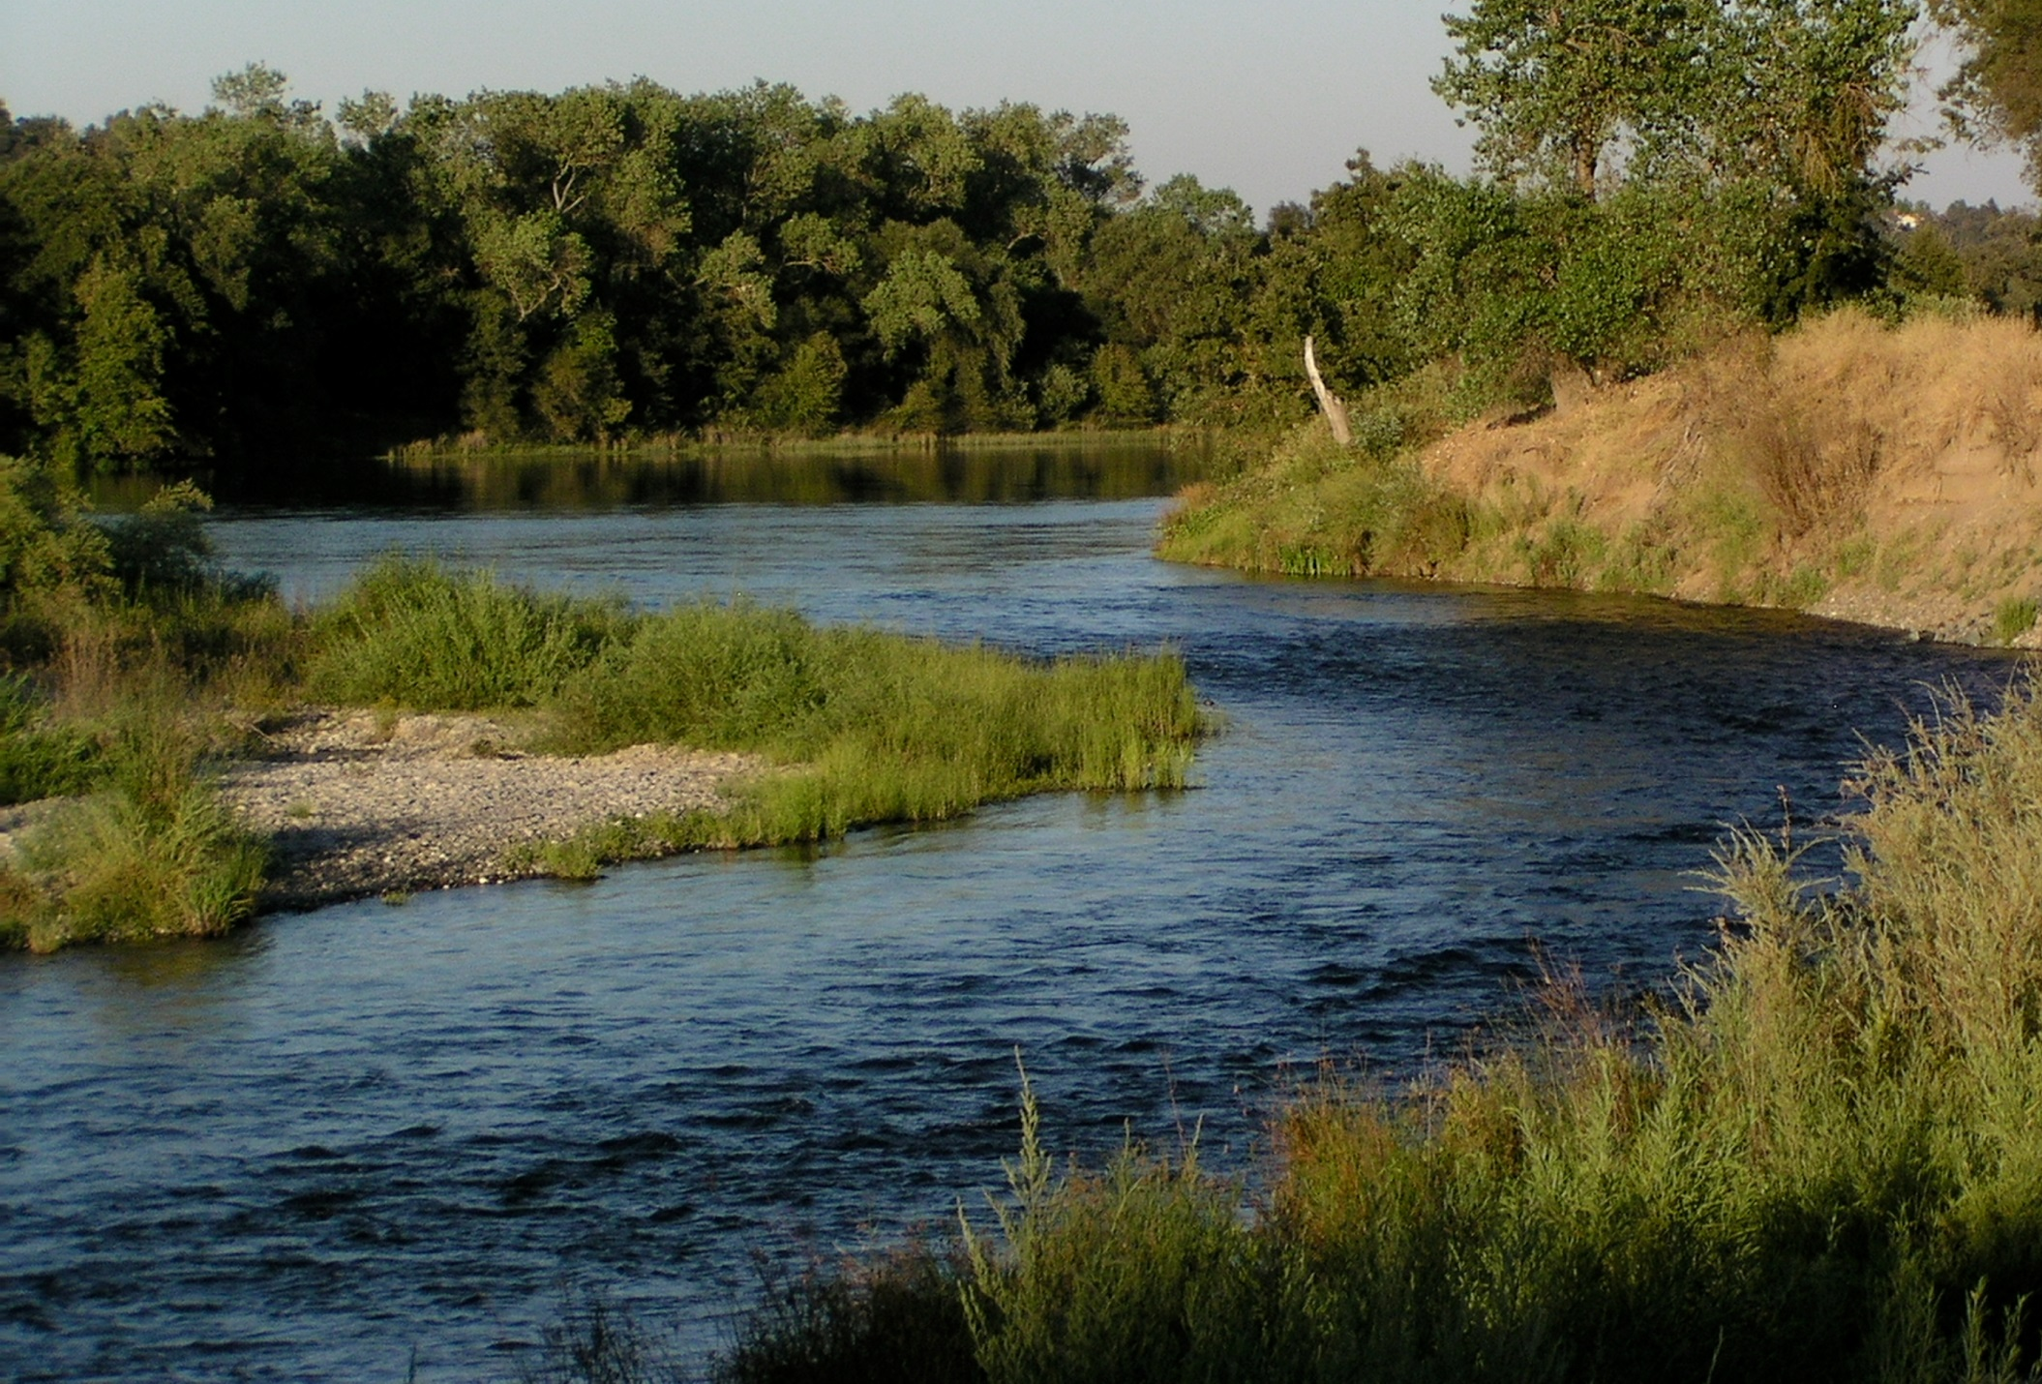
As Viewed by Enviros

Slide 8
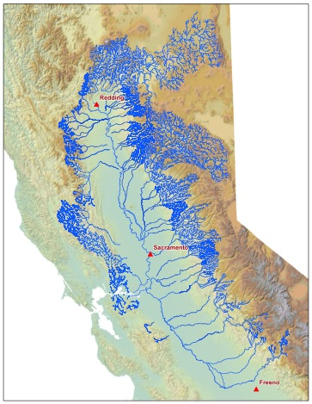
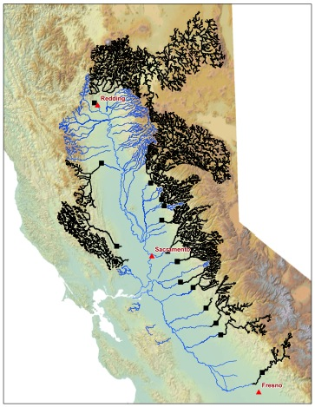
American River: Highly Altered
Then
Now
NOAA 2009
Notes:
Migrate into Sierra

Slide 9
American River: Highly Altered
Salmonids have to complete entire life cycle in limited environment.
Notes:
Now have to complete entire life cycle in a limited environment

Slide 10
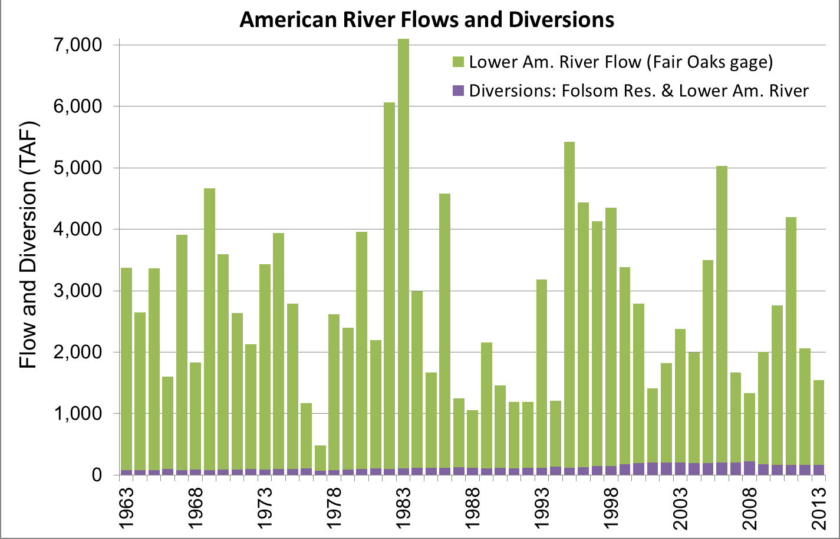
Flows & Demands

Slide 11
General: Flow Regime
Flow Regime Components
Magnitude
Frequency
Duration
Timing
Rate of Change
Primary regulators of integrity
Water Quality
Energy Sources
Physical Habitat
Biotic Interactions
Ecological Integrity
Poff et al. 1997

Slide 12
Management Actions for Highly Altered System
Flow manipulation
Selective cold water releases
Gravel/wood replacement
Reduced diversions
Re-vegetation
Drought response
River-friendly landscaping
New temperature shutters
… and more …
Lower American River Flow Standard
Other
Water Forum
Actions

Slide 13

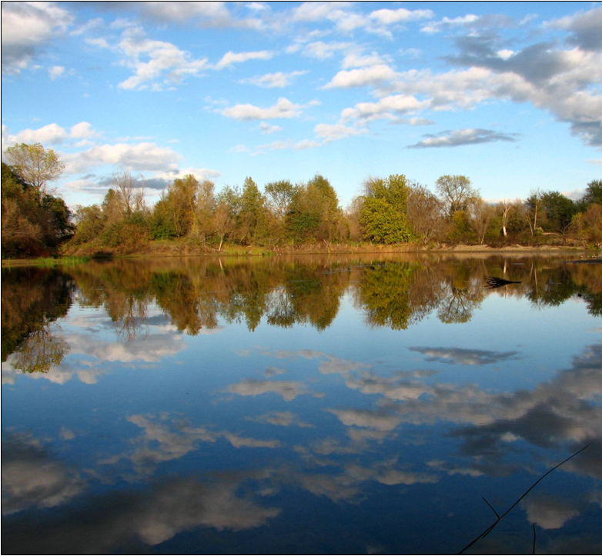
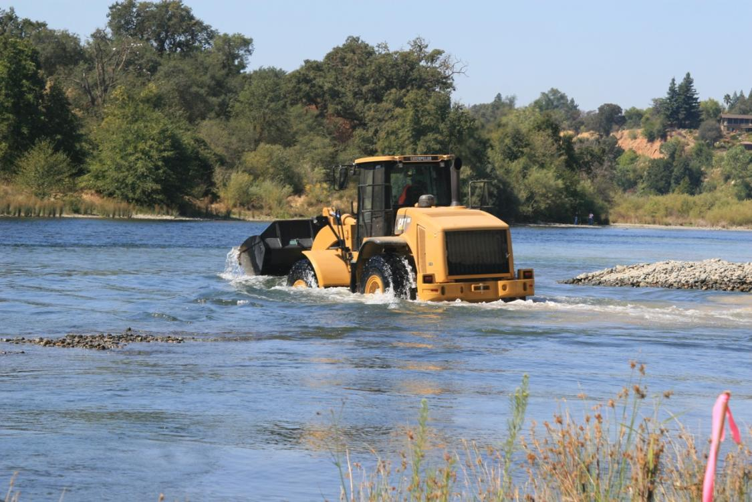
Habitat Management
September 03, 2010
Riverbed Restoration will Strengthen Salmon Runs
By Matt Weiser
More spawning gravel will be restored in the American River starting Tuesday as part of a long-running effort to bolster the river's salmon and steelhead runs.
On Tuesday, crews will begin working at Sailor Bar Recreation Area off Olive Avenue to clean and sort gravel removed from the river during gold-dredging activity a century ago. The gravel will then be put back in the riverbed to restore fish spawning habitat destroyed by that mining.
The work involves taking gravel piled on the river banks, sifting it to obtain the size fish prefer, washing it to remove 100 years of dirt and other contaminants, then spreading it in the riverbed. About 12,000 tons of gravel will be put back into the river.
Ecosystem restoration
Using good science
Leveraging local funds
Meet mitigation requirements
Notes:
The question is – how do you protect the LAR with increased flow diversions?
Flow Standard – 1958 – Water Right Decision 893.
State Board acknowledged it is not protective of beneficial uses in a 1990 report when acting as a court appointed referee in the EBMUD litigation case. Board said it would adopt an updated standard by 1992. Never happened. Became a WF job.
Habitat Management – WF stakeholders using American River CVP water contribute about $450,000 annually to be used for LAR habitat projects.
Water Conservation- an element that that provides benefits to both water supply reliability and LAR protection.
Conjunctive use – the method that enables dry year cutbacks
Dry Year cutbacks – reduction of surface water diversions as the water year becomes dry. Water not diverted is meant to be available specifically for fish protection.

Slide 14
Dry Year Cutbacks
Protects the River
Varies by purveyor
Notes:
The question is – how do you protect the LAR with increased flow diversions?
Flow Standard – 1958 – Water Right Decision 893.
State Board acknowledged it is not protective of beneficial uses in a 1990 report when acting as a court appointed referee in the EBMUD litigation case. Board said it would adopt an updated standard by 1992. Never happened. Became a WF job.
Habitat Management – WF stakeholders using American River CVP water contribute about $450,000 annually to be used for LAR habitat projects.
Water Conservation- an element that that provides benefits to both water supply reliability and LAR protection.
Conjunctive use – the method that enables dry year cutbacks
Dry Year cutbacks – reduction of surface water diversions as the water year becomes dry. Water not diverted is meant to be available specifically for fish protection.

Slide 15
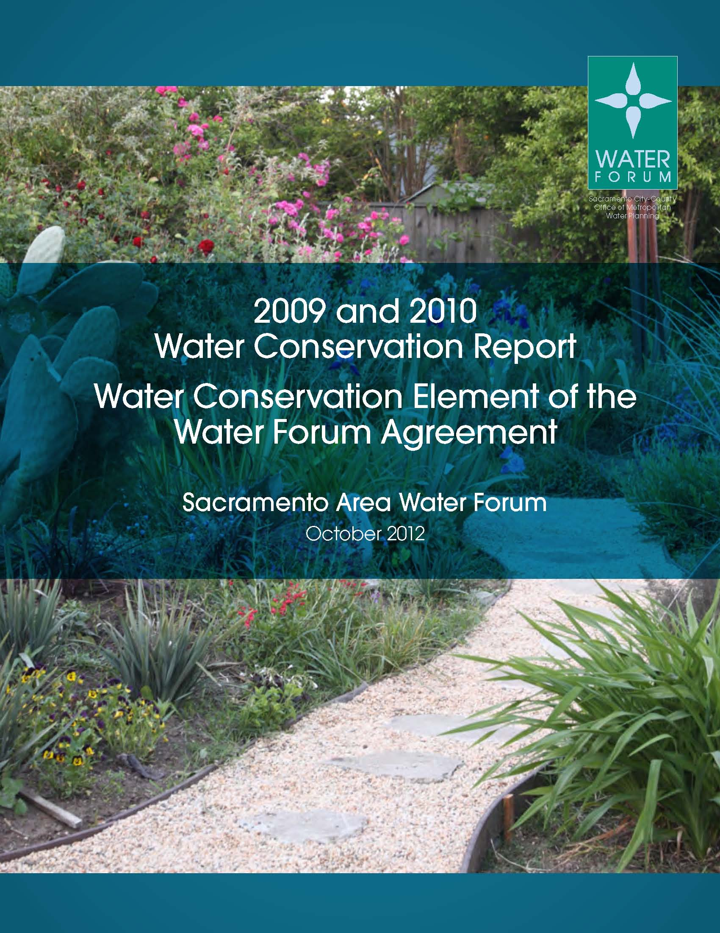
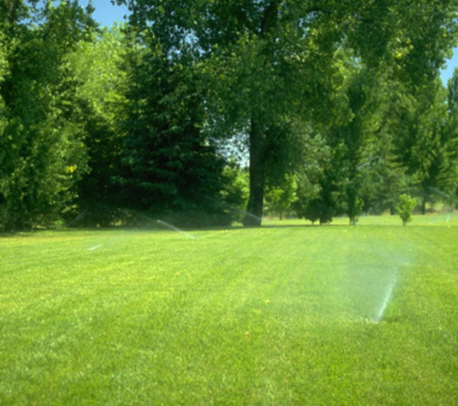
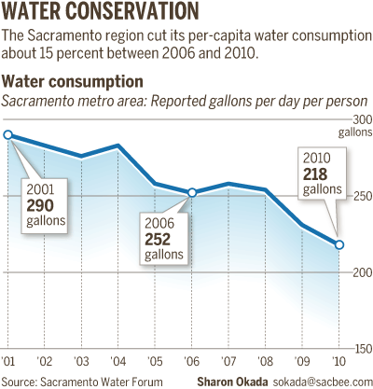
Water Conservation
November 03, 2012
Region Reduces Its Water Use
By Matt Weiser
Sacramento region has made
significant strides in water
conservation in recent years,
according to a new report.
What remains unclear,
however, is whether the
improvement is real or an
artifact of the recession,
which left thousands of
area homes vacant.
The report by the Sacramento
Water Forum provides
data from 15 water utilities
across the capital metro area
for 2009 and 2010. It is the
first such report since the
group required . member
Support Role
  BMPs
  Reporting
  20 x 2020 (SB 7x)
  Planning
  Public Outreach
  Grant Applications
Notes:
The question is – how do you protect the LAR with increased flow diversions?
Flow Standard – 1958 – Water Right Decision 893.
State Board acknowledged it is not protective of beneficial uses in a 1990 report when acting as a court appointed referee in the EBMUD litigation case. Board said it would adopt an updated standard by 1992. Never happened. Became a WF job.
Habitat Management – WF stakeholders using American River CVP water contribute about $450,000 annually to be used for LAR habitat projects.
Water Conservation- an element that that provides benefits to both water supply reliability and LAR protection.
Conjunctive use – the method that enables dry year cutbacks
Dry Year cutbacks – reduction of surface water diversions as the water year becomes dry. Water not diverted is meant to be available specifically for fish protection.

Slide 16
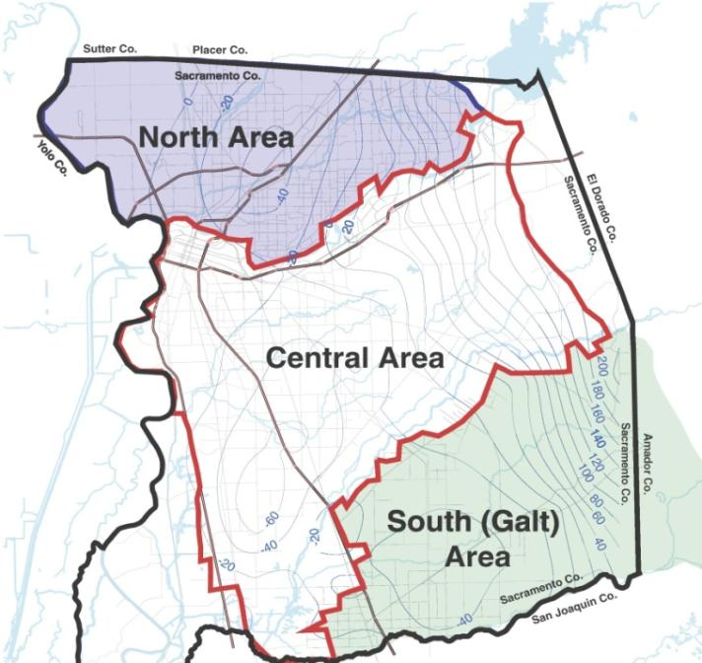
Groundwater Management
Sustainable Yields
North Area
  131,000 Acre-feet
Central Area
  273,000 Acre-feet
South Area
  115,000 Acre-feet
Plan & JPA (SGA)
Plan & JPA (SCGA)
Plan
Notes:
*Vic Fazio Water – PL 101-514 – Directed the USBR to sell 50TAF of water to Sacramento region water purveyors (American River watershed)
San Juan Water District – 13 TAF
City of Folsom – 7 TAF
Sacramento County – 15 TAF
El Dorado County – 15 TAF
*Forum accomplishment (not directly related to slide)

Slide 17

The New California Landscape www.ecolandscape.org

Slide 18
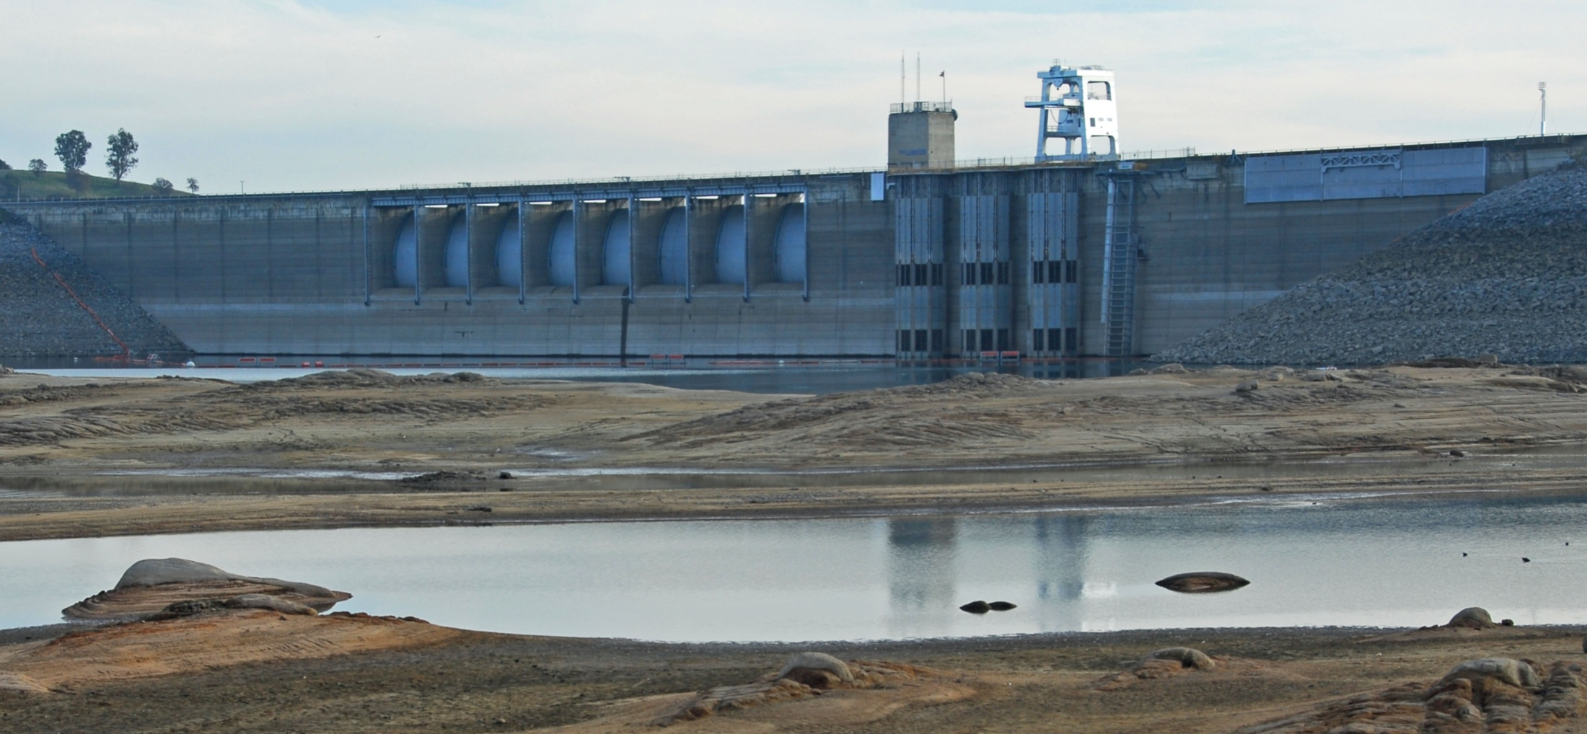
Upgrading Folsom Dam
Temperature Control Device

Slide 19
American River
Flow-Related Ecological Goals
Sustain diverse aquatic & riparian ecosystem
Restore/enhance natural processes
Reduce Stressors
  Increase Fall-run Chinook Salmon spawning habitat
  Reduce of redd superimposition and dewatering
  Improve Fall-run Chinook spawning temperatures
  Reduce egg mortality due to water temperature
  Improve summer juvenile Steelhead rearing temperatures

Slide 20
Compare / Contrast:
DSP Hybrid & Am. River Approaches
✓
Step 1) Stream segment classification
Step 2) Hydrologic analysis
Step 3) Site-specific field work
Step 4) Extrapolation of findings
Step 5) Produce environmental flow regime
Step 6) Interaction: scientists & stakeholders
Step 7) An adaptive management protocol
✓
✓

✓
✓
✓

Slide 21
Step 1) Stream segment classification
✓
DSP Hybrid Approach
American River Approach
Physical variables
  Depth
  Velocity
Stream attributes
  Substrate
  Cover
Stream reaches:
  Ecological zones

Slide 22
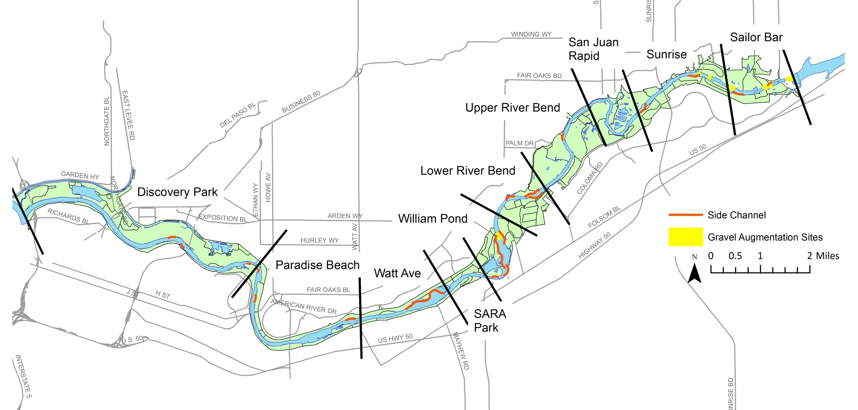
Step 1) Stream segment classification
✓
DSP Hybrid Approach
American River Approach
Physical variables
  Depth
  Velocity
Stream attributes
  Substrate
  Cover
Stream reaches:
  Ecological zones

Slide 23
Step 2) Hydrologic analysis
✓
DSP Hybrid Approach
American River Approach
Separate hydrology into key flow regime components (blocking) and an analysis of historical changes.
… more than the consideration of species specific habitats
… consider full range of flows
Flow Standard is blocked into:
Flood control
Steelhead spawning & rearing
Fall-run spawning & rearing
Other species & life stages
Pulses
CVP operations

Slide 24
Step 3) Site-specific field work
✓
DSP Hybrid Approach
American River Approach
… targeted toward representative species assemblages and processes … such as instream habitat requirements of notable fish species …
(e.g. floodplain connectivity, benthic productivity or native assemblages)
Detailed surveys &habitat modeling
  Substrate
  Bathymetry
  Depth
  Velocity
  Redds
  Temperature
  DO
  Stranding
  Other

Slide 25
Step 4) Extrapolation of findings

DSP Hybrid Approach
American River Approach
… the essence of … setting flow criteria
Not needed. Ours is site-specific approach.
While a more regional approach is desired either due to time or resource constraints, it should be acknowledged that a site-specific approach would be more scientifically defensible simply because uncertainties associated with extrapolation would be avoided.

Slide 26
Step 5) Production of an environmental flow regime
✓
DSP Hybrid Approach
American River Approach
Species
Processes – such as:
- Temperature
- Sediment transport
- Lateral connectivity
  Steelhead
  Fall-run Chinook
  Temperature management
  Delta water quality
  Sediment transport
  Floodplain connectivity
  Pulse flows
Reliance on flow alteration statistics alone may or may not address these issues.

Slide 27
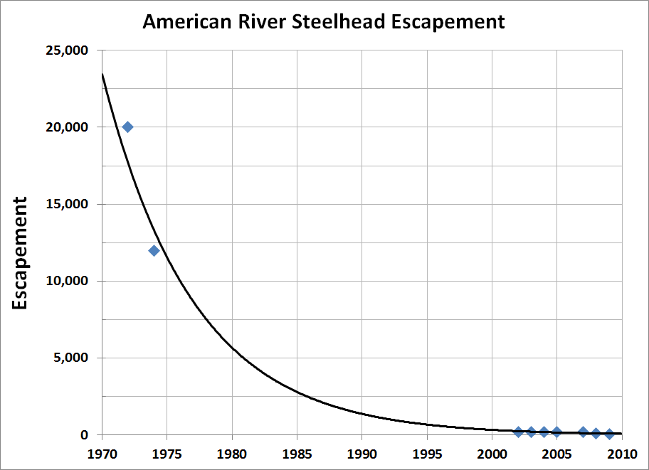
Steelhead
Central Valley steelhead listed as threatened under the Federal Endangered Species Act in 1998 (status reaffirmed in 2006)
“New information since 2005 indicates increased extinction risk.“
- NOAA Fisheries, 2011
“An average of 154 redds have been
counted each year since 2003 on the American River.“
- NOAA Fisheries, 2011
Less than 250

Slide 28
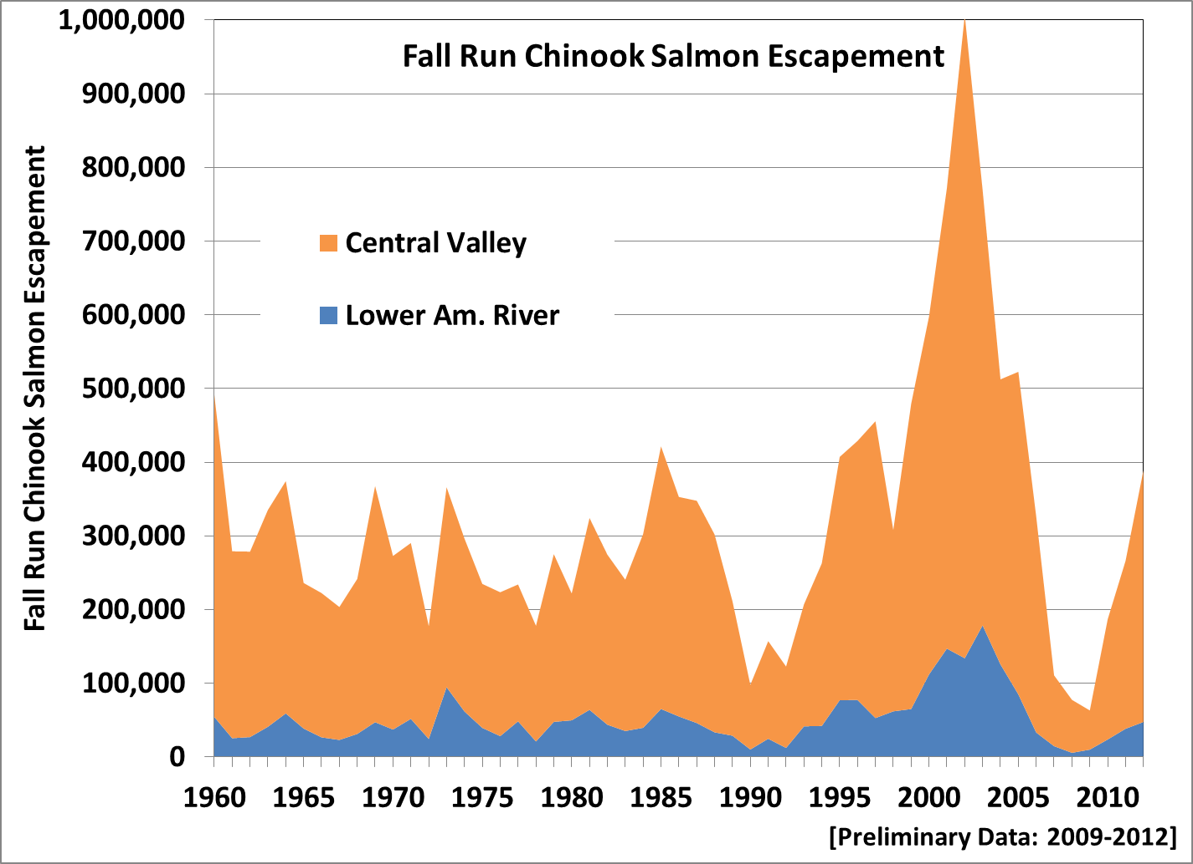
Fall Run Chinook
(Averages 19% of Central Valley)
~ 2500
in
2008

Slide 29
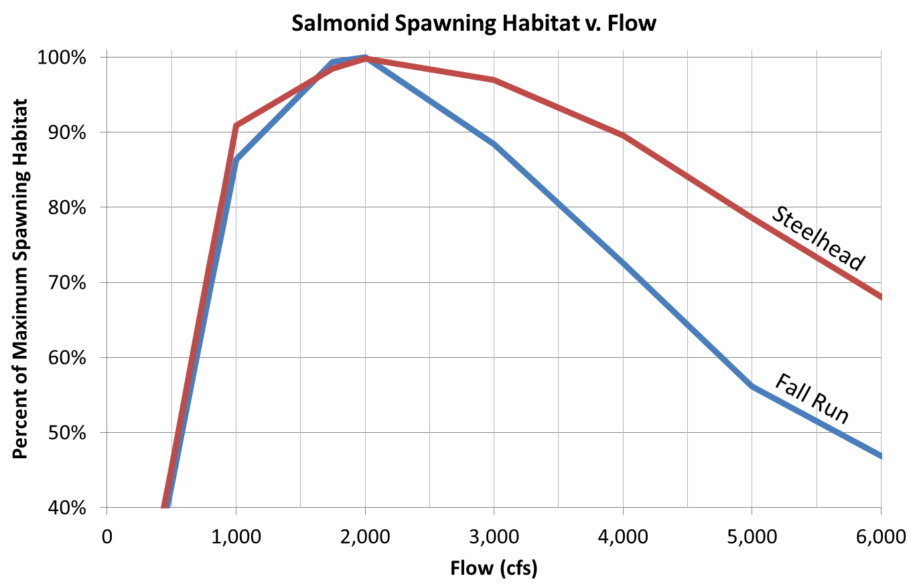
Flow and Habitat
Above 800 cfs
Optimal Range:
80% of Habitat

Slide 30
Minimum Flows
Developed to:
Optimize habitat
Support sensitive life stages of salmonids
Avoid redd superimposition
Avoid redd dewatering
Avoid stranding
Note: USBR can operate above the minimum.
Min. Flow (cfs)

Slide 31
Seeking Optimal Habitat

Slide 32
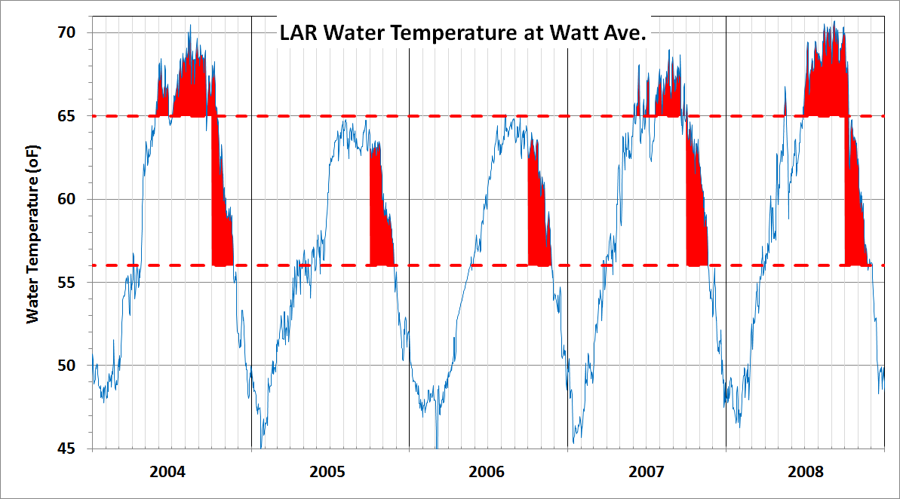
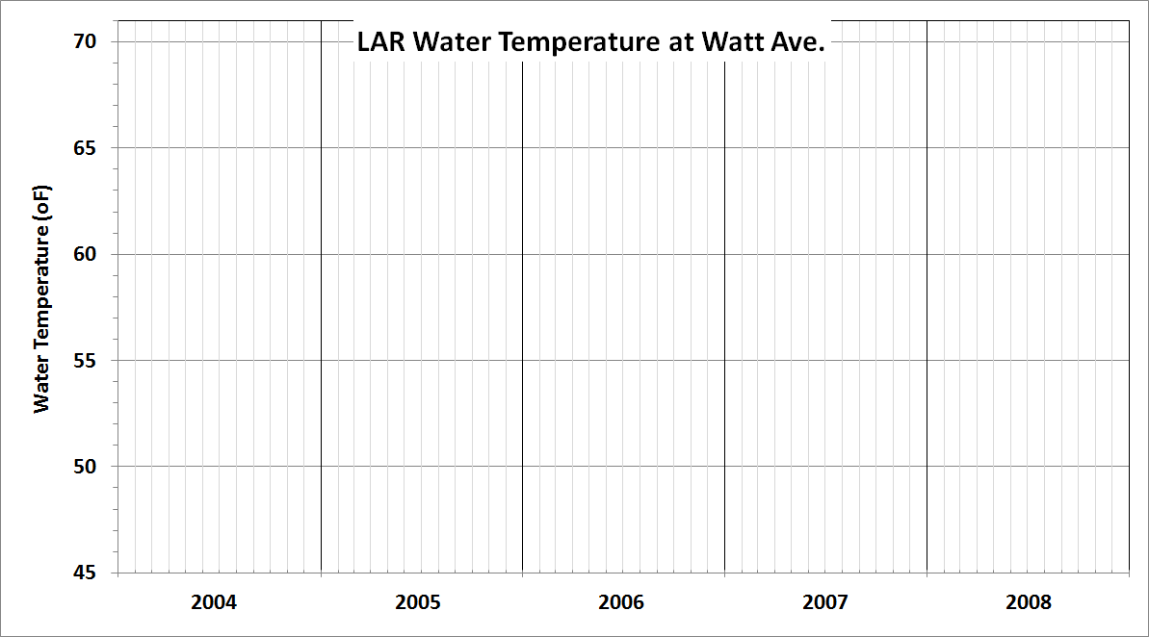
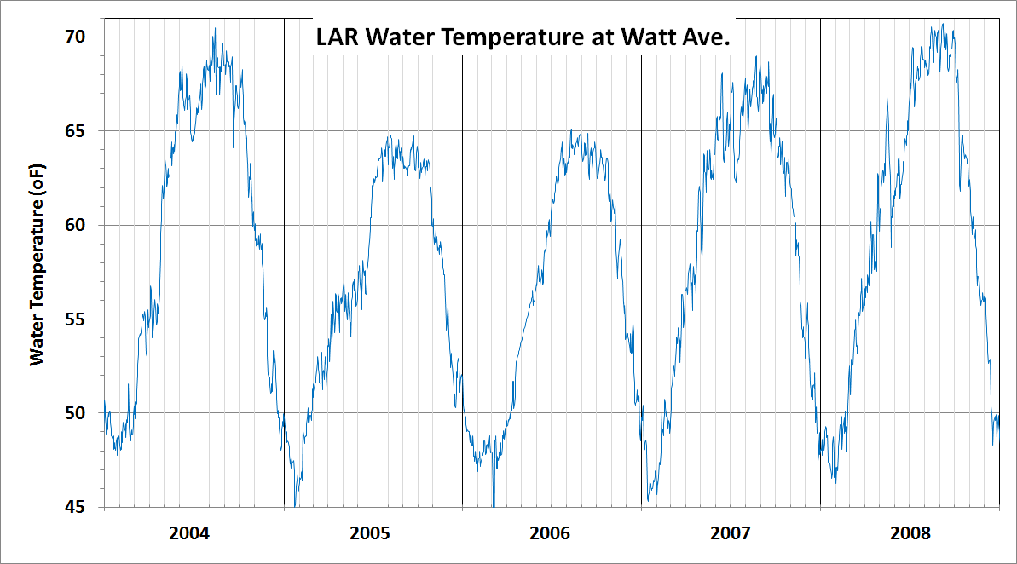
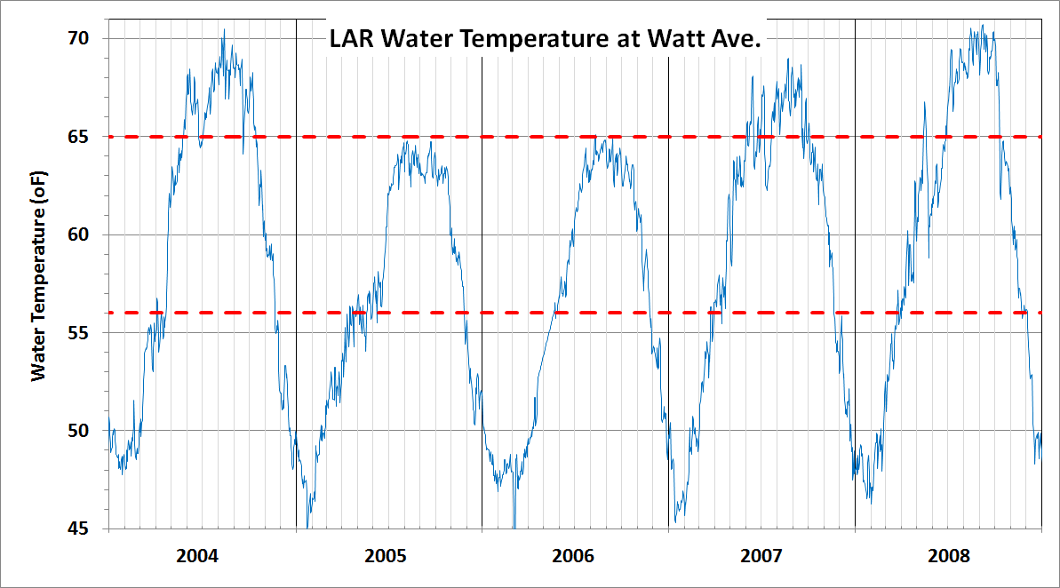
Problem – Water Too Warm

Slide 33
Temperature Management
- Annual Plan & Operations -
76 ºF
74
72
70
68
66
64
62
60
58
56
Obtains BEST POSSIBLE temperature
Temperature shutter operations
Temperature targets set by May 1
Fixed compliance point (Watt Ave)
  Ongoing oversight (NMFS approval)
Requires Analysis by USBR
  Good technical tools
  Good data

Slide 34
Folsom Dam Temperature Control Device (Shutters)

Slide 35
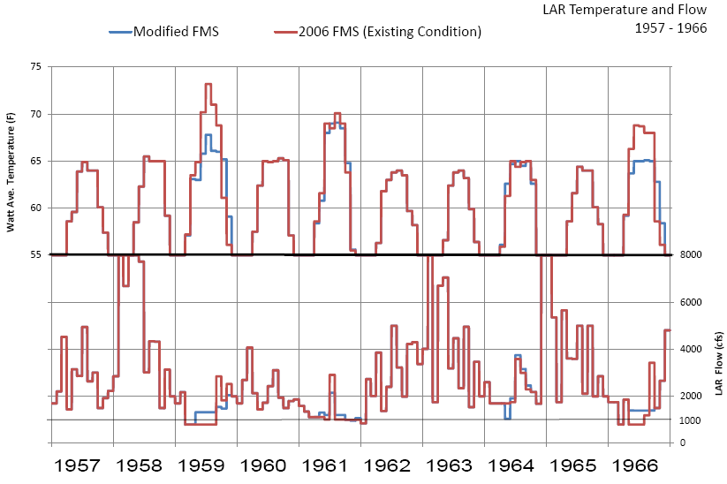
Modified Flow Pattern
2014
DROUGHT

Slide 36
Carryover Storage Alternative
Balancing ecological benefits
  Near-term: Am. River habitat; Delta water quality
  Long-term: Protect against dry year impacts
Must consider potential unintended consequences: Delta; Sacramento River
In response to
  2014 Drought
  Recent changes in CVP operations

Slide 37
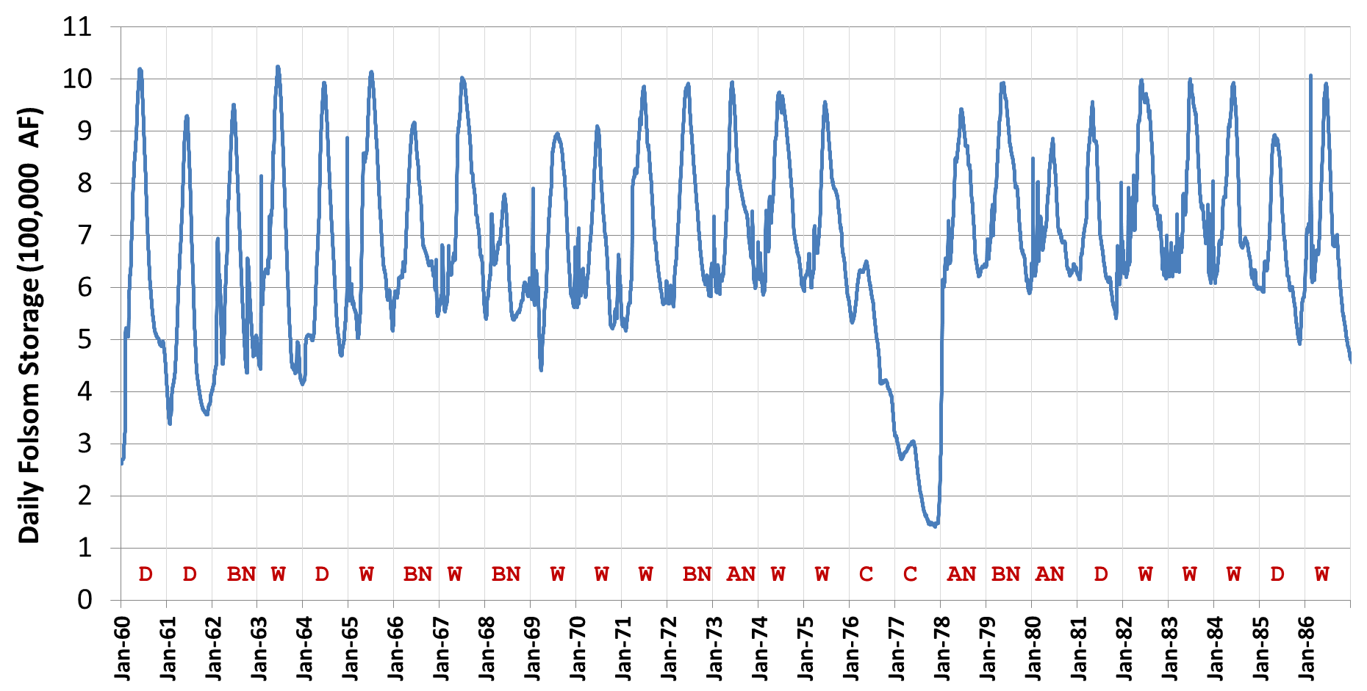
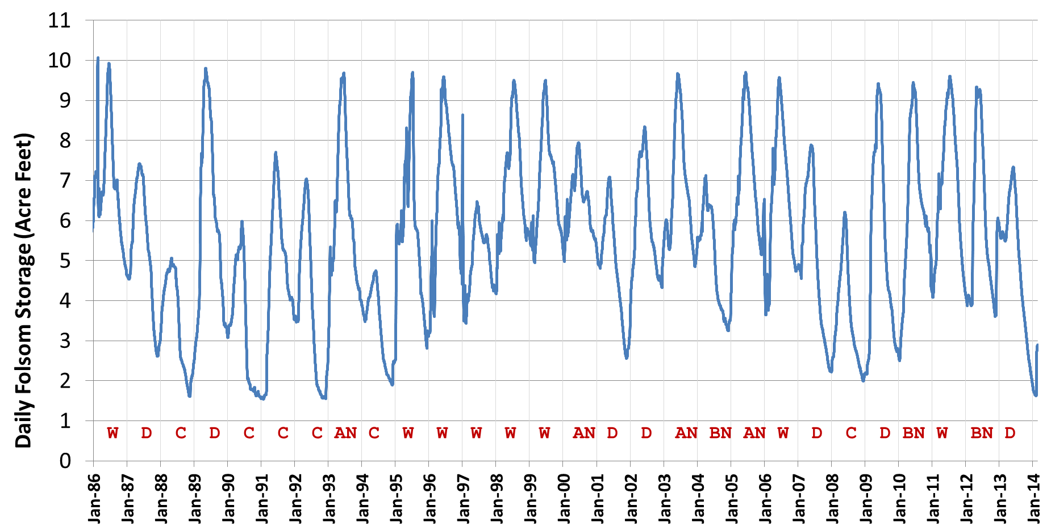
Historical Folsom Storage
10
9
8
7
6
5
4
3
2
1
0
10
9
8
7
6
5
4
3
2
1
0
Folsom Storage (TAF)
Folsom Storage (TAF)
1977 Drought
10
9
8
7
6
5
4
3
2
1
0
Folsom: drawn down more since 1990’s drought
Folsom Storage (TAF)
1990’s Drought

Slide 38
✓
Step 5) Production of an environmental
flow regime
Salmonid habitat
Water temperature
Other Processes
  Sediment Transport
  Pulse flows
  Lateral connectivity
  Flood plain inundations

Slide 39
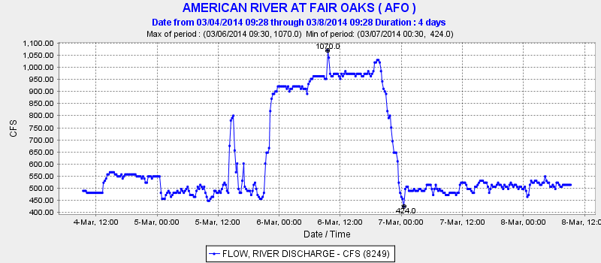
Step 5) Production of an environmental flow regime
✓
1,000 cfs
Additional Protections
Ramping rates
Avoiding
redd superimposition
Drought response: 2014 Example
  Water Forum dry year conference
  Fishery working group
  March pulse flow
March 6
500 cfs

Slide 40
Step 6) Interaction between scientists and stakeholders
✓
DSP Hybrid Approach
American River Approach
Successful implementation of flow standards commonly rests more heavily on these societal challenges than any challenges that are of a more scientific nature.
Have ongoing science & stakeholder interaction and buy-in.
Science Team
Management and Resource Agencies
Water Forum Stakeholders
Ideally, stakeholder involvement is ongoing from the earliest stages … essential that all stakeholders are involved … so that there is support and consensus

Slide 41
Step 6) Interaction between scientists and stakeholders: Am. River
✓
Science Team
Fisheries Biologists
  Paul Bratovich, Mike Bryan, et al
Hydrologist & Geomorphologists
  Chris Bowles, Chris Hammersmark, et al
Water and Power Systems
  Buzz Link, Jeff Weaver, et al
Food Service
  Tom Gohring

Slide 42
Step 6) Interaction between scientists and stakeholders: Am. River
✓
Management and Resource Agencies
US Bureau of Reclamation
  Implementing since 2006
  Flow approach in 2008 BA
US Fish and Wildlife Service
National Marine Fisheries Service
  Flow approach in 2009 BiOp
California Department of Fish and Wildlife

Slide 43
Step 6) Interaction between scientists and stakeholders: Am. River
✓
Stakeholders
Water
Public
Business
Environmental

Slide 44
Step 6) Interaction between scientists and stakeholders: Am. River
Stakeholders
BUSINESS
AKT Development
Associated General Contractors
North State Building Industry Association
Sacramento Association of Realtors
Sacramento Metropolitan Chamber of Commerce
Sacramento Sierra Building & Construction Trades Council
PUBLIC
City of Sacramento
County of Sacramento
League of Women Voters of California
Sacramento County Alliance of Neighborhoods
Sacramento County Taxpayers League
Sacramento Municipal Utility District
WATER
California-American Water Company
Carmichael Water District
Citrus Heights Water District
City of Folsom
City of Roseville
Clay Water District
Del Paso Manor Water District
El Dorado County Water Agency
El Dorado Irrigation District
Elk Grove Water Service
Fair Oaks Water District
Florin County Water District
Galt Irrigation District
Georgetown Divide Public Utility District
Golden State Water Company
Natomas Central Mutual Water Company
Omochumne-Hartnell Water District
Orange Vale Water Company
Placer County Water Agency
Rancho Murieta Community Service District
Regional Water Authority
Rio Linda/Elverta Community Water District
Sacramento County Farm Bureau
Sacramento Suburban Water District
San Juan Water District
ENVIRONMENTAL
Environmental Council of Sacramento
Friends of the River
Save the American River Association, Inc.
Sierra Club Mother Lode Chapter

Slide 45
Step 6) Interaction between scientists and stakeholders: Am. River
✓
All Together - American River Group
Reclamation
US FWS
NMFS
Cal DFW
State Water Board
Scientists
Water Forum stakeholders

Slide 46
Step 7) An adaptive management protocol
✓
DSP Hybrid Approach
American River Approach
Provides flexibility and feedback to the management of natural resources in the face of considerable uncertainty.
Minimum flow – changes based on hydrology and storage
Temperature management – changes with available coldwater pool and balances Steelhead and Fall-run needs
Ongoing monitoring program: leads to changes as necessary

Slide 47
Step 7) An adaptive management protocol
✓
American River Approach
DSP Hybrid Approach
Ongoing monitoring program
  Biological
  Physical
  Chemical
  Operations
“What have we learned” approach
Equating physical & operational changes to biological response.
American River Group – ongoing oversight and adaptive decision-making

Slide 48
Compare / Contrast:
DSP Hybrid & Am. River Approaches
✓
Step 1) Stream segment classification
Step 2) Hydrologic analysis
Step 3) Site-specific field work
Step 4) Extrapolation of findings
Step 5) Produce environmental flow regime
Step 6) Interaction: scientists & stakeholders
Step 7) An adaptive management protocol
✓
✓

✓
✓
✓

Slide 49
American River: Next Steps
Continue working with State Board staff
Update models – 2013 DRR, etc.
Complete investigation into Carryover Storage option
Complete EIR
Long-term implementation

Slide 50

Ideal Ecological Flow: Am. River
Magnitude
  Maximum spawning habitat availability for fall-run Chinook and steelhead spawning
  Allow channel forming, floodplain inundation, and riparian vegetation establishment
Frequency
  High probability of occurrence of flows providing maximum spawning habitat
Duration
  Seasonally-encompassing flows (lifestage periodicity oriented)
Timing
  A range of flows, within and among years
  Maintain channel and riparian dynamics and, consequently, aquatic habitat
  Allow behavioral responses – adult immigration and juvenile emigration
Rate of Change
  Ramping rate and flow fluctuation limits for spawning, incubation and juvenile rearing
Suitable water temperature regime
  Fall-run Chinook spawning and incubation, and over-summer rearing juvenile steelhead
  Shape flow pattern for best water temperatures
Notes:
“Criteria” according to the SWRCB
Remember: we are keeping mountain fishery on valley floor.

Slide 51
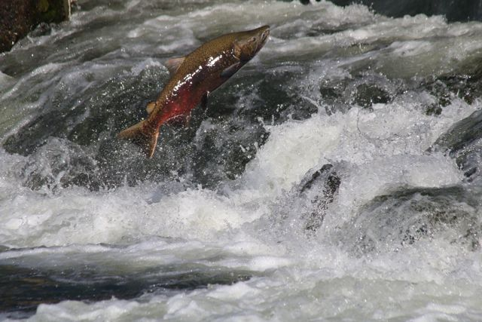
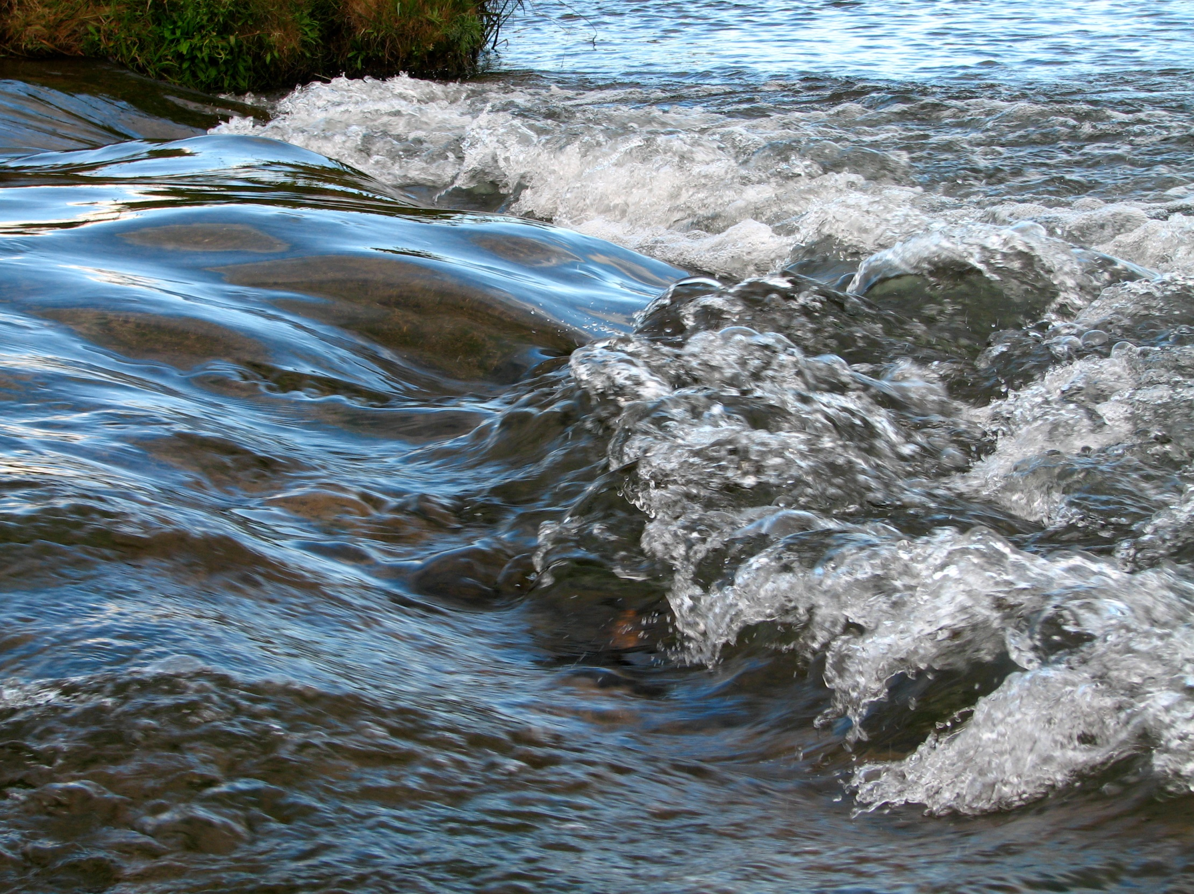
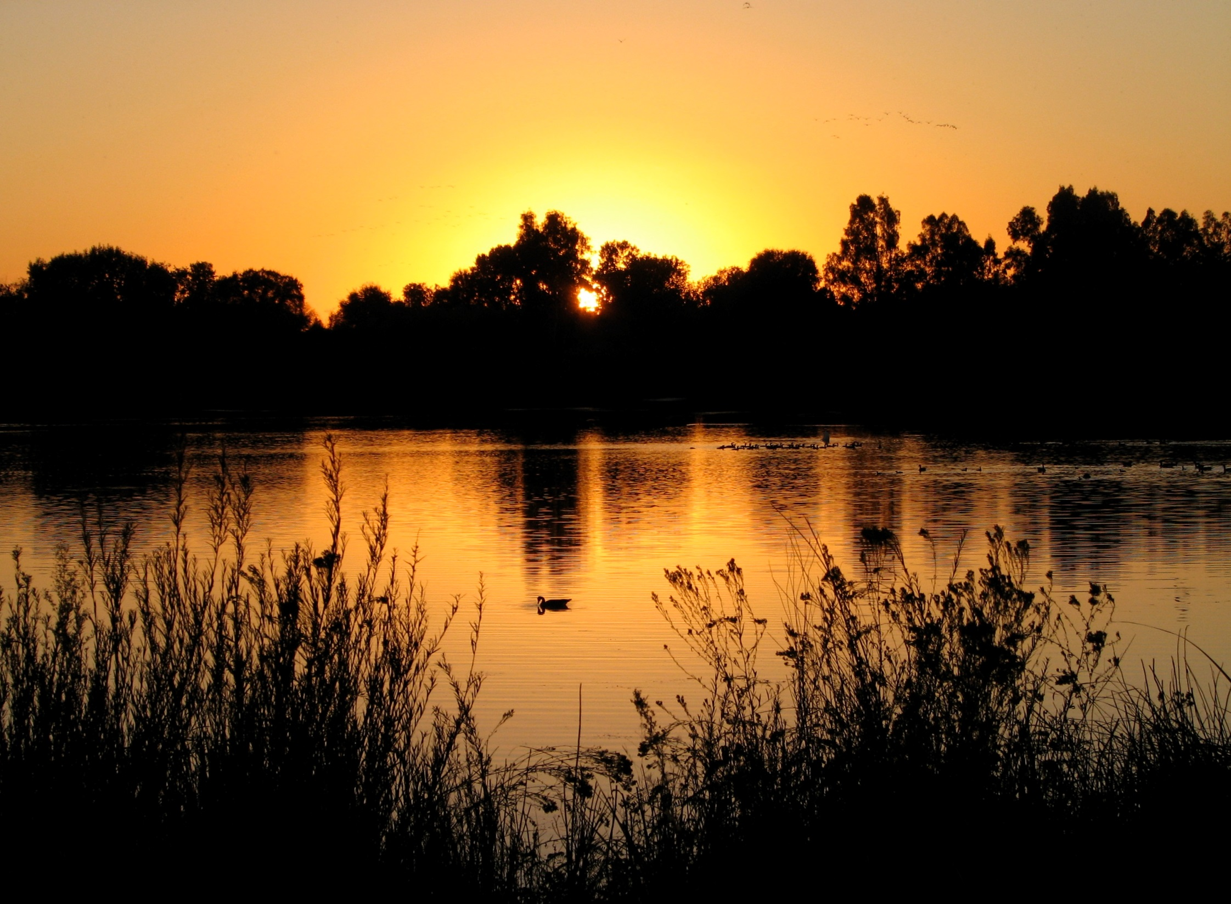
Ideal Ecological Flow: Am. River
Magnitude
  Maximum spawning habitat availability for fall-run Chinook and steelhead spawning
  Allow channel forming, floodplain inundation, and riparian vegetation establishment
Frequency
  High probability of occurrence of flows providing maximum spawning habitat
Duration
  Seasonally-encompassing flows (lifestage periodicity oriented)
Timing
  A range of flows, within and among years
  Maintain channel and riparian dynamics and, consequently, aquatic habitat
  Allow behavioral responses – adult immigration and juvenile emigration
Rate of Change
  Ramping rate and flow fluctuation limits for spawning, incubation and juvenile rearing
Suitable water temperature regime
  Fall-run Chinook spawning and incubation, and over-summer rearing juvenile steelhead
  Shape flow pattern for best water temperatures
Notes:
“Criteria” according to the SWRCB
Remember: we are keeping mountain fishery on valley floor.

