Slide 1
Overview of 2017 Report by Statewide Advisory Committee on Cooling Water Intake Structures
Rob Oglesby
Executive Director
California Energy Commission
June 20, 2017

Slide 2
OTC Progress and Reliability Assessment
SACCWIS annual review of OTC facility compliance dates
CPUC, ISO and CEC continue to assess resource, infrastructure and reliability needs

Slide 3
Planned Resources to Replace SONGS and Implement OTC
Preferred resources
Energy efficiency
Demand response
Distributed generation
Storage
Transmission solutions
Reactive support (e.g., synchronous generators)
Transmission lines and grid upgrades
Conventional generation
Notes:
Preliminary Reliability Plan from 2013
In order to meet our policy objectives, back in Sept. 2013 a policy directive was made to meet 50% of incremental need with preferred resources, and to authorize transmission upgrades to reduce needs. Lastly to authorize conventional resources where preferred resources and transmission upgrades are insufficient.

Slide 4
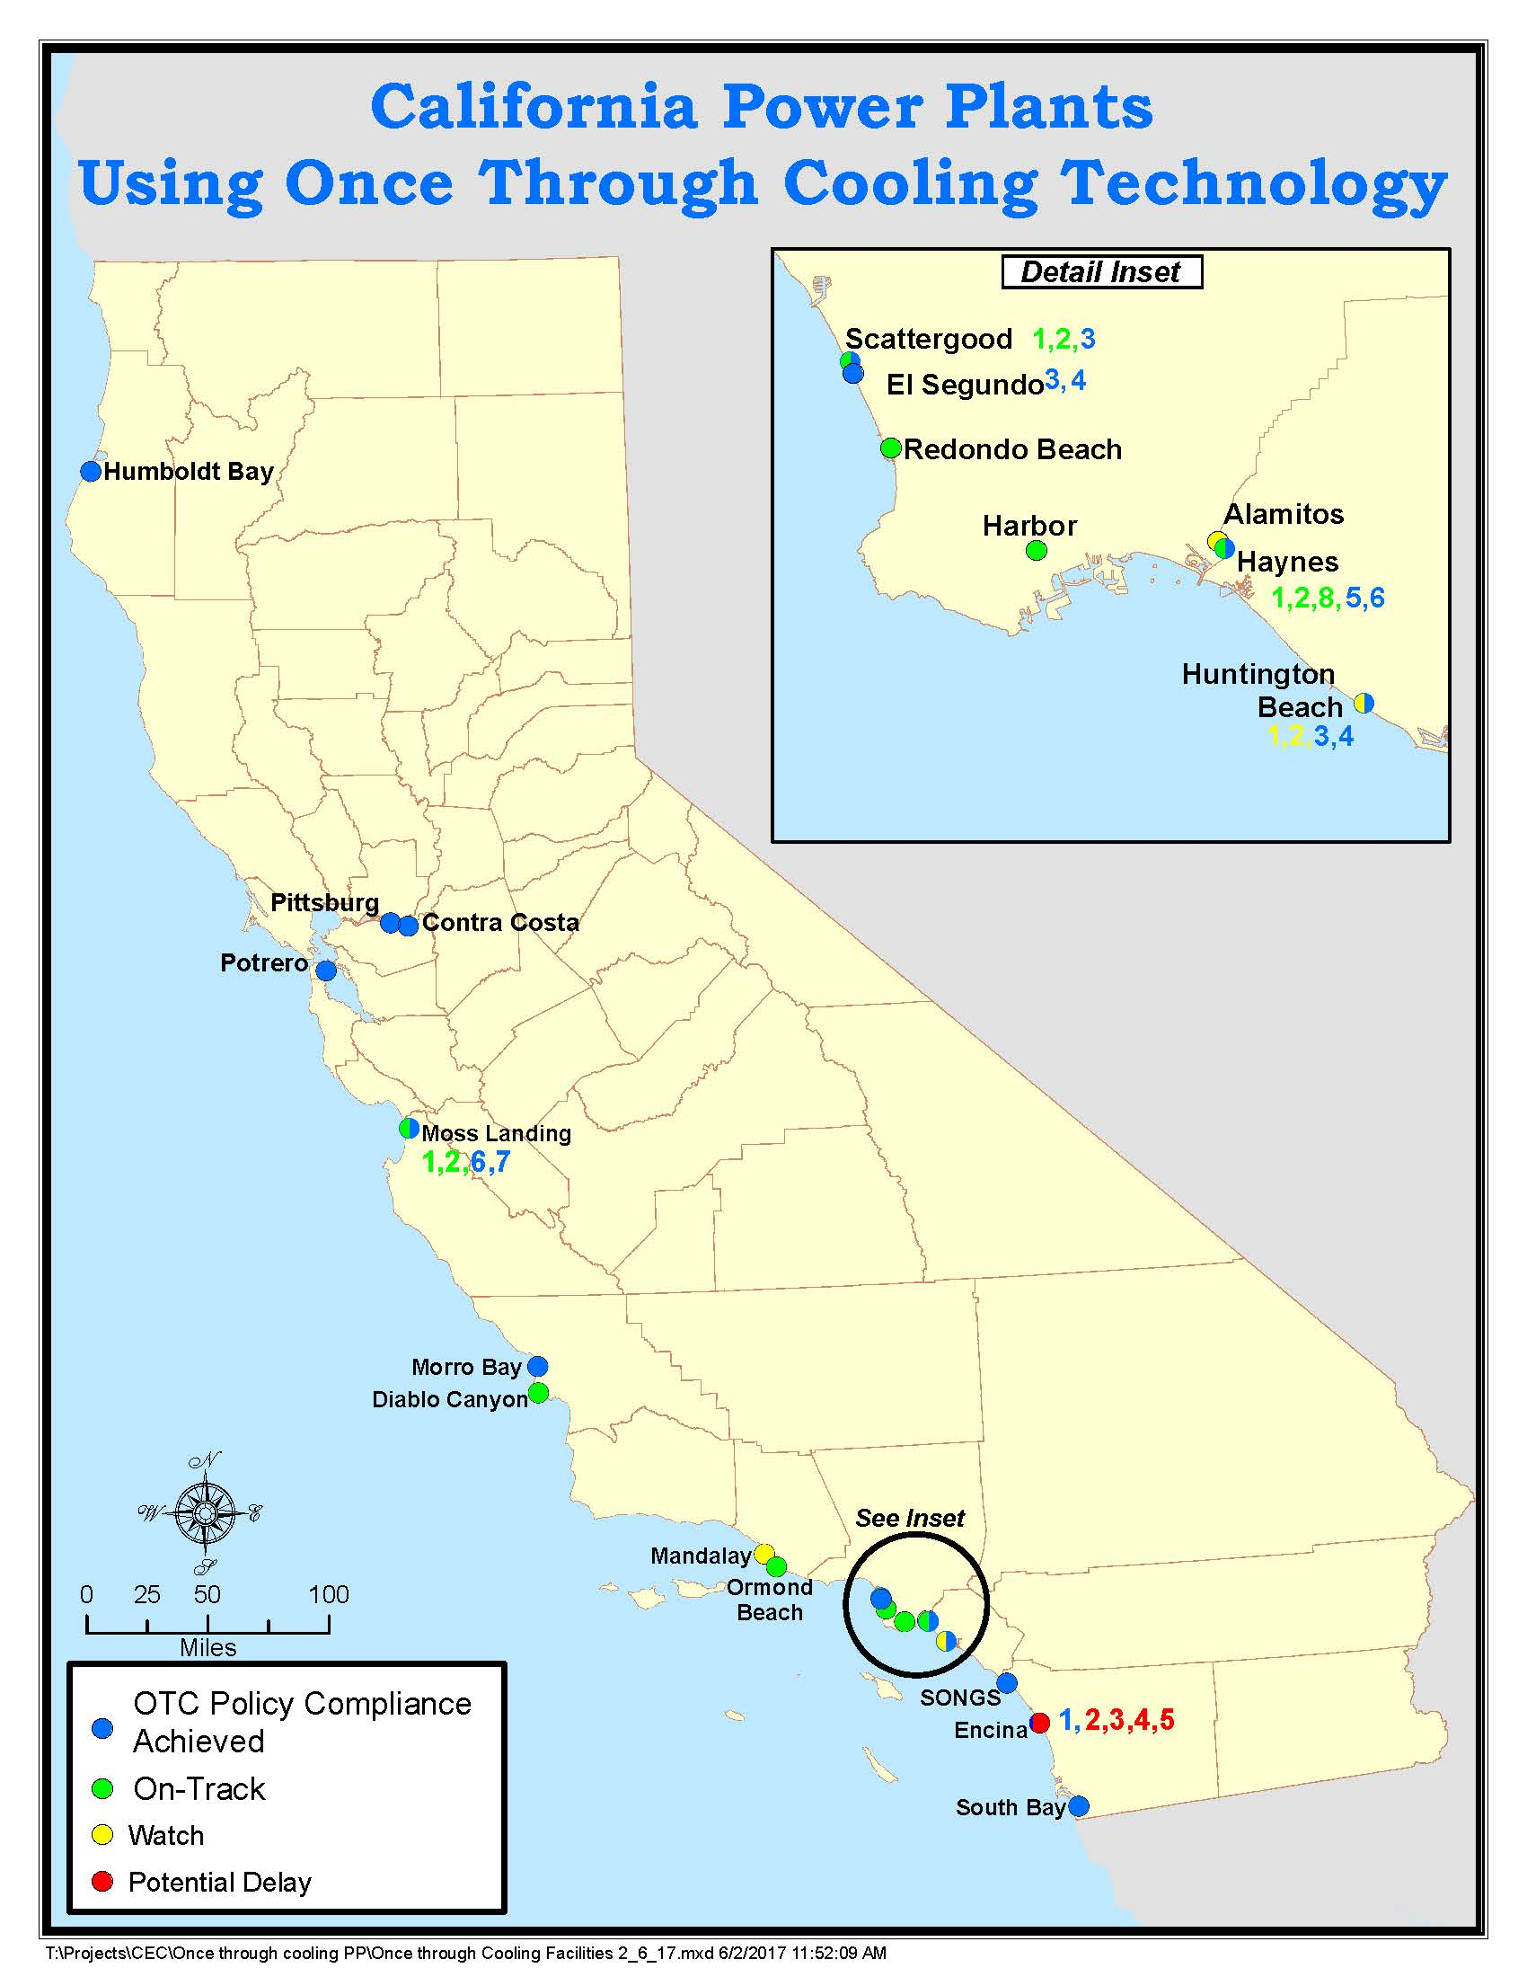
Current Status
Notes:
8 plants achieved compliance- Humboldt, Southbay, Potrero, Contra Costa, El Segundo, SONGS, Morro Bay, Pittsburg
6 plants on track– Moss Landing, Ormond Beach,, Redondo Beach, Harbor, Haynes, Scattergood
3 plants on Watch list – Huntington Beach, Alamitos, Encina/Carlsbad, Mandalay/Puente
1 plant – PG&E plans to retire Diablo at the end of its NRC license which will require an extension of unit 2

Slide 5
Once-Through Cooling Compliance Achievement During this Past Year
Facility & Units | NQC | Compliance Date | Retirement Date
Pittsburg | 1,159 | Dec. 31, 2017 | Operations ceased Dec 31, 2016
Moss Landing 6, 7 | 1,509 | Dec. 31, 2020 | Retired January 1, 2017
Encina Unit 1 | 106 | Dec. 31, 2017 | Retired March 1, 2017
Notes:
Source: Table 1 from page 2 of the 2017 SACCWIS report.

Slide 6
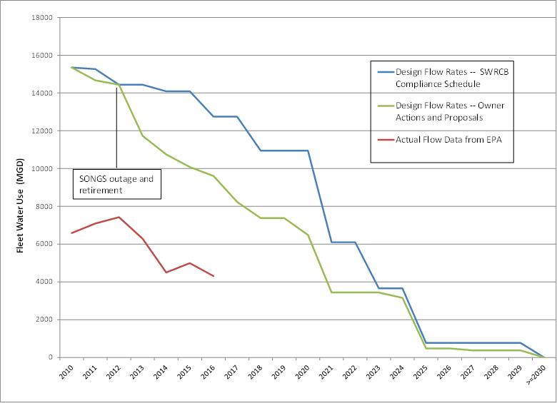
Historic and Projected Water Usage by the Combined OTC Fleet
Notes:
There is no single reason that explains the uptick in 2015 from 2014, but there are a few main contributing factors. Though hydro production is lower in 2015, total in-state gas generation for the state is not higher, except for the OTC units. Evaluating individual OTC unit operations provides some insight into the reasons for the slight increase in OTC generation and associated water usage in 2015.
2 units at Diablo Canyon were on a refueling outage in 2014 whereas only 1 unit was out in 2015. This resulted in more generation in 2015. The higher generation at Diablo explains about 25% of the increased water usage in 2015.
The OTC gas generation had slightly more generation in 2015 than 2014, just above a 1% increase. Some of the reasons for slightly higher OTC generation in 2015 could be from contracting issues, weather related increases, or renewable integration. For example, Moss Landing units 6 and 7 (older steam units) ran more in 2015 than 2014 while units 1 and 2 (newer combined cycle units) ran less in 2015 than 2014. Units 6 and 7 have a higher water usage rate than the newer combined cycle units 1 and 2. This generation pattern appears to be tied to the RA contracted capacity in 2014 and 2015.

Slide 7
Important Pending Actions
Licensing proceeding for Puente Power Project or Mission Rock (Mandalay)
Mesa Loop-In project ties 500kV transmission to load serving circuits in Western LA Basin. Potential delay of Mesa Loop-In transmission project to 2022 could result in need for temporary extension of Redondo Beach or Alamitos OTC compliance dates
Notes:
Mesa Loop-In: It is called Mesa Loop-In because 500kV transmission lines are tied into the 230 kV circuits serving all of Western LA Basin at the Mesa substation. A very short link of new 500 kV line and a major upgrade to the Mesa substation is the scope of the project. Renewable power from Tehachapi area can substitute for some local resources in West LA.

Slide 8
Across the Finish Line
Pittsburg - January 2017

Slide 9
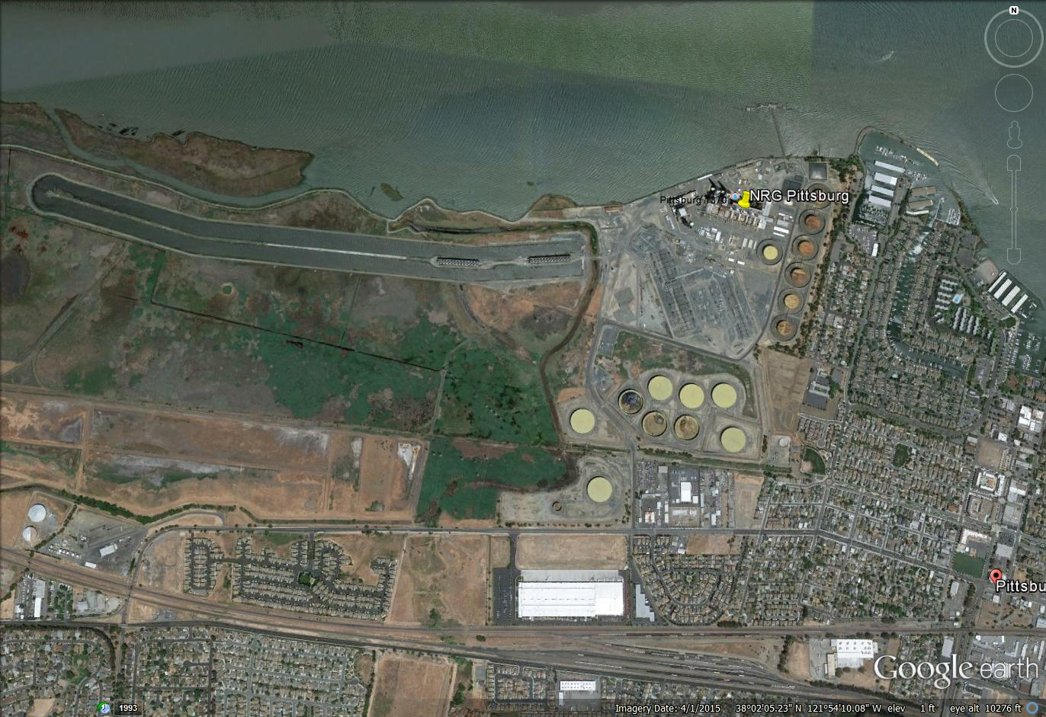
Pittsburg

Slide 10
Pittsburg (2017)
Permanently ceased once-through-cooling operation for all three units (5, 6 and 7) as of December 31, 2016
NRG placed the Pittsburg units on long term outage effective January 1, 2017 to preserve deliverability status for a potential replacement project at the same location that would not use once-through-cooling
Pittsburg Power Plant has come into compliance with its OTC schedule before its originally projected date

Slide 11
On Track
Moss Landing
Ormond Beach

Slide 12
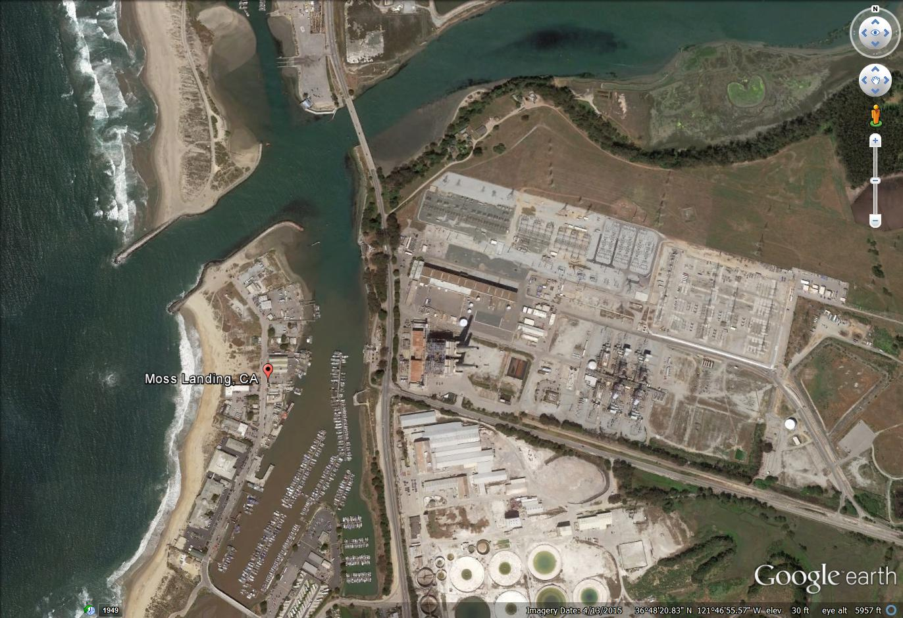
Moss Landing

Slide 13
Moss Landing (2020)
Units 6-7 are old steam boilers, 750MW each; Units 1-2 are new combined cycles, 500MW each
Units 6 & 7 retired December 31, 2016
Variable speed drive controls on Units 1-2 completed December 16, 2016
Units 1 & 2 are scheduled for Track 2 compliance by December 31, 2020
All construction is expected to occur during scheduled maintenance outages (no dual unit outages anticipated)
Maximum capacity factor for both Unit 1 and Unit 2 will be 78 percent of the allowable capacity factor before Track 2 compliance
SACCWIS does not recommend a change in compliance dates
Notes:
Speaking Note: Dynegy plans to achieve Track 2 compliance through prior flow reduction credits, use of operational controls, and installation of technology controls for Units 1 and 2.
Moss Landing units 1 and 2 are needed to meet the new South Bay-Moss Landing subarea requirement.

Slide 14
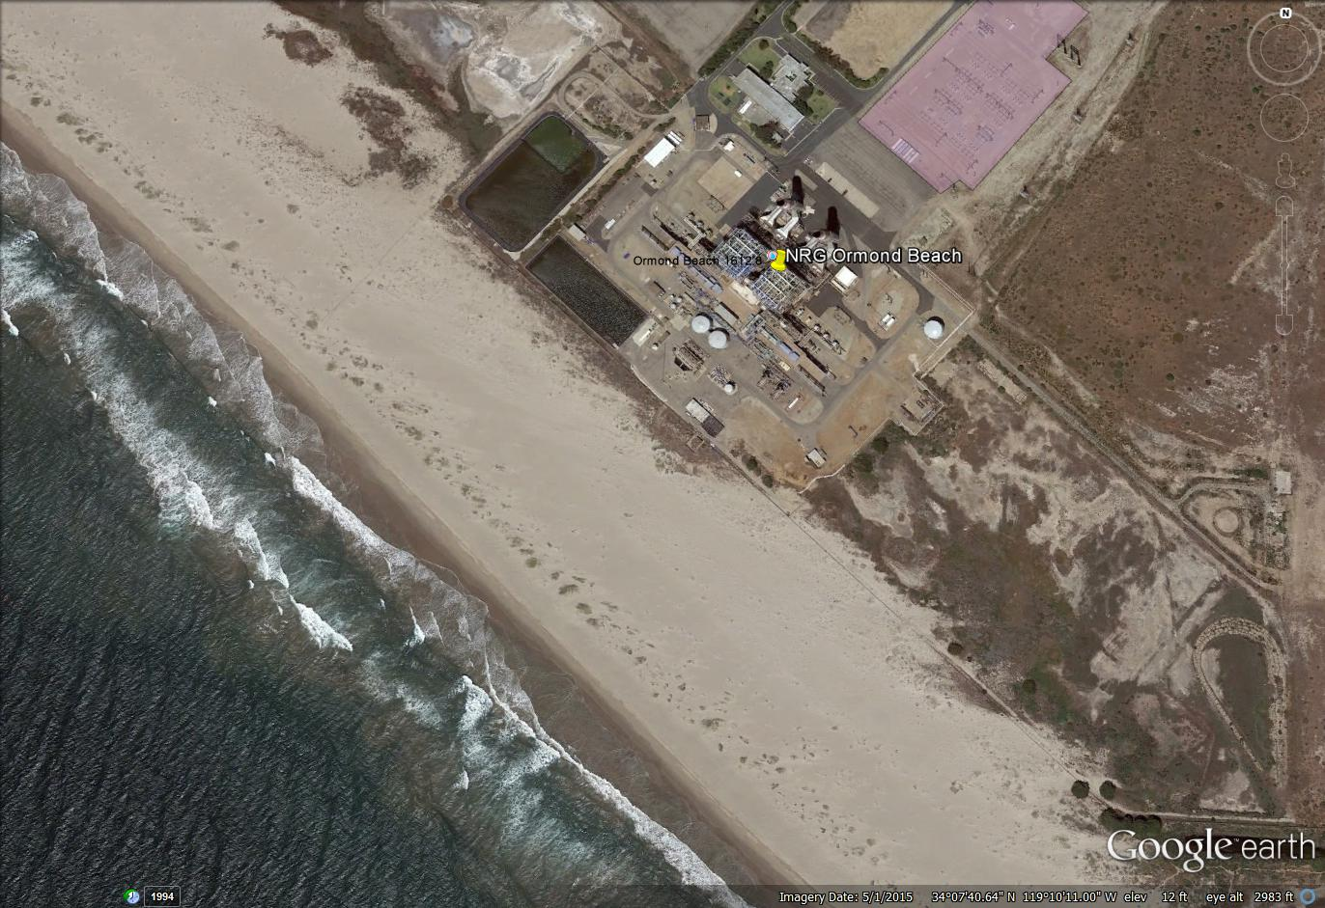
Ormond Beach

Slide 15
Ormond Beach (2020)
Two units combined capacity of 1,486 MW
CPUC authorized 215-290 MW in the area where Ormond Beach and Mandalay are located
SCE selected a 262 MW repower of Mandalay, which the CPUC has approved
January 4, 2017, NRG confirmed its intent to retire the facility by its compliance date with no further operations
SACCWIS does not recommend a change in compliance dates

Slide 16
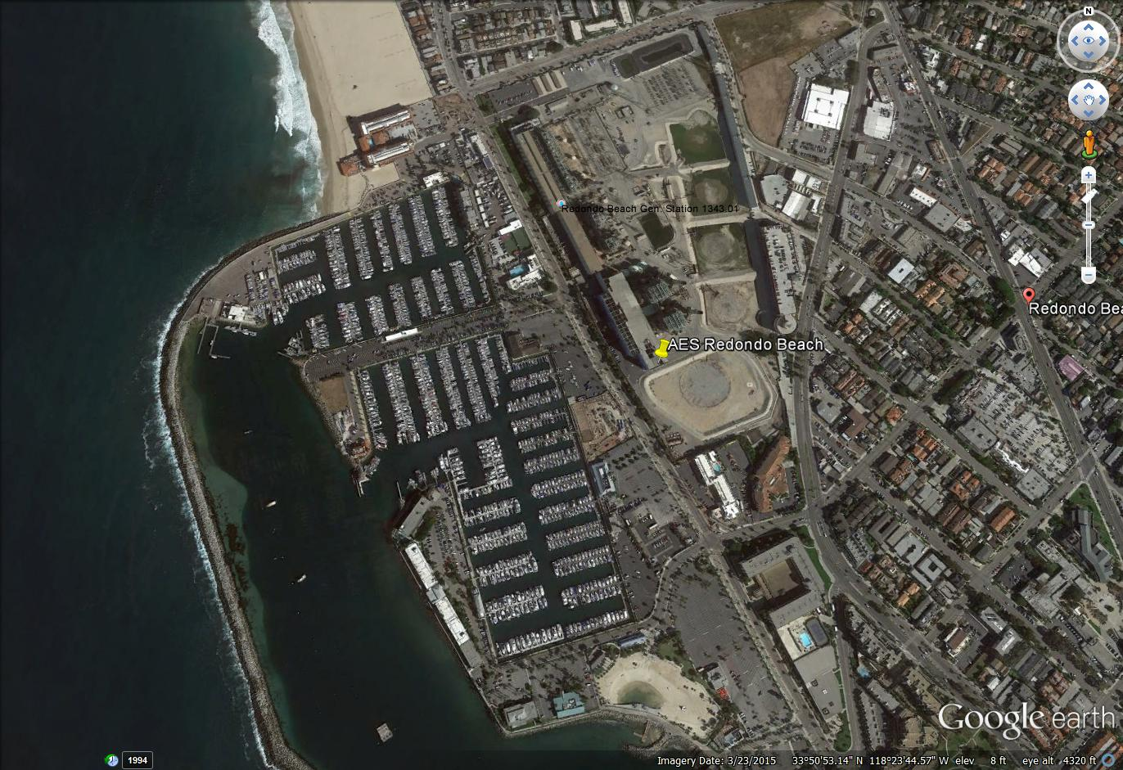
Redondo Beach

Slide 17
Redondo Beach (2020)
Consists of four units; 1,300 MW total
CEC licensing suspended November 2015
AES did not receive a Power Purchase Agreement
AES plans to use some Redondo Beach air credits to repower Huntington Beach
Unit 7 is scheduled to shut down October 31, 2019 in advance of the OTC Policy compliance date
Delay of Mesa Loop-In beyond June 2021 could result in need for temporary extension of Redondo Beach or Alamitos compliance
In the event of a potential delay, further study is needed
SACCWIS does not recommend a change in compliance dates
Notes:
Speaking Notes: RB 7 is proposed to shut down 10/31/2019 to provide air credits for Huntington Beach
AES is marketing Redondo Beach for non-industrial use.

Slide 18
Watch List
Huntington Beach
Alamitos
Mandalay/Puente
Encina/Carlsbad
Notes:
Replacement projects need to be online before these plants can retire.

Slide 19
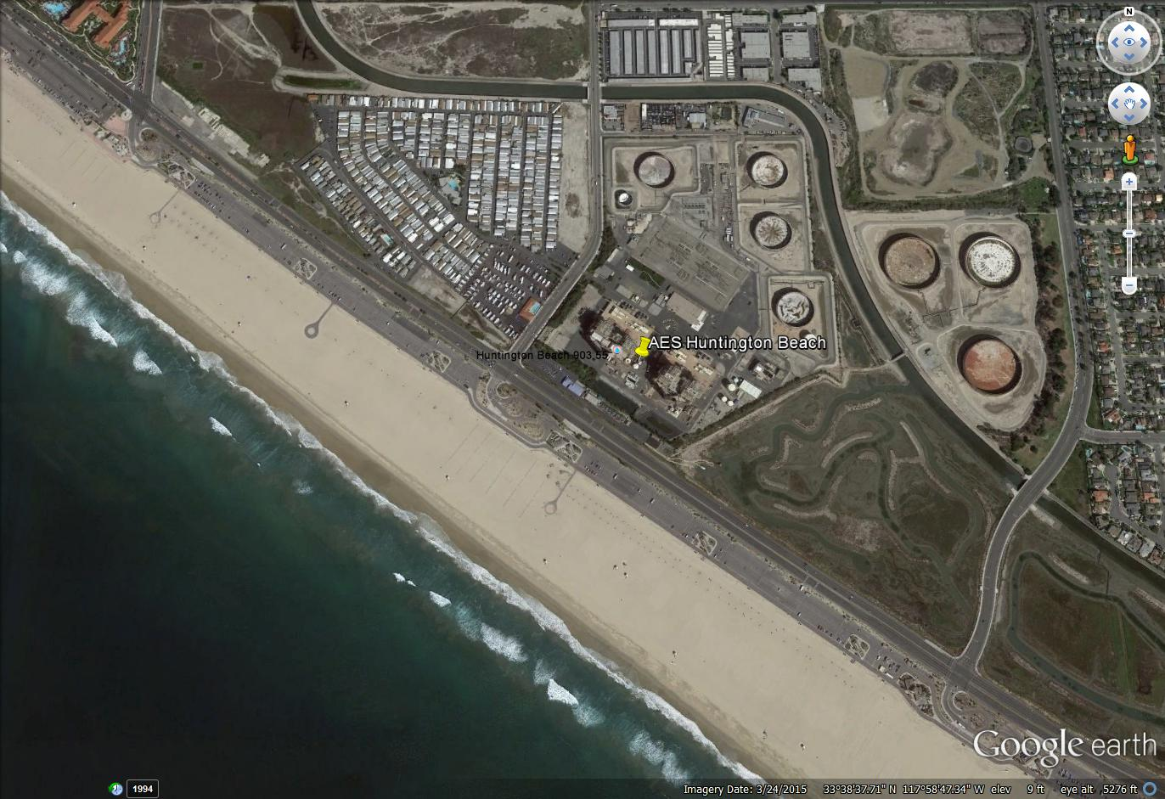
Huntington Beach

Slide 20
Huntington Beach (2020) - Watch
Units 1 and 2
Capacity of 226 MW
RA contract has been executed that would extend the operation of Huntington Beach units 1 and 2 through December 31, 2019 and December 31, 2020 respectively
Will be shut down and permanently retired at those contract end dates
CEC license (Petition to Amend) approved on April 12, 2017.
Repowering project - Awarded a PPA for 644 MW capacity with a planned commercial online date of March 2020
SACCWIS does not recommend a change in compliance dates
Notes:
Speaking Note: RB 7 is proposed to shut down 10/1/2019 to provide air credits for HB.
RA - Resource Adequacy
Units 3 & 4 retired on October 31, 2012 and converted to synchronous condensers in 2013. These will be in use until transmission upgrades are completed at Talega (2015), San Luis Rey (2017), and Imperial Valley (2017). Both are contracted through 2017 and will be retired at that time.

Slide 21
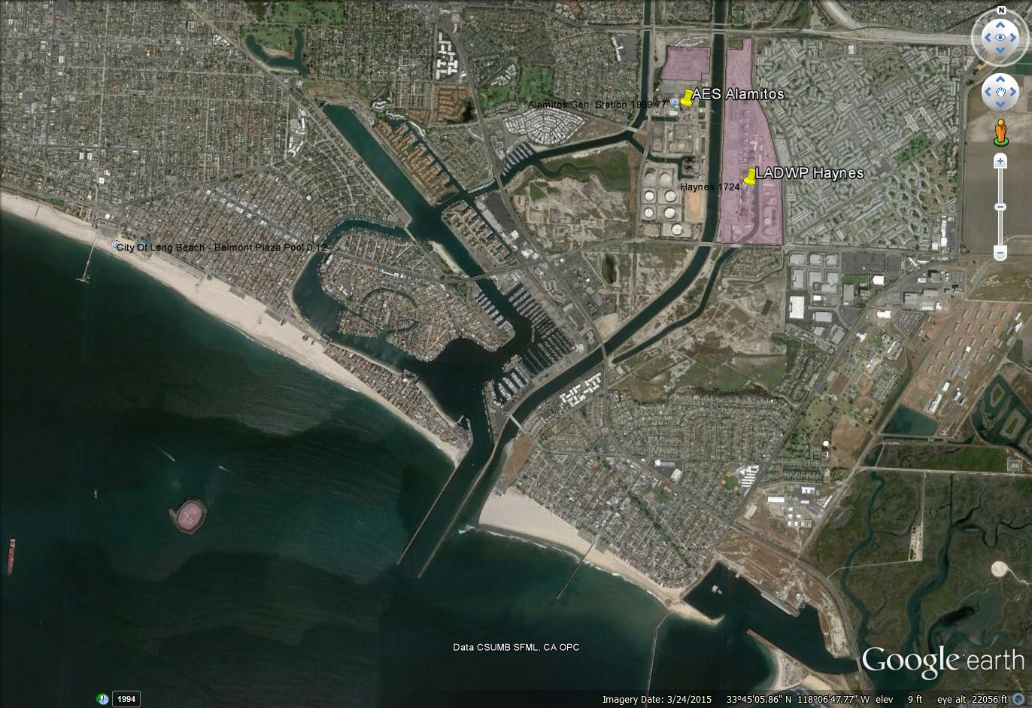
Alamitos

Slide 22
Alamitos (2020) - Watch
Existing six OTC units totaling 2,010 MW
CEC license approved April 12, 2017
November 2014 AES awarded 640 MW PPA with SCE
Units 1, 2, and 6 are contracted through December 31, 2019 and are expected to shut down earlier than the OTC compliance date to meet air pollution requirements
Units 3, 4, and 5 will likely operate through at least December 31, 2020
Delay of Mesa Loop-In beyond June 2021 could result in need for temporary extension of Redondo Beach or Alamitos compliance
In the event of a potential delay, further study is needed
SACCWIS does not recommend a change in compliance dates
Notes:
Speaking Notes: Units 1, 2 and 6 are scheduled to be retired in 2019 to qualify for emission offsets.

Slide 23
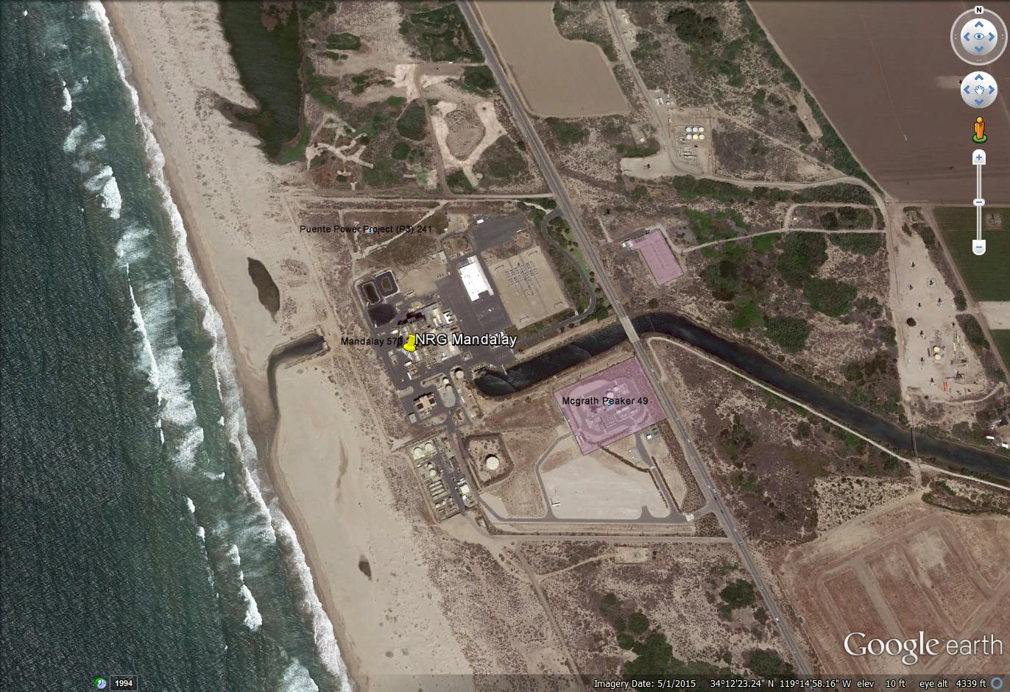
Mandalay
Notes:
A key feature of this picture is that Mandalay is at the end of long canal that brings cooling water.

Slide 24
Mandalay (2020) - Watch
Units 1 & 2 OTC; 215 MW each
NRG:
Intends to build Puente Power Project, 262 MW peaker to replace Units 1 & 2 by June 1st, 2020 in the existing Mandalay site
Submitted application with CEC in April, 2015; and application for air permits in March, 2015 – both applications under review
Confirmed in its January 4, 2017 implementation plan that it is on track to achieve commercial operation by June 2020
ISO modeling 262 MW project as well as 12.5 MW of preferred resources to replace both Mandalay and Ormond Beach generation
CEC is processing an application for certification for a competing project, Mission Rock Energy Center, which does not have a power purchase agreement
SACCWIS does not recommend a change in compliance dates
Notes:
Speaking Note:
City of Oxnard extended by one year its moratorium prohibiting power plant development within the Oxnard Coastal zone pending studies on Local Coastal Plan, zoning ordinances, and other regulations (approved at May 19, 2015 city council meeting with extension to July 2016)
Settlement with SWRCB in October 2014 determined Track 1 compliance infeasible.
NRG is on track to comply with OTC policy by December 31, 2020

Slide 25
OTC Deferral Recommended
Encina

Slide 26
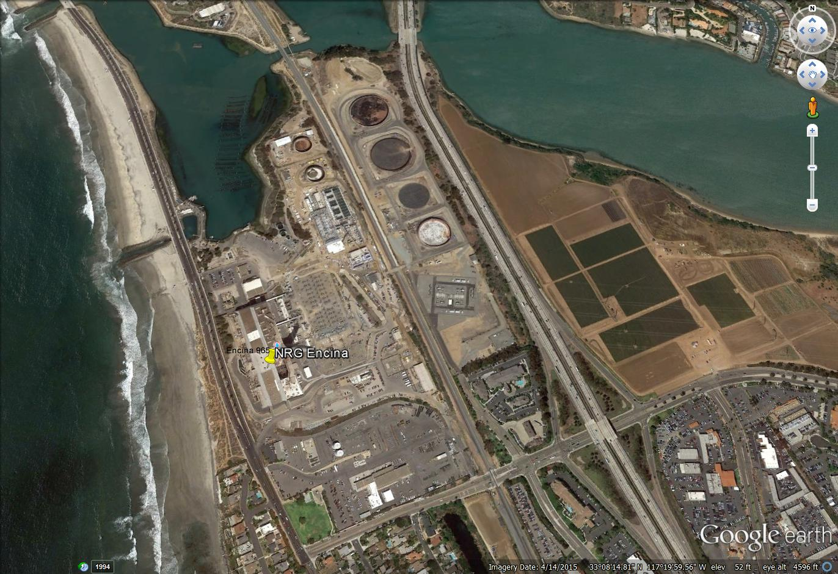
Encina

Slide 27
Encina (2017) - Delay
Five OTC units with an aggregate capacity of 950 MW
Encina Unit 1 (106 MW) retired early on March 1, 2017
Legal challenges have delayed NRG’s commercial operation date of Carlsbad Energy Center to fourth quarter of 2018
May 21, 2015, the CPUC approved 500 MW of the 600 MW originally requested - allocated remaining 100 MW to preferred or energy storage
November 2015 CEC approved 600 MW Carlsbad Energy Center Project
November 2015 appeals were filed. The First District Court of Appeal ruled on December 1, 2016 to affirm the original CPUC decision
February 23, 2017, SACCWIS adopted report recommending the SWRCB defer the OTC compliance date from Dec. 31, 2017 to Dec. 31, 2018
SACCWIS report presented to the SWRCB on March 21, 2017
SWRCB Draft staff report on Encina OTC Deferral published May 23, 2017
Public hearing and adoption planned for August 15 with OAL approval in December 2017
Notes:
Carlsbad is the replacement project for Encina.
Encina Unit 1 retired early to make way for Carlsbad construction.
SWRCB Draft staff report on Encina OTC Deferral published May 23, 2017, which starts a 45 day comment period.

Slide 28
Conclusions
No additional recommendations for compliance date changes beyond Encina
ISO, CEC, and CPUC believe IOU procurement authorizations are sufficient to maintain reliability, but will continue to monitor developments and perform additional analyses with most recent data available
In case of potential delays, staff is evaluating timelines necessary to form a contingency, which could be procuring new resources or deferring existing deadlines
Not all OTC units need to be replaced
It may be necessary to modify final compliance dates for specific generating units
Notes:
Speaking notes:
Retirement of SONGS (in 2012, 10 years ahead of compliance schedule) has accelerated aggregate reduction in ocean water intake flows so much that even several limited term compliance date deferrals of fossil OTC facilities would still mean ocean water usage reductions faster than contemplated by the compliance dates of the adopted OTC policy.
Several OTC plants have retired before their compliance dates, e.g. Moss Landing 6 & 7, Encina unit 1, Pittsburg

