Slide 1

April 20, 2016
Beyond the Drought Emergency:
The Case for Returning the Sacramento Region to Long-Term Conservation

Slide 2
Overview
Region Introduction
Conservation Drought Response
Long Term Water Efficiency Progress
2016 Water Supply Conditions
Transitioning Back to Long Term Efficiency
Proposed Region-based Framework

Slide 3
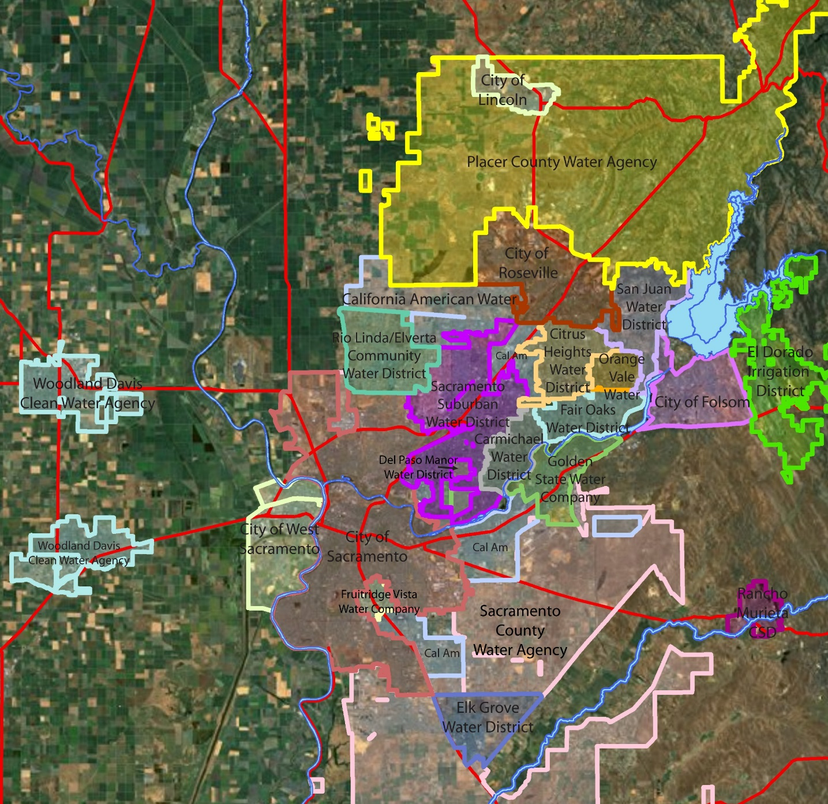

Slide 4
RWA Water Provider Members
California American Water | Elk Grove Water District
Carmichael Water District | Fair Oaks Water District
Citrus Heights Water District | Golden State Water Company
City of Folsom | Orange Vale Water Company
City of Lincoln | Placer County Water Agency
City of Roseville | Rancho Murieta CSD
City of Sacramento | Rio Linda/Elverta CWD
City of West Sacramento | Sacramento County
City of Yuba City | Sacramento Suburban Water District
Del Paso Manor Water District | San Juan Water District
El Dorado Irrigation District | Woodland Davis Clean Water Agency

Slide 5
2014/2015 Conservation
In 2015, the region saved 49 billion gallons
or enough to serve 360,000 households for a year, 18% of the region’s population.
Notes:
January 11.5%, 18% in Feb.

Slide 6
Monthly Conservation Reductions

Slide 7
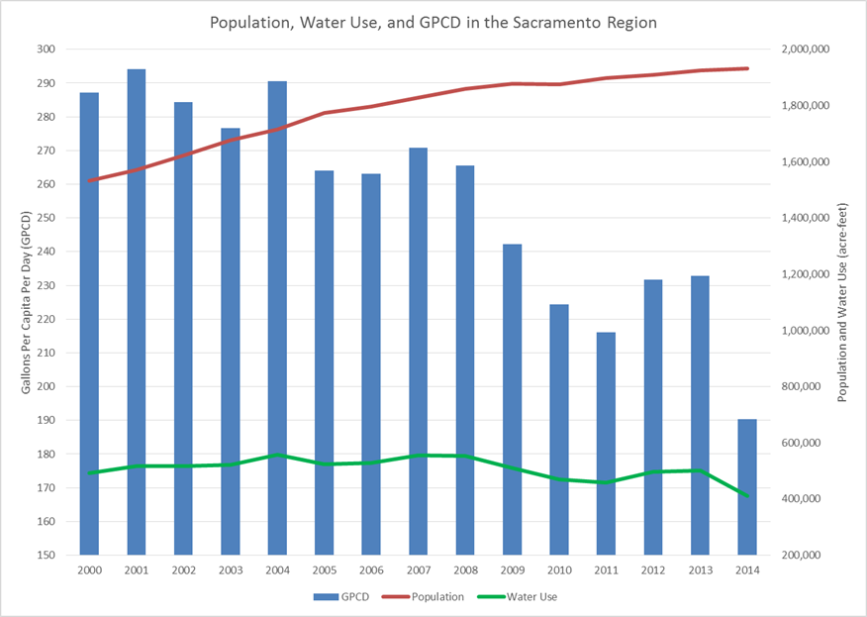
Headline Here
20% Savings in GPCD since 2000

Slide 8
Current Water Supply Conditions
Folsom is 110% of historical average storage
Central Sierra snowpack is 87% of normal
American River Basin runoff is 101% of average
8 station precipitation index is at 123% of average
Central Valley Project is providing 100% deliveries
Groundwater is recovering from drought conditions
We are not in emergency drought conditions

Slide 9
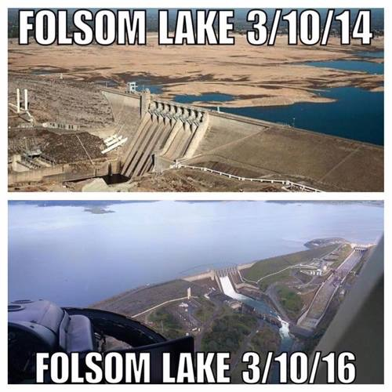

Slide 10
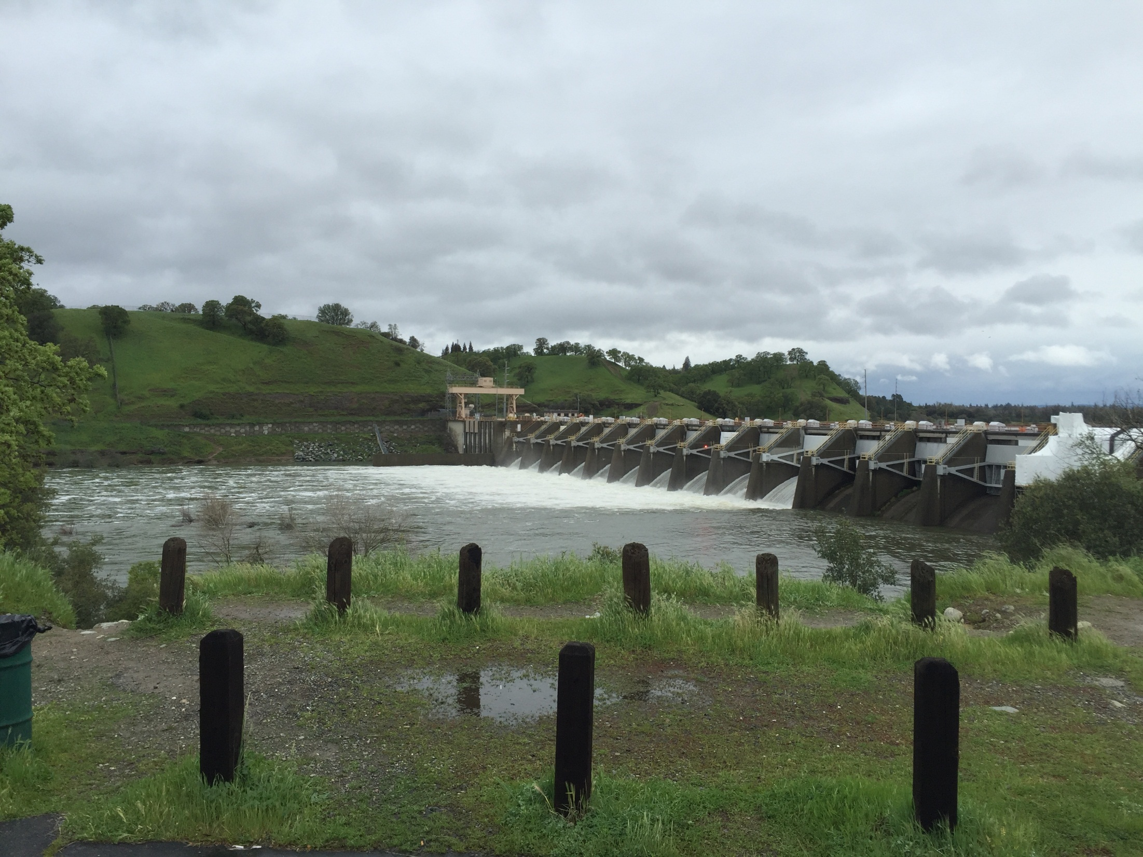

Slide 11
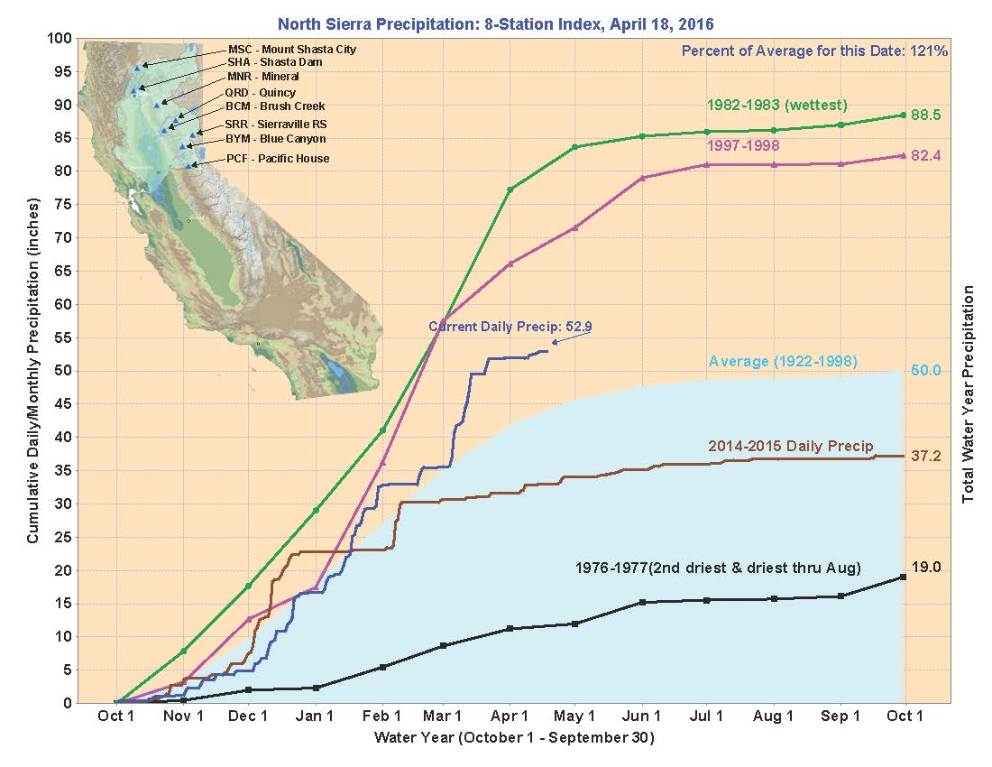

Slide 12
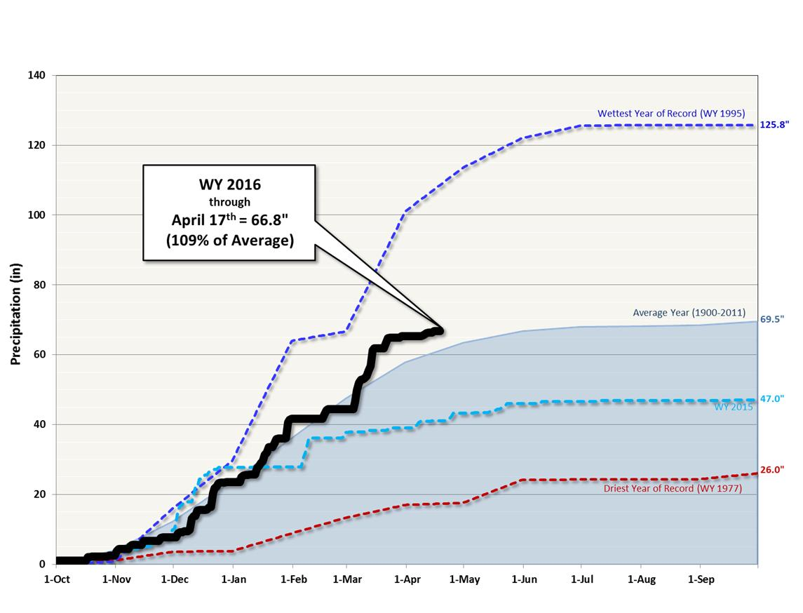
WY 2016 Cumulative Precipitation @ Lake Spaulding

Slide 13
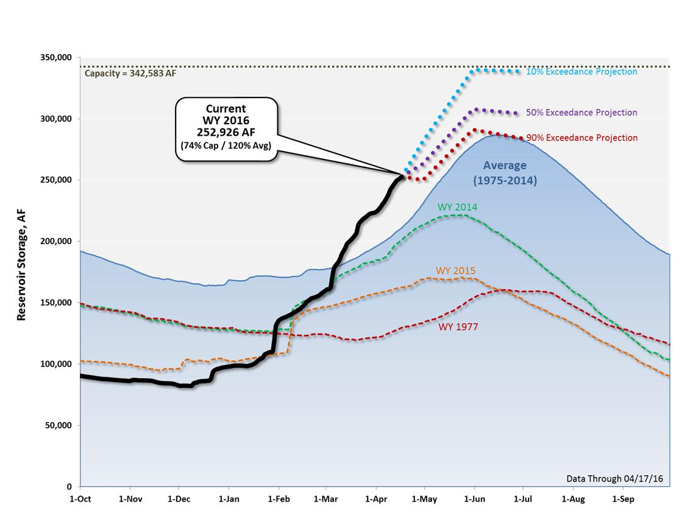
Middle Fork Project: Current Storage and Projections

Slide 14
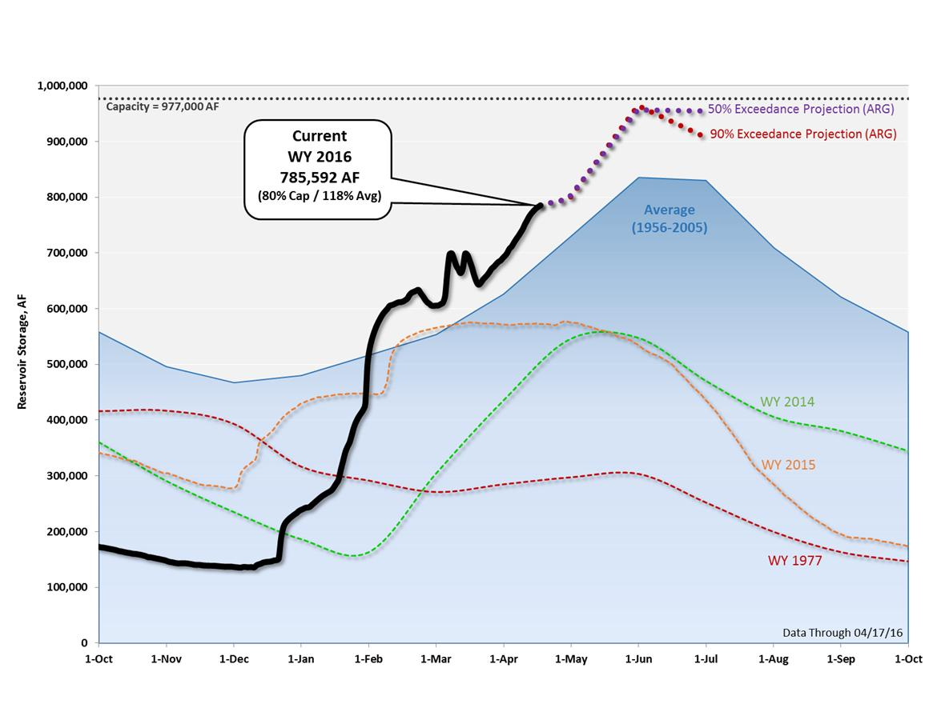
Folsom Lake: Current Storage and Projections

Slide 15
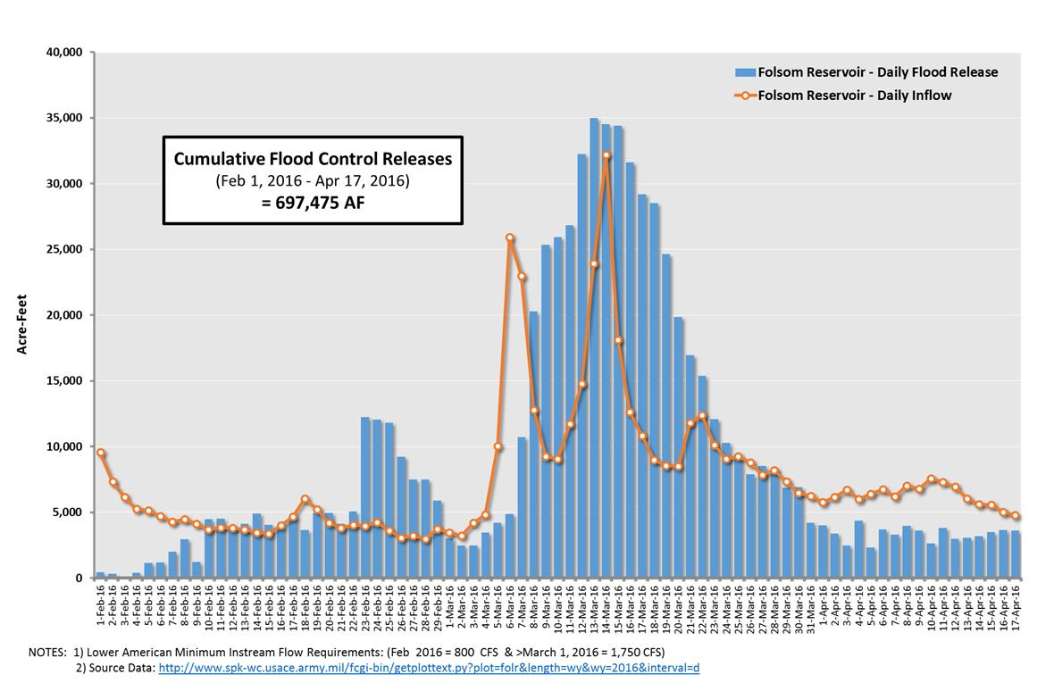
Folsom Lake: Daily Inflow and Flood Control Releases

Slide 16
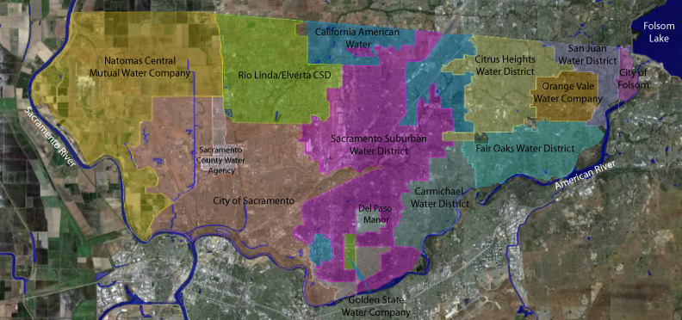

Slide 18
Transition to
Long Term Efficiency
Actions a water agency takes to respond to an emergency and long term efficiency initiatives are different
Currently in an enforcement mode
Promoting, analyzing and enhancing programs

Slide 19
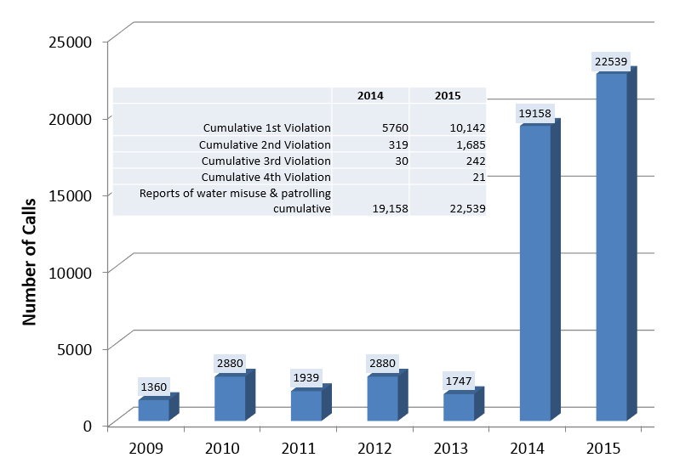
Water Misuse Complaints & NOV’s

Slide 20
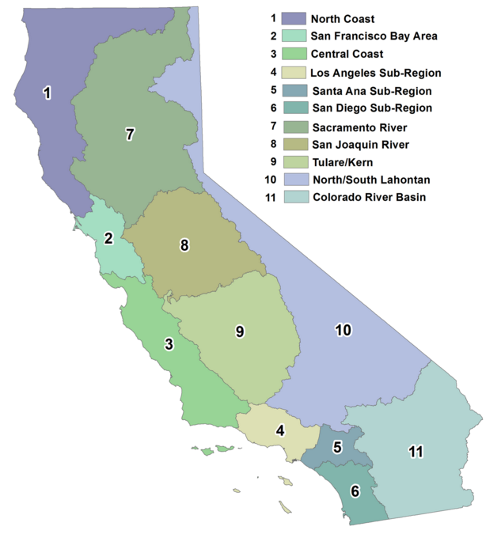
Region-based Framework
Hydrologic Regions
Use Existing Data
  Bulletin 120
Rescind Emergency Regulation for regions with recovering water supplies

Slide 21
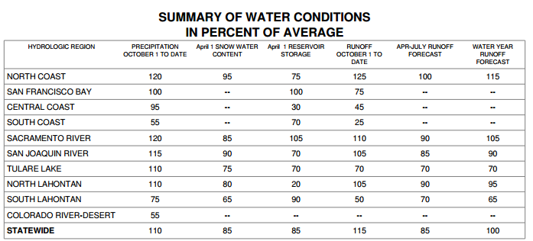
April 1st Bulletin 120

