Slide 1
East San Gabriel valley watershed Group Watershed Management Program (WMP) Development Cities of claremont, La Verne, pomona, and san dimas

Slide 2
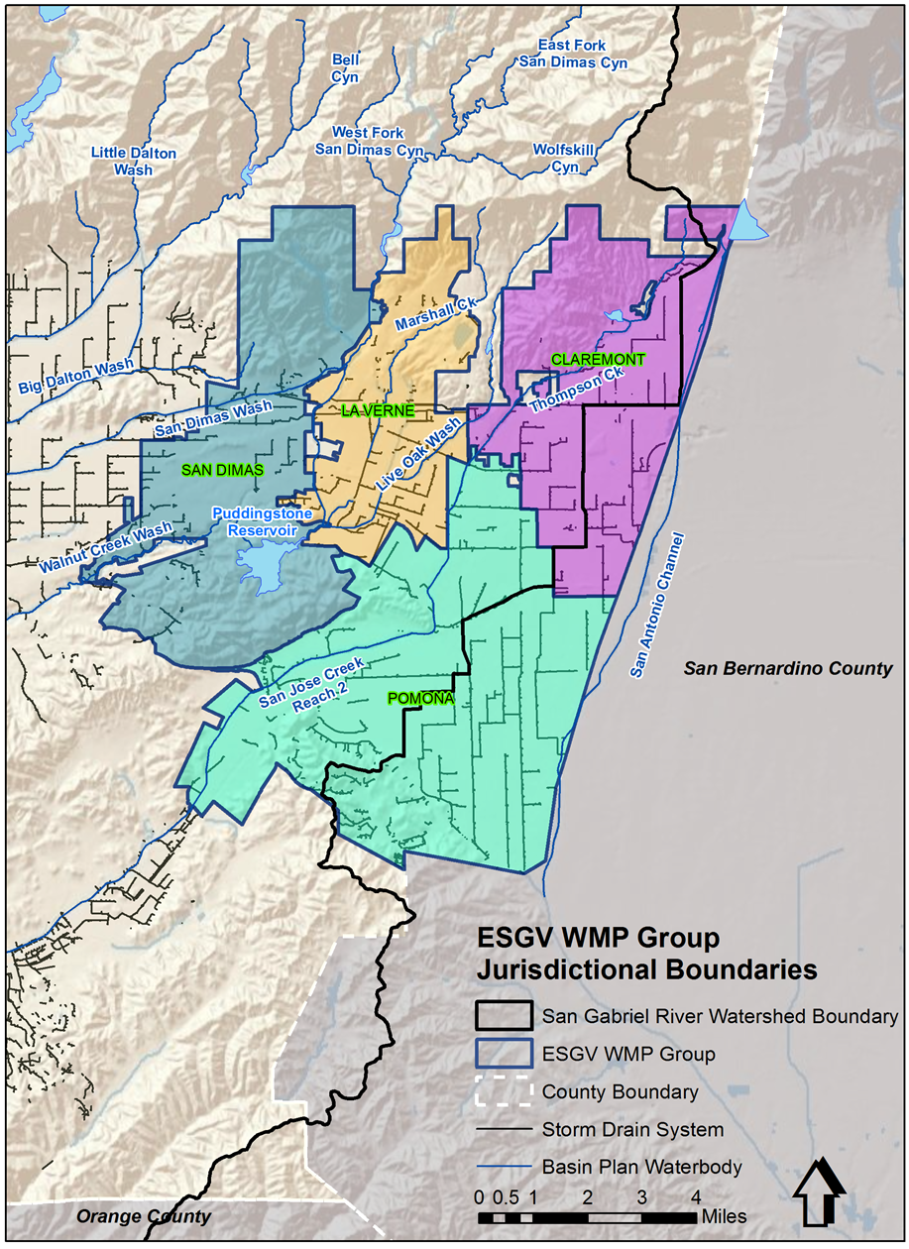
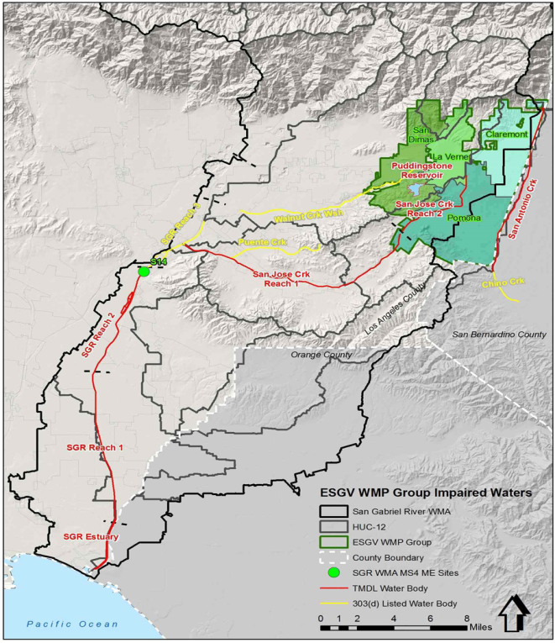
East san Gabriel Valley wmp
Principal Receiving Waters:
Walnut Creek Wash
San Dimas Wash
San Jose Creek
San Gabriel River
San Gabriel Estuary
Notes:
Group Members
Area (square miles)
Claremont - 13.0
La Verne - 6.3
Pomona - 21.9
San Dimas - 14.3
Total = 55.5
A portion of the Angeles National Forest and other open spaces overlap the Group Member jurisdictions, not all areas in each jurisdiction are serviced by the MS4 system. For purposes of the CIMP, the areas of or similar to the national forest are excluded from consideration.

Slide 3
Water Quality Priorities
Water Body | Category 1 | Category 2 | Category 3
Walnut Creek Wash | Lead (wet weather) | Indicator Organisms, Benthic-Macroinvertebrates, pH | Selenium
San Gabriel River Reach 2 | Lead (wet weather) | Indicator Organisms, Cyanide | Cyanide, Selenium, Copper, Lead, Zinc, Mercury, Sulfate, Chloride, Total Dissolved Solids (TDS), Polycyclic Aromatic Hydrocarbons (PAH)
San Gabriel River Reach 3 | Lead (wet weather) | Indicator Organisms | Copper, PAH, Dissolved Oxygen (DO), Cyanide
San Jose Creek Reach 1 | Selenium (dry weather), Lead (wet weather) | Indicator Organisms, pH, Toxicity, Ammonia, TDS | PAH, DO, Cyanide, Lead, Zinc, Lindane
San Jose Creek Reach 2 | Selenium (dry weather), Lead (wet weather) | Indicator Organisms | PAH, DO, Copper
Inflow to Puddingstone Reservoir | Total Nitrogen, Total Phosphorus, Total Mercury, PCB*, Chlordane*, Dieldrin*, DDT* |  | Copper, Lead, Zinc, Mercury
San Gabriel River Reach 1 | Copper (dry weather) | Indicator Organisms, pH | DO, Selenium
San Gabriel Estuary | Copper (dry weather) | DO, Dioxin, Nickel | DO, Selenium, Silver, Lindane
Santa Ana River | Fecal Coliform and E. coli (wet and dry weather)
Notes:
No need to go through one by one. Maybe just important to hit the “typical MS4 constituents in the LA region: metals, bacteria, legacy pollutants (PCB, OC pesticides), and nutrients”

Slide 4
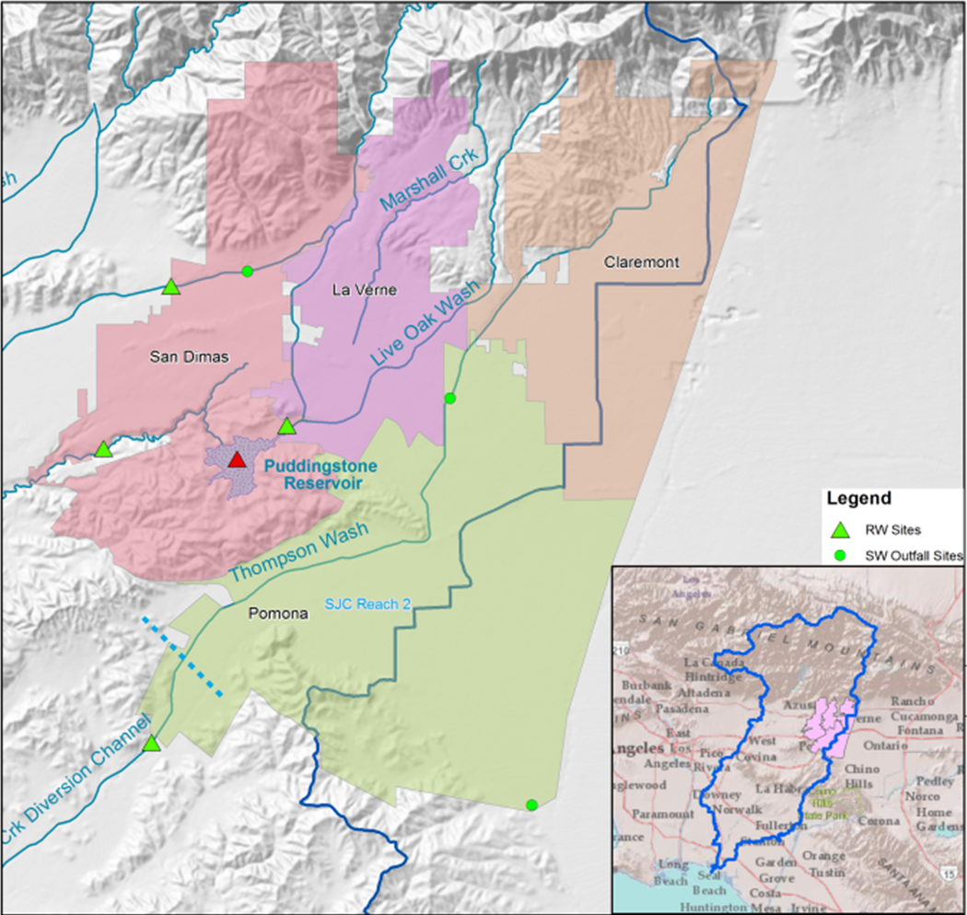
Monitoring Sites
4 Receiving Water Sites
3 Stormwater Outfalls Sites

Slide 5
REASONABLE Assurance Analysis
Watershed Management Modeling System
Design storm used as critical condition
BMPs to retain design storm identified for each subwatershed in WMP area
Green streets
LID on public parcels
Residential runoff program (downspout disconnects)
LID due to new/redevelopment
Regional BMPs (to address remaining capacity)

Slide 6
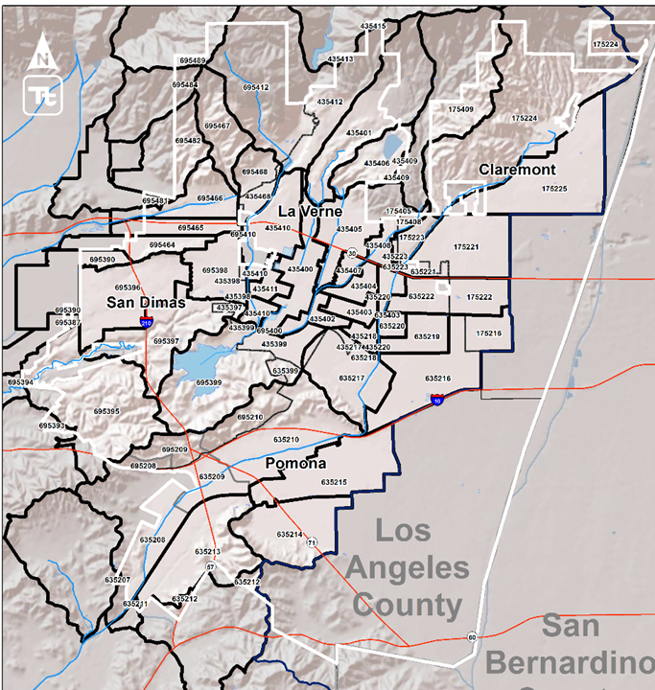
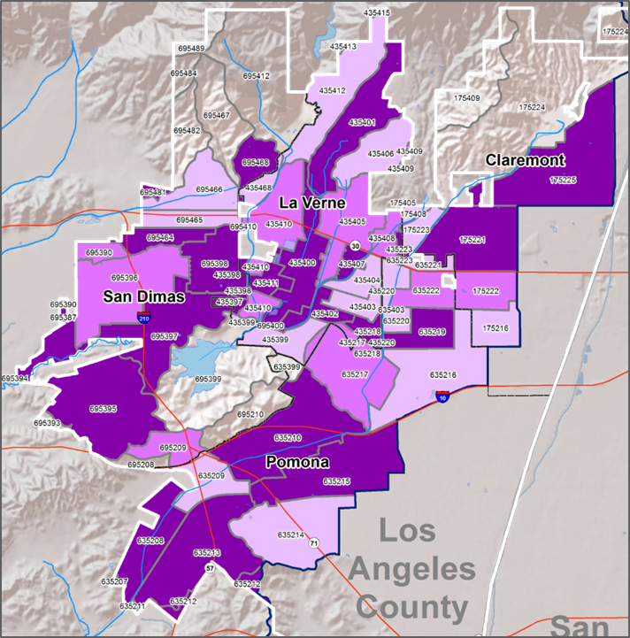
Sequencing
Subwatershed Index
Milestones
Notes:
Dark purple : 35% interim milestone in 2020
Medium purple: 65% interim milestone in 2023
Light purple: 100 % interim milestone in 2026

Slide 7
Selected Watershed Control measures
Permittee | Number of Existing and Planned BMPs within Permit Term
Claremont | 13
La Verne | 12
Pomona | 16
San Dimas | 26
Notes:
Projects include:
Underground retention/detention systems, biofilters/vegetated swales, infiltration basins, bioretention
University of La Verne, Harvey Mudd College, Pomona Valley Hospital, Oak Grove Walk, Foothill Blvd

Slide 8
Selected Watershed Control measures
Non-Structural BMPs consist of:
Rooftop Runoff Reduction Program
LID for New/Redevelopment
Enhanced Construction Site Inspections
Verification of Post Construction BMPs
Enhanced Catch Basin Cleaning
Source Control
Dependent on Dry-Weather Monitoring (ongoing)
Notes:
The Rooftop Runoff Reduction Program (Program), which will seek to incentivize control measures on private property to capture rooftop runoff prior to discharge to the MS4. The Program will emphasize deployment of rain barrels, disconnection of downspouts that are directly plumbed into the MS4 collection system and, if necessary, consideration of other BMPs to address stormwater runoff at the source. While the program will provide an I
For Examples: The City of San Dimas is proposing to consider a uniform inspection approach. Inspection of construction sites one (1) acre or greater would occur bi-weekly during the wet weather season and monthly during the dry weather season. Structural BMPs (distributed & regional, retrofits).
mportant vehicle for educating the public on the need to retain stormwater runoff, the program will also be designed such that volume reductions are quantifiable and trackable.

Slide 9
Status of LID Ordinance and Green Streets Policy
All 4 Cities have LID Ordinances & Green Streets Policy in place.
Notes:
For Examples: The City of San Dimas is proposing to consider a uniform inspection approach. Inspection of construction sites one (1) acre or greater would occur bi-weekly during the wet weather season and monthly during the dry weather season. Structural BMPs (distributed & regional, retrofits).
Additional customization will be considered during WMP implementation and updates will be made during Adaptive Management process.

Slide 10
Adaptive Management
As information is gathered, WMP will undergo modifications allowing the WMP to become more effective by assessing:
Progress Towards Achieving Water Quality Limits
Monitoring Data
Achievement of Interim Milestones
Re-evaluate Water Quality Strategies

Slide 11
Outreach and Stakeholder Input
Participation in working groups.
Informational flyer was created for distribution and posting at public facilities to solicit community input.
Presentations at City Council meetings that are televised to distribute information regarding Permit compliance to stakeholders.
Video presentation has been developed for city websites to solicit input and support from the community.

Slide 12
CLOSING
BMPs identified represent a monumental challenge in stormwater management by the ESGV Group.
The projected levels of expenditure will require a of 20 fold increase in annual stormwater management budgets.
Additional funding sources will be needed.
Communities will need to support funding measures for stormwater capital improvements.

