Slide 1
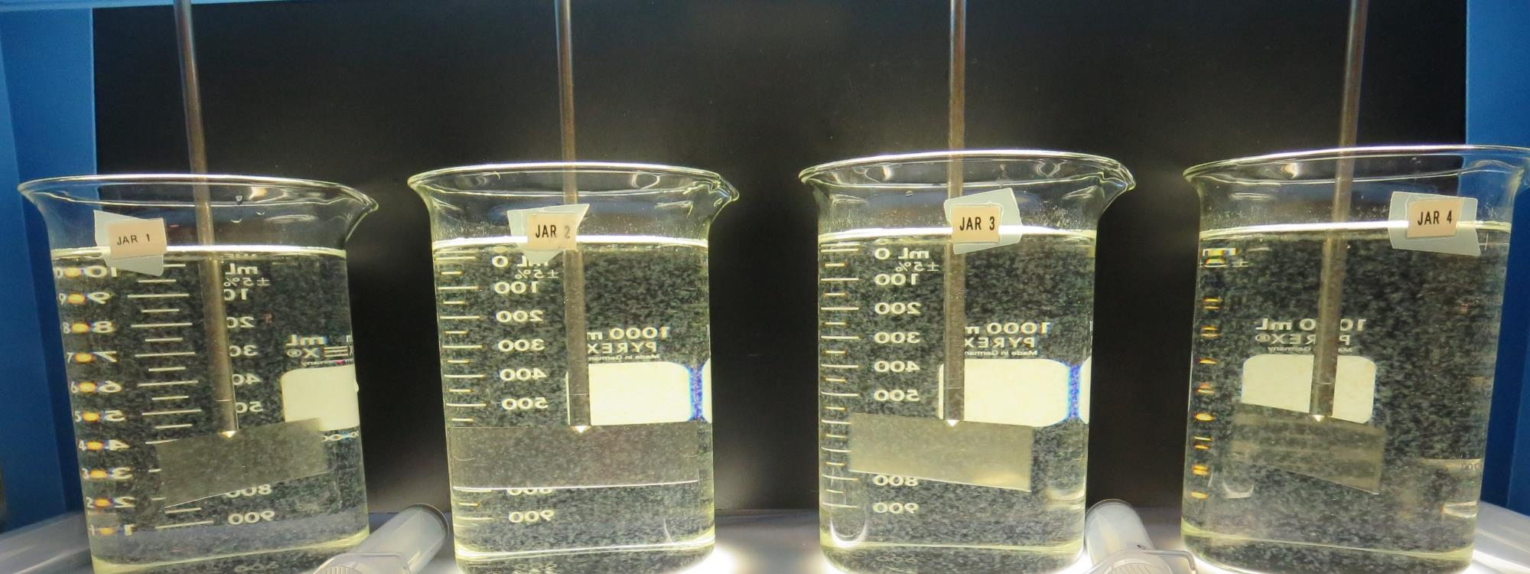
Howell Mountain Mutual Water Company CA2810001 Napa County Jar Test
by Guy Schott, P.E.
September 28, 2019

Slide 2
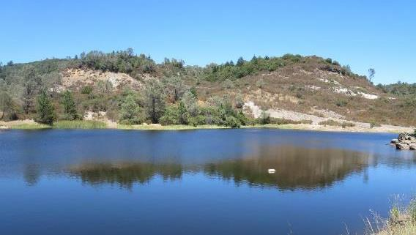
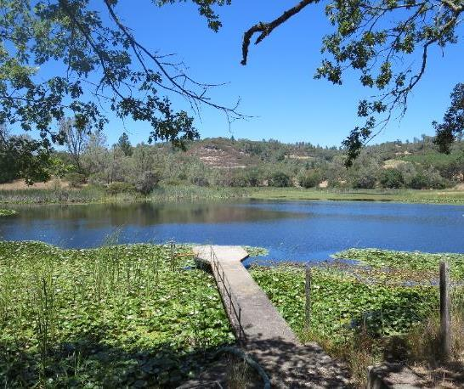
Source Waters (blend): Lake Henne/Lake Newton
Source Water Characteristics
September 28, 2019
Turbidity: 1.16 NTU
pH: 7.39
UVT: 73.7%, UVA: 0.133/cm
0.4 um Filtered
UVT: 74.8%, UVA: 0.126/cm

Slide 3
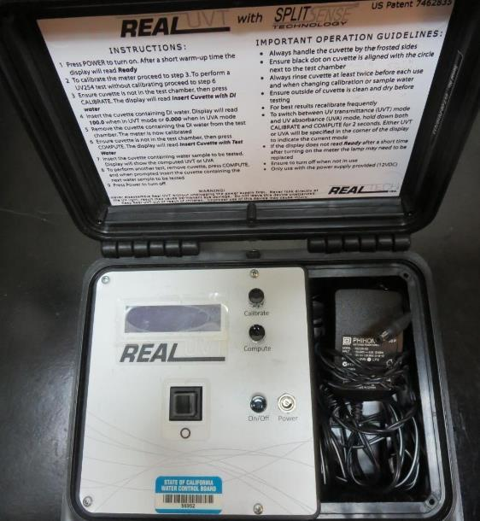
UVT/UVA
UV transmittance (UVT) is a measurement of the amount of ultraviolet light (commonly at 254 nm due to its germicidal effect) that passes through a water sample compared to the amount of light that passes through a pure water sample. The measurement is expressed as a percentage, % UVT.
%UVT = 10^{(-UVA)} x 100%
UV absorbance (UVA) is calculated as a relative measure of the amount of light absorbed by a water sample compared with the amount of light absorbed by a pure water sample.
UVA = -log(%UVT/100)

Slide 4
Applied Coagulants for Jar Testing
Pro Pac 917 (NTU Technologies, Inc.)
10% Trade Secret
40-50% Aluminum Chlorohydrate (ACH)
40-50% Water
SG = 1.25-1.34

Slide 5
Coagulant Used for Jar Testing
917 (NTU Technologies, Inc)
40-50% Aluminum Chlorohydrate
40-50% Water
10% Trade Secret
SG = 1.34
7066 (Garratt Callahan)
10 – 30% Poly Aluminum Hydroxychloride Sulfate
50% Basicity
SG = 1.2
AH-710 (Garratt Callahan)
1-50% 1,2-Ehaanediammine, polymer w/(chloromethyl) and Methylmethanamine (Epichlorohydrin Dimethylamine Copolymer)
SG = 1.31

Slide 6
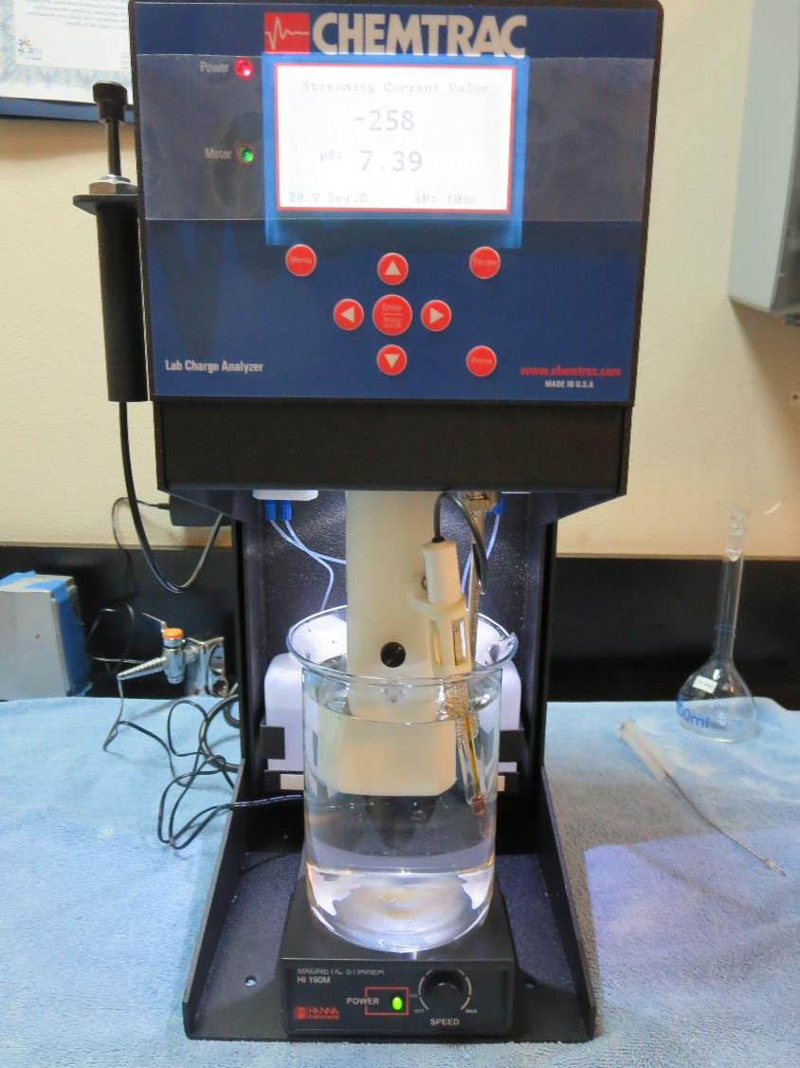
Laboratory Charge Analyzer
LCA: Used to determine coagulant demand of a source water entering the treatment plant.
Source pH: 7.39
LCA #1:
917: 18.8 mg/L as product (no pH adjustment)
Final pH: 7.20
LCA #2:
7076: 98 mg/L as product (no pH adjustment)
Final pH: 6.57
LCA #3:
AH-710: 17 mg/L as product (no pH adjustment)
Final pH: 7.26

Slide 7
Howell Mountain MWC: Jar Test 1-8 Results
Jar # | 200 RPM Flash Mix seconds | RPM Floc Duration 5 min | 917 mg/L | Filtrate NTU | Filtrate %UVT | Filtrate UVA/cm | Settle NTU 25 min | Al Added mg/L
J1 | 60 | 30 | 17 | 0.09 | 87.4 | 0.058 | 0.45 | 1.95
J2 | 60 | 30 | 19 | 0.08 | 87.9 | 0.056 | 0.33 | 2.18
J3 | 60 | 30 | 21 | 0.08 | 88.5 | 0.053 | 0.31 | 2.41
J4 | 60 | 30 | 23 | 0.08 | 89.2 | 0.050 | 0.35 | 2.64
J5 | 60 | 10 | 17 | 0.09 | 86.7 | 0.062 | 0.52 | 1.95
J6 | 60 | 10 | 19 | 0.09 | 86.9 | 0.061 | 0.52 | 2.18
J7 | 60 | 10 | 21 | 0.08 | 87.8 | 0.057 | 0.57 | 2.41
J8 | 60 | 10 | 23 | 0.08 | 88.2 | 0.055 | 0.42 | 2.64

Slide 8
Howell Mountain MWC: Jar Test 9-16 Results
Jar # | 200 RPM Flash Mix seconds | RPM Floc Duration 5 min | 7066 mg/L | Filtrate NTU | Filtrate %UVT | Filtrate UVA/cm | Settle NTU 25 min | Al Added mg/L
J9 | 60 | 30 | 64 | 0.07 | 88.3 | 0.054 | 0.20 | 3.2
J10 | 60 | 30 | 68 | 0.06 | 88.7 | 0.052 | 0.17 | 3.4
J11 | 60 | 30 | 72 | 0.06 | 88.6 | 0.053 | 0.30 | 3.6
J12 | 60 | 30 | 76 | 0.06 | 89.0 | 0.051 | 0.22 | 3.8
J13 | 60 | 10 | 64 | 0.07 | 87.9 | 0.056 | 0.20 | 3.2
J14 | 60 | 10 | 68 | 0.06 | 88.4 | 0.054 | 0.22 | 3.4
J15 | 60 | 10 | 72 | 0.05 | 88.7 | 0.052 | 0.33 | 3.6
J16 | 60 | 10 | 76 | 0.05 | 89.0 | 0.051 | 0.28 | 3.8

Slide 9
Howell Mountain MWC: Jar Test 17-20 Results
Jar # | 200 RPM Flash Mix seconds | RPM Floc Duration 5 min | AH-710 mg/L | Filtrate NTU | Filtrate %UVT | Filtrate UVA/cm | Settle NTU 25 min | Al Added mg/L
J17 | 60 | 30 | 15 | 0.09 | 86.4 | 0.063 | 0.43 | 1.65
J18 | 60 | 30 | 17 | 0.07 | 86.9 | 0.061 | 0.40 | 1.87
J19 | 60 | 30 | 19 | 0.07 | 87.3 | 0.059 | 0.38 | 2.09
J20 | 60 | 30 | 21 | 0.08 | 88.0 | 0.056 | 0.30 | 2.31

Slide 10
Howell Mountain MWC: Jar Test 21-28 Results
Jar # | 200 RPM Flash Mix seconds | RPM Floc Duration 5 min | 917 mg/L | Filtrate NTU | Filtrate %UVT | Filtrate UVA/cm | Settle NTU 25 min | Al Added mg/L
J21 | 60 | 5 | 24 | 0.07 | 89.8 | 0.047 | 0.28 | 2.76
J22 | 60 | 10 | 24 | 0.07 | 89.7 | 0.047 | 0.22 | 2.76
J23 | 60 | 15 | 24 | 0.07 | 89.6 | 0.048 | 0.22 | 2.76
J24 | 60 | 20 | 24 | 0.07 | 89.8 | 0.047 | 0.21 | 2.76
J25 | 60 | 5 | 26 | 0.07 | 89.6 | 0.048 | 0.33 | 2.99
J26 | 60 | 5 | 28 | 0.08 | 89.7 | 0.047 | 0.50 | 3.22
J27 | 60 | 5 | 30 | 0.08 | 89.9 | 0.046 | 0.78 | 3.45
J28 | 60 | 5 | 32 | 0.07 | 90.3 | 0.044 | 0.98 | 3.68

Slide 11
Howell Mountain MWC: Jar Test 29-32 Results
Jar # | 200 RPM Flash Mix seconds | RPM Floc Duration 5 min | 7066 mg/L | Filtrate NTU | Filtrate %UVT | Filtrate UVA/cm | Settle NTU 25 min | Al Added mg/L
J29 | 60 | 30 | 76 | 0.06 | 89.3 | 0.049 | 0.17 | 3.8
J30 | 60 | 30 | 80 | 0.06 | 89.6 | 0.048 | 0.17 | 4.0
J31 | 60 | 30 | 84 | 0.06 | 89.8 | 0.047 | 0.28 | 4.2
J32 | 60 | 30 | 88 | 0.06 | 90.1 | 0.045 | 0.31 | 4.4

Slide 12
Jars 1-4 Test Flash Mix 60 Sec (200 RPM) Floc Mix 5 min (30 RPM) Applied Coagulant 917

Slide 13
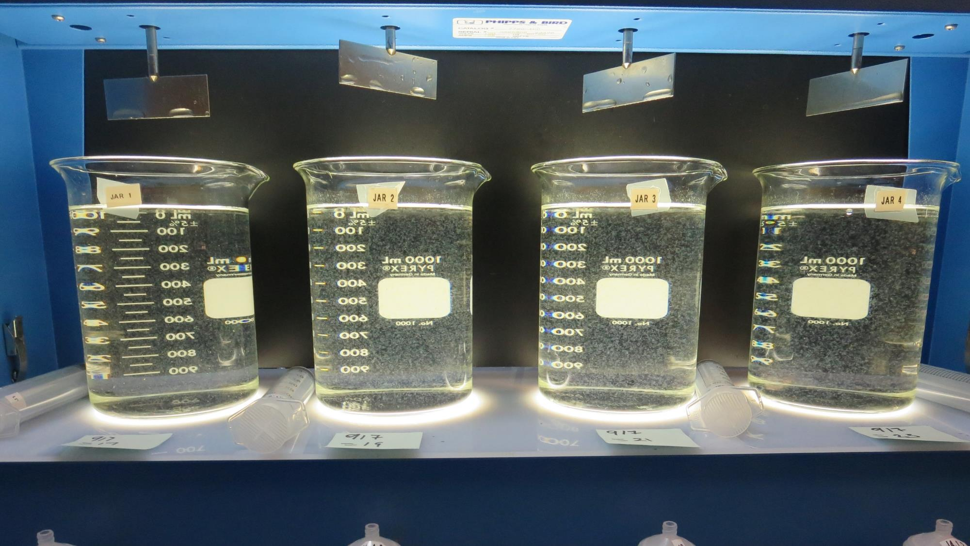
Jars 1-4: End of 5-minute flocculation (30 RPM) duration.
17 mg/L 917
Filtrate 0.09 NTU
UVT: 87.4%
UVA: 0.058/cm
Settled: 0.45 NTU
19 mg/L 917
Filtrate 0.08 NTU
UVT: 87.9%
UVA: 0.056/cm
Settled: 0.33 NTU
21 mg/L 917
Filtrate 0.08 NTU
UVT: 88.5%
UVA: 0.053/cm
Settled: 0.31 NTU
23 mg/L 917
Filtrate 0.08 NTU
UVT: 89.2%
UVA: 0.050/cm
Settled: 0.35 NTU

Slide 14
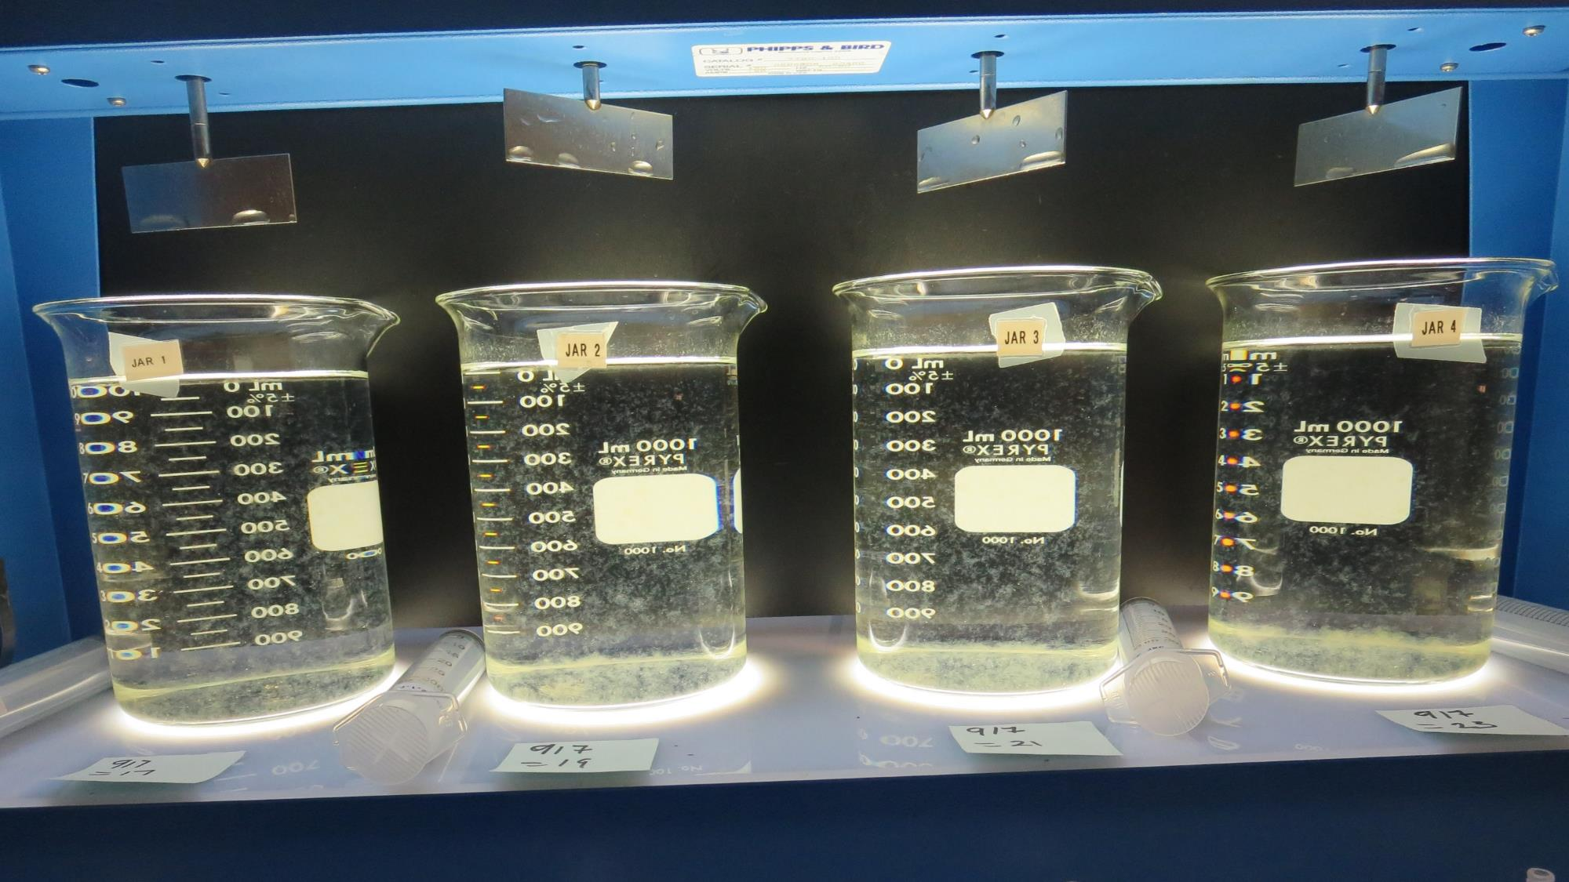
Jars 1-4: After 5 min of settling, 25 mL is syringed for filterability and %UVT/UVA.

Slide 15
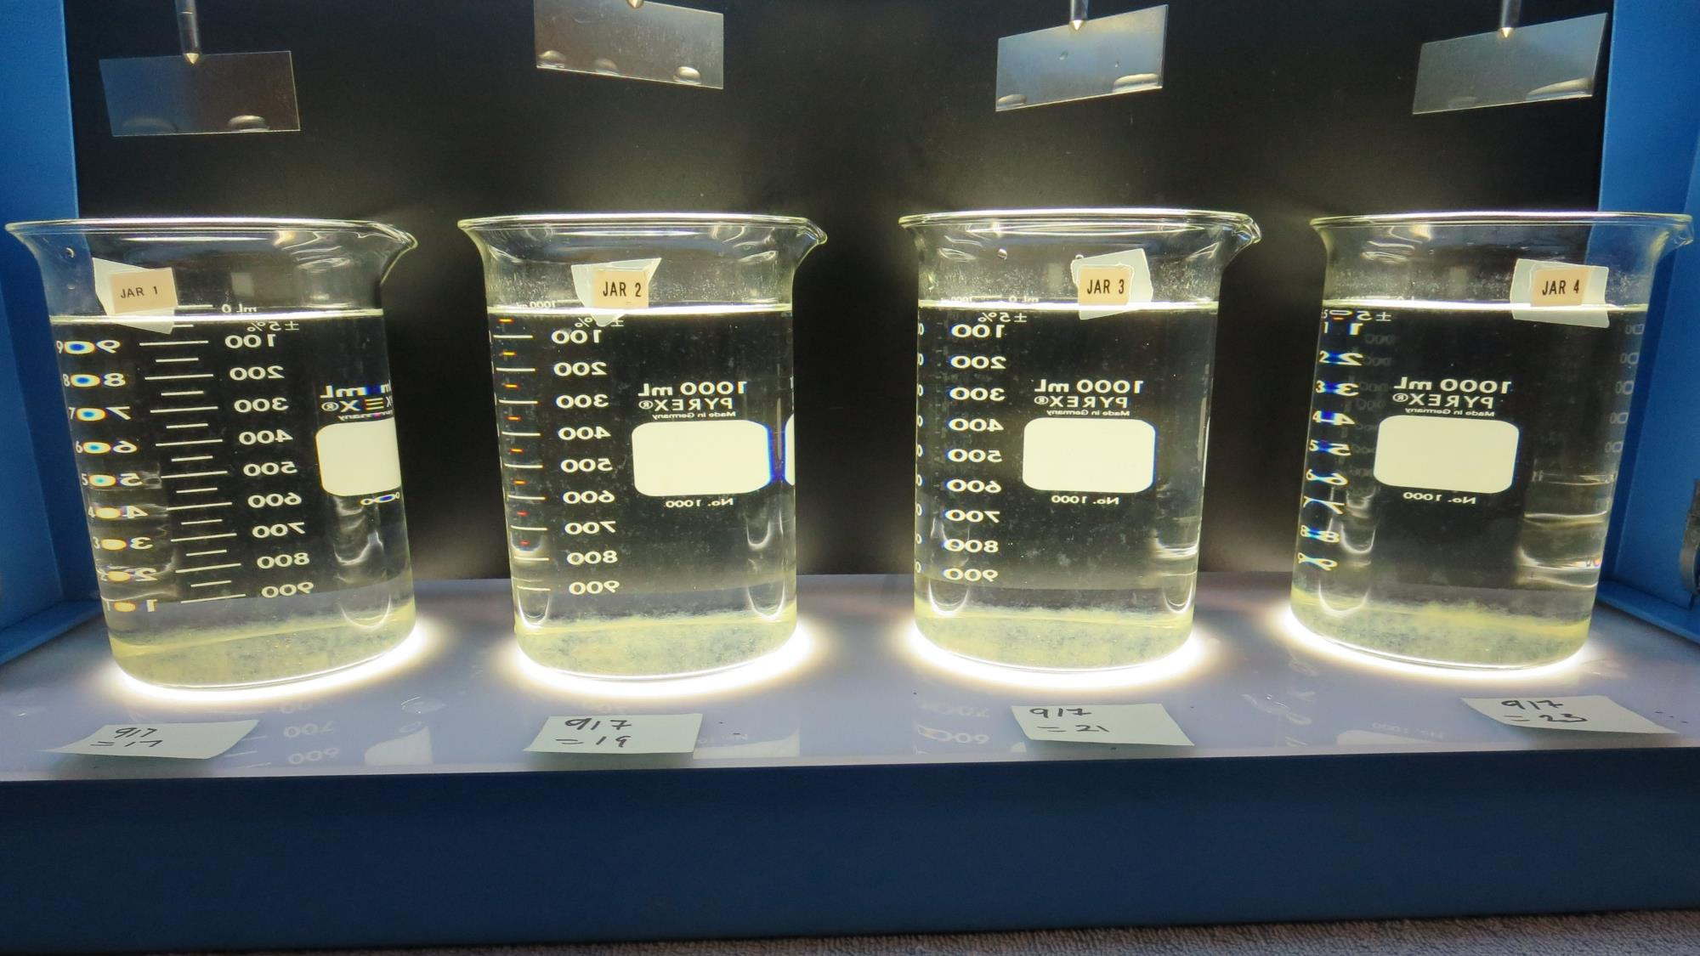
Jars 1-4: After 25-minutes of settling, settled water turbidity is taken.
17 mg/L 917
Filtrate 0.09 NTU
UVT: 87.4%
UVA: 0.058/cm
Settled: 0.45 NTU
19 mg/L 917
Filtrate 0.08 NTU
UVT: 87.9%
UVA: 0.056/cm
Settled: 0.33 NTU
21 mg/L 917
Filtrate 0.08 NTU
UVT: 88.5%
UVA: 0.053/cm
Settled: 0.31 NTU
23 mg/L 917
Filtrate 0.08 NTU
UVT: 89.2%
UVA: 0.050/cm
Settled: 0.35 NTU

Slide 16
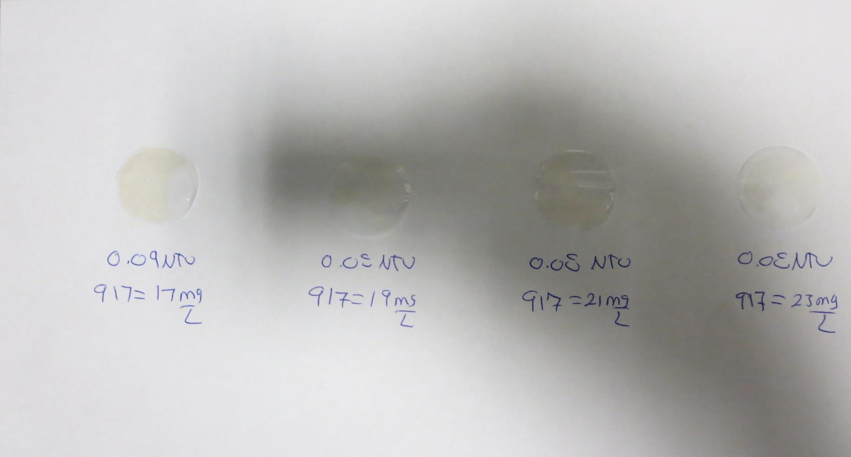
Visual of Filterability of Jars 1-4
17 mg/L 917
Filtrate 0.09 NTU
UVT: 87.4%
UVA: 0.058/cm
Settled: 0.45 NTU
19 mg/L 917
Filtrate 0.08 NTU
UVT: 87.9%
UVA: 0.056/cm
Settled: 0.33 NTU
21 mg/L 917
Filtrate 0.08 NTU
UVT: 88.5%
UVA: 0.053/cm
Settled: 0.31 NTU
23 mg/L 917
Filtrate 0.08 NTU
UVT: 89.2%
UVA: 0.050/cm
Settled: 0.35 NTU

Slide 17
Jars 5-8 Test No Flash Mix Floc Mix 5 min (10 RPM) Applied Coagulant 917

Slide 18
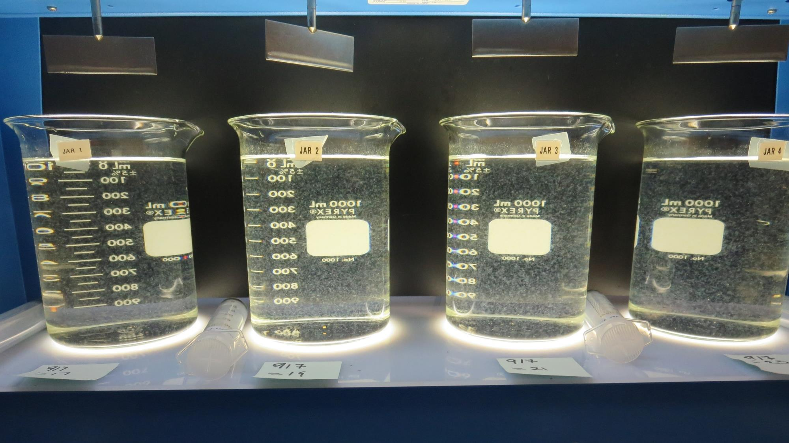
Jars 5-8: End of 5-minute flocculation (10 RPM) duration.
17 mg/L 917
Filtrate 0.09 NTU
UVT: 86.7%
UVA: 0.062/cm
Settled: 0.52 NTU
19 mg/L 917
Filtrate 0.09 NTU
UVT: 86.9%
UVA: 0.061/cm
Settled: 0.52 NTU
21 mg/L 917
Filtrate 0.08 NTU
UVT: 87.8%
UVA: 0.057/cm
Settled: 0.57 NTU
23 mg/L 917
Filtrate 0.08 NTU
UVT: 88.2%
UVA: 0.055/cm
Settled: 0.42 NTU

Slide 19
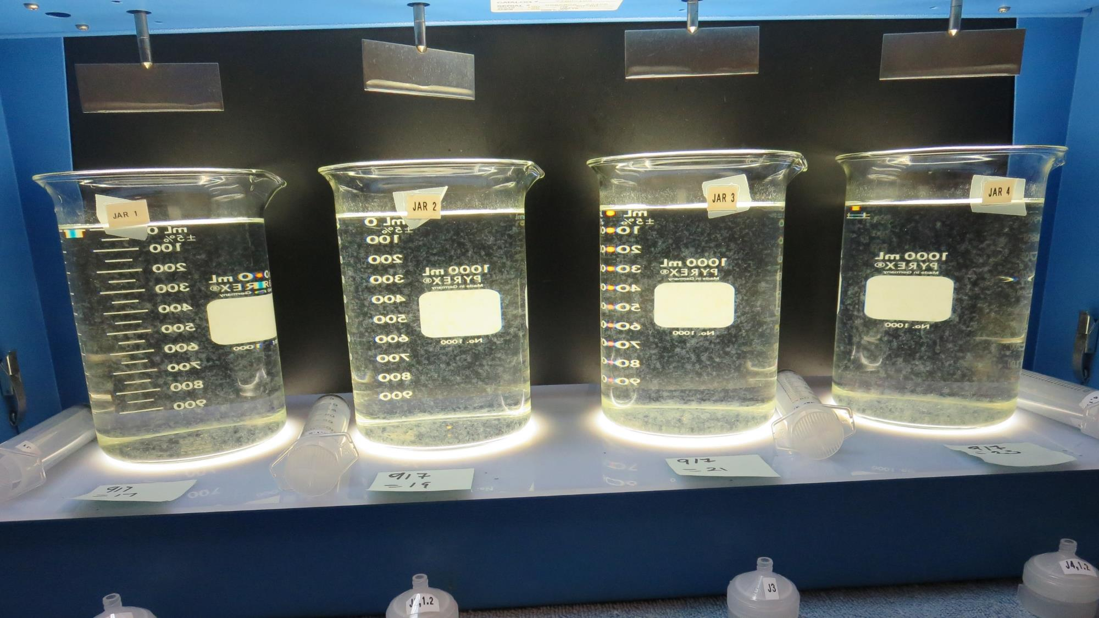
Jars 5-8: After 5 min of settling, 25 mL is syringed for filterability and %UVT/UVA.

Slide 20
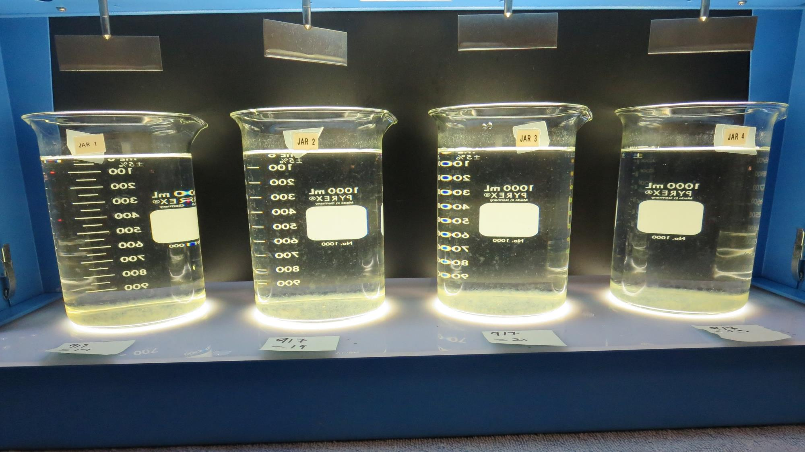
Jars 5-8: After 25-minutes of settling, settled water turbidity is taken.
17 mg/L 917
Filtrate 0.09 NTU
UVT: 86.7%
UVA: 0.062/cm
Settled: 0.52 NTU
19 mg/L 917
Filtrate 0.09 NTU
UVT: 86.9%
UVA: 0.061/cm
Settled: 0.52 NTU
21 mg/L 917
Filtrate 0.08 NTU
UVT: 87.8%
UVA: 0.057/cm
Settled: 0.57 NTU
23 mg/L 917
Filtrate 0.08 NTU
UVT: 88.2%
UVA: 0.055/cm
Settled: 0.42 NTU

Slide 21
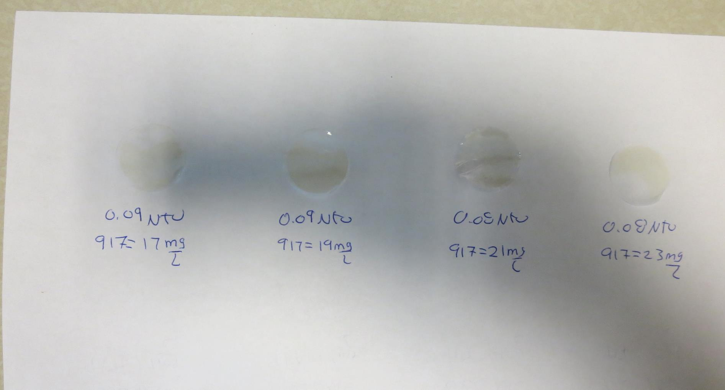
Visual of Filterability of Jars 5-8
17 mg/L 917
Filtrate 0.09 NTU
UVT: 86.7%
UVA: 0.062/cm
Settled: 0.52 NTU
19 mg/L 917
Filtrate 0.09 NTU
UVT: 86.9%
UVA: 0.061/cm
Settled: 0.52 NTU
21 mg/L 917
Filtrate 0.08 NTU
UVT: 87.8%
UVA: 0.057/cm
Settled: 0.57 NTU
23 mg/L 917
Filtrate 0.08 NTU
UVT: 88.2%
UVA: 0.055/cm
Settled: 0.42 NTU

Slide 22
Jars 9-12 Test Flash Mix 60 Sec (200 RPM) Floc Mix 5 min (30 RPM) Applied Coagulant 7066

Slide 23
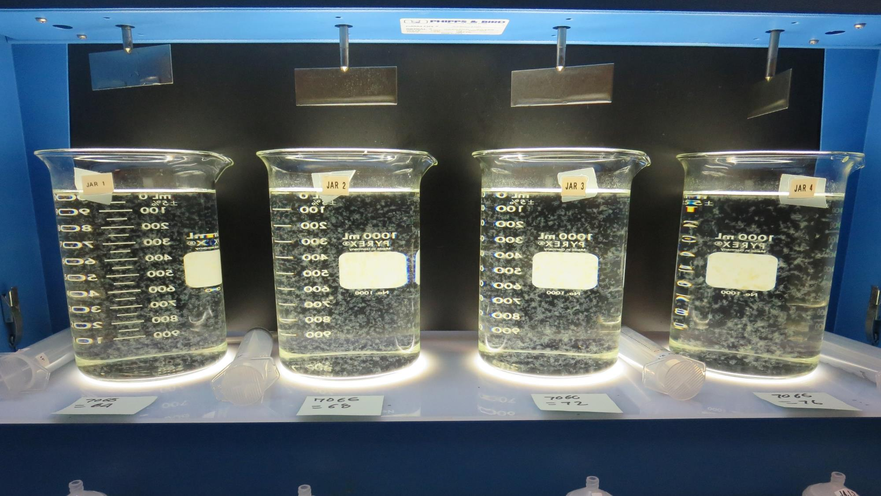
Jars 9-12: End of 5-minute flocculation (30 RPM) duration.
64 mg/L 7066
Filtrate 0.07 NTU
UVT: 88.3%
UVA: 0.054/cm
Settled: 0.20 NTU
68 mg/L 7066
Filtrate 0.06 NTU
UVT: 88.7%
UVA: 0.052/cm
Settled: 0.17 NTU
72 mg/L 7066
Filtrate 0.06 NTU
UVT: 88.6%
UVA: 0.053/cm
Settled: 0.30 NTU
76 mg/L 7066
Filtrate 0.06 NTU
UVT: 89.0%
UVA: 0.051/cm
Settled: 0.22 NTU

Slide 24
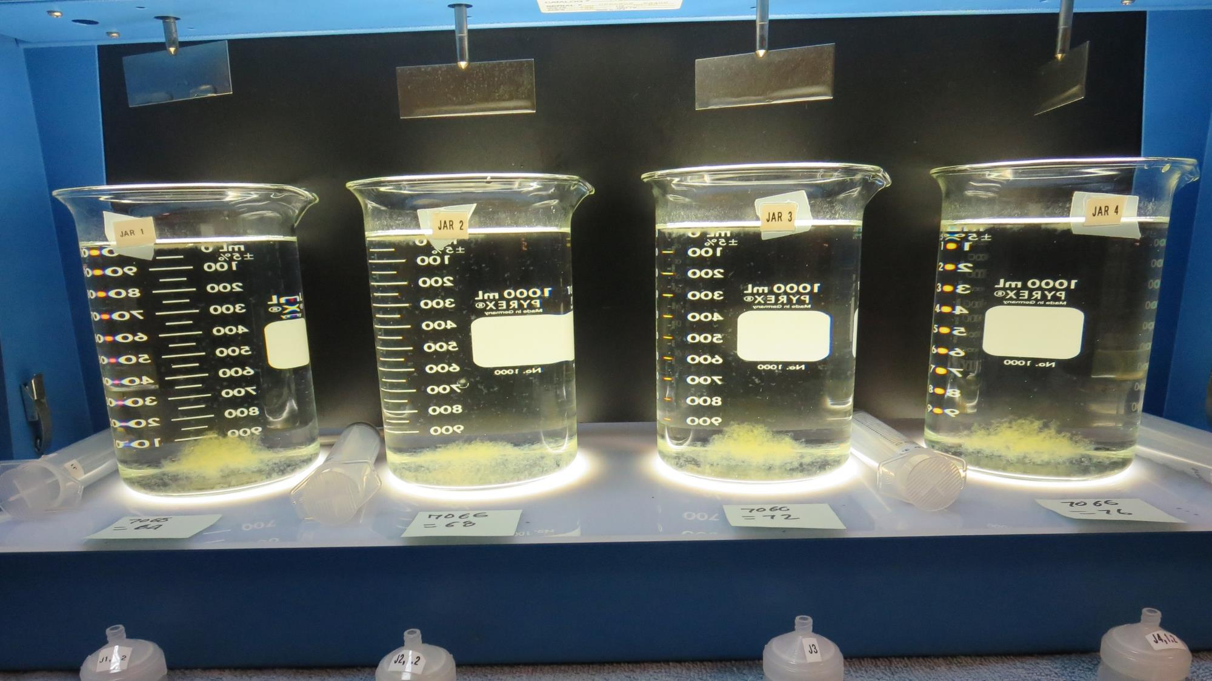
Jars 9-12: After 5 min of settling, 25 mL is syringed for filterability and %UVT/UVA.

Slide 25
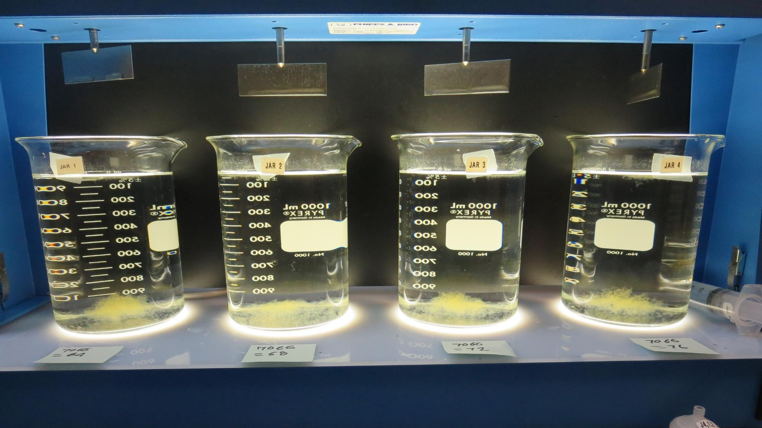
Jars 9-12: After 25-minutes of settling, settled water turbidity is taken.
64 mg/L 7066
Filtrate 0.07 NTU
UVT: 88.3%
UVA: 0.054/cm
Settled: 0.20 NTU
68 mg/L 7066
Filtrate 0.06 NTU
UVT: 88.7%
UVA: 0.052/cm
Settled: 0.17 NTU
72 mg/L 7066
Filtrate 0.06 NTU
UVT: 88.6%
UVA: 0.053/cm
Settled: 0.30 NTU
76 mg/L 7066
Filtrate 0.06 NTU
UVT: 89.0%
UVA: 0.051/cm
Settled: 0.22 NTU

Slide 26
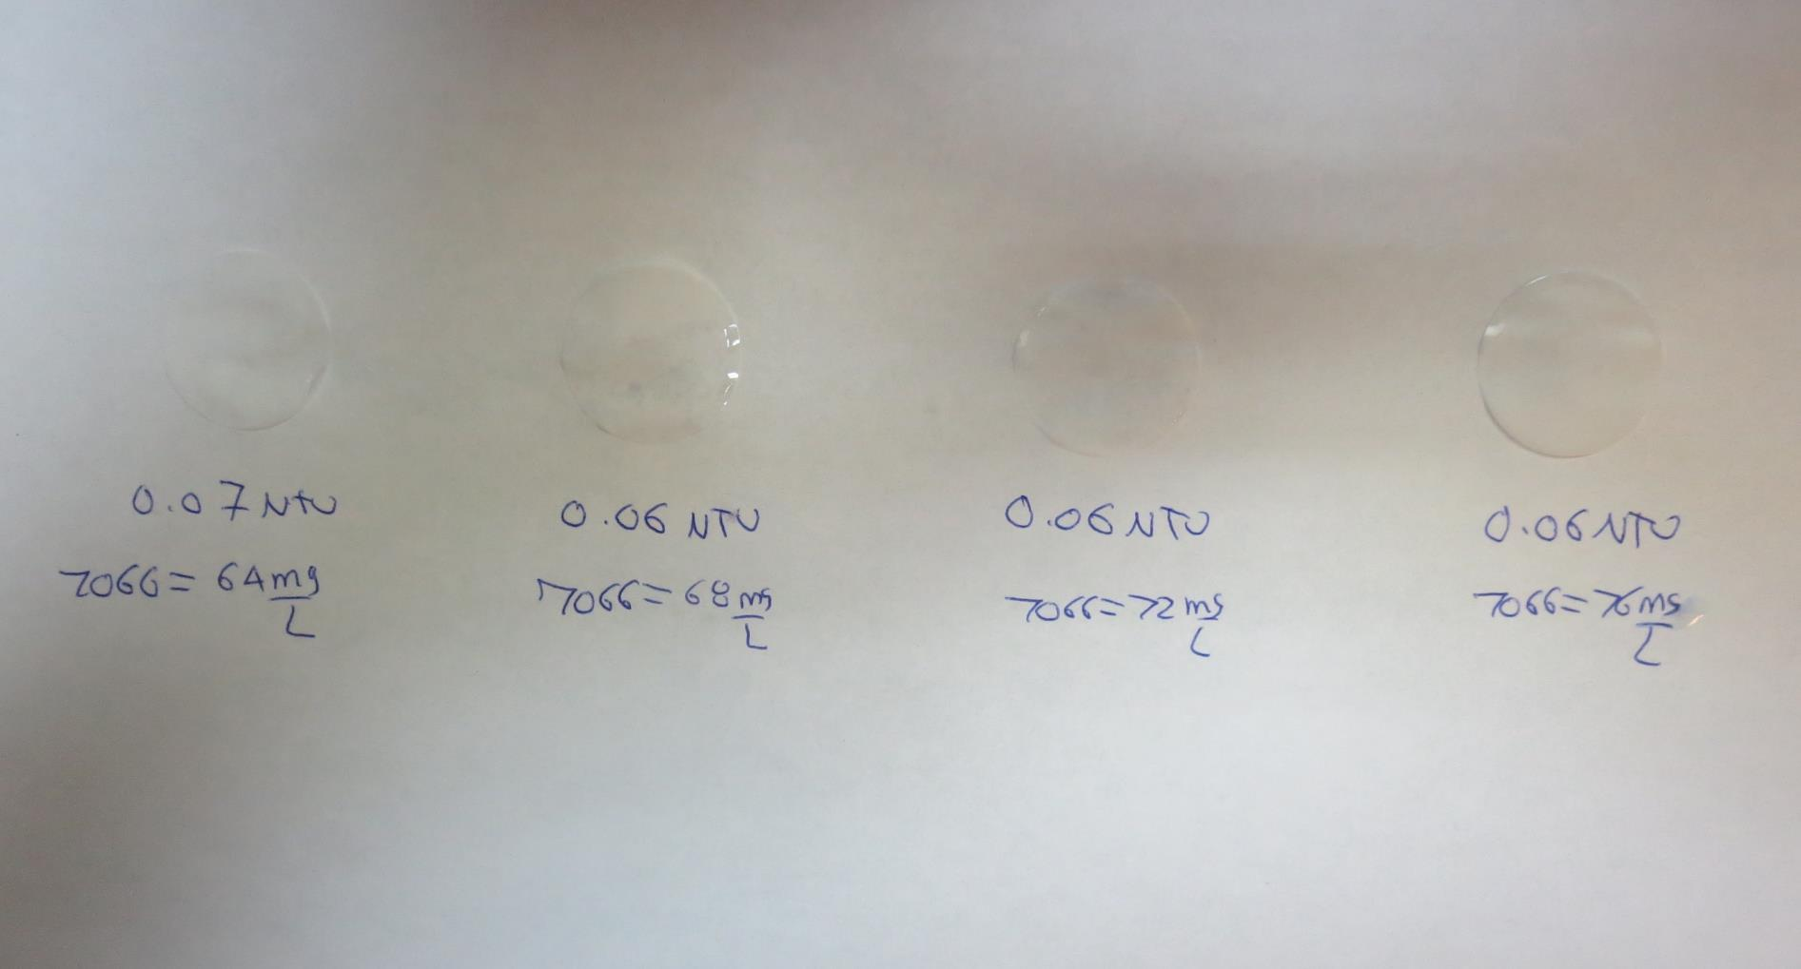
Visual of Filterability of Jars 9-12
64 mg/L 7066
Filtrate 0.07 NTU
UVT: 88.3%
UVA: 0.054/cm
Settled: 0.20 NTU
68 mg/L 7066
Filtrate 0.06 NTU
UVT: 88.7%
UVA: 0.052/cm
Settled: 0.17 NTU
72 mg/L 7066
Filtrate 0.06 NTU
UVT: 88.6%
UVA: 0.053/cm
Settled: 0.30 NTU
76 mg/L 7066
Filtrate 0.06 NTU
UVT: 89.0%
UVA: 0.051/cm
Settled: 0.22 NTU

Slide 27
Jars 13-16 Test Flash Mix 60 Sec (200 RPM) Floc Mix 5 min (30 RPM) Applied Coagulant 7066

Slide 28
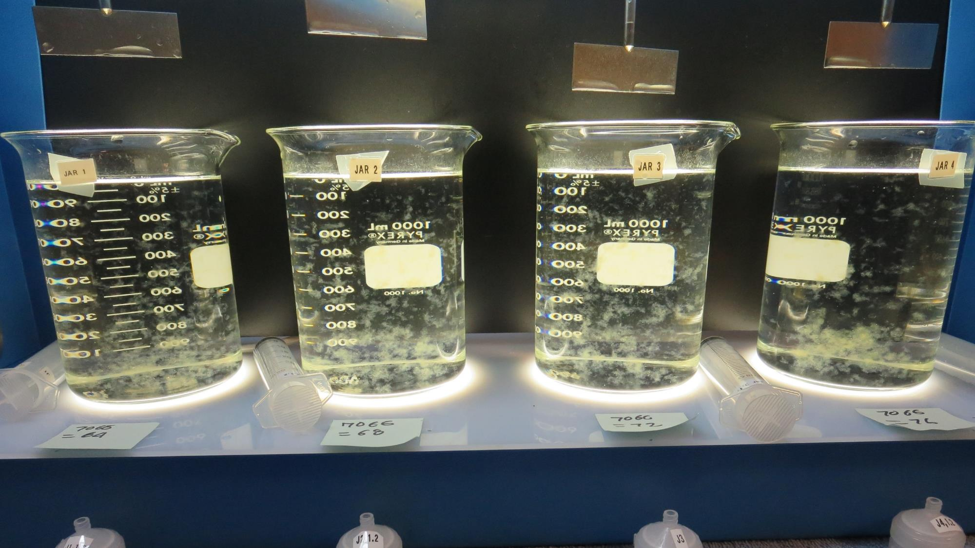
Jars 13-16: End of 5-minute flocculation (10 RPM) duration.
64 mg/L 7066
Filtrate 0.07 NTU
UVT: 87.9%
UVA: 0.056/cm
Settled: 0.20 NTU
68 mg/L 7066
Filtrate 0.06 NTU
UVT: 88.4%
UVA: 0.054/cm
Settled: 0.22 NTU
72 mg/L 7066
Filtrate 0.05 NTU
UVT: 88.7%
UVA: 0.052/cm
Settled: 0.33 NTU
76 mg/L 7066
Filtrate 0.05 NTU
UVT: 89.0%
UVA: 0.051/cm
Settled: 0.28 NTU

Slide 29
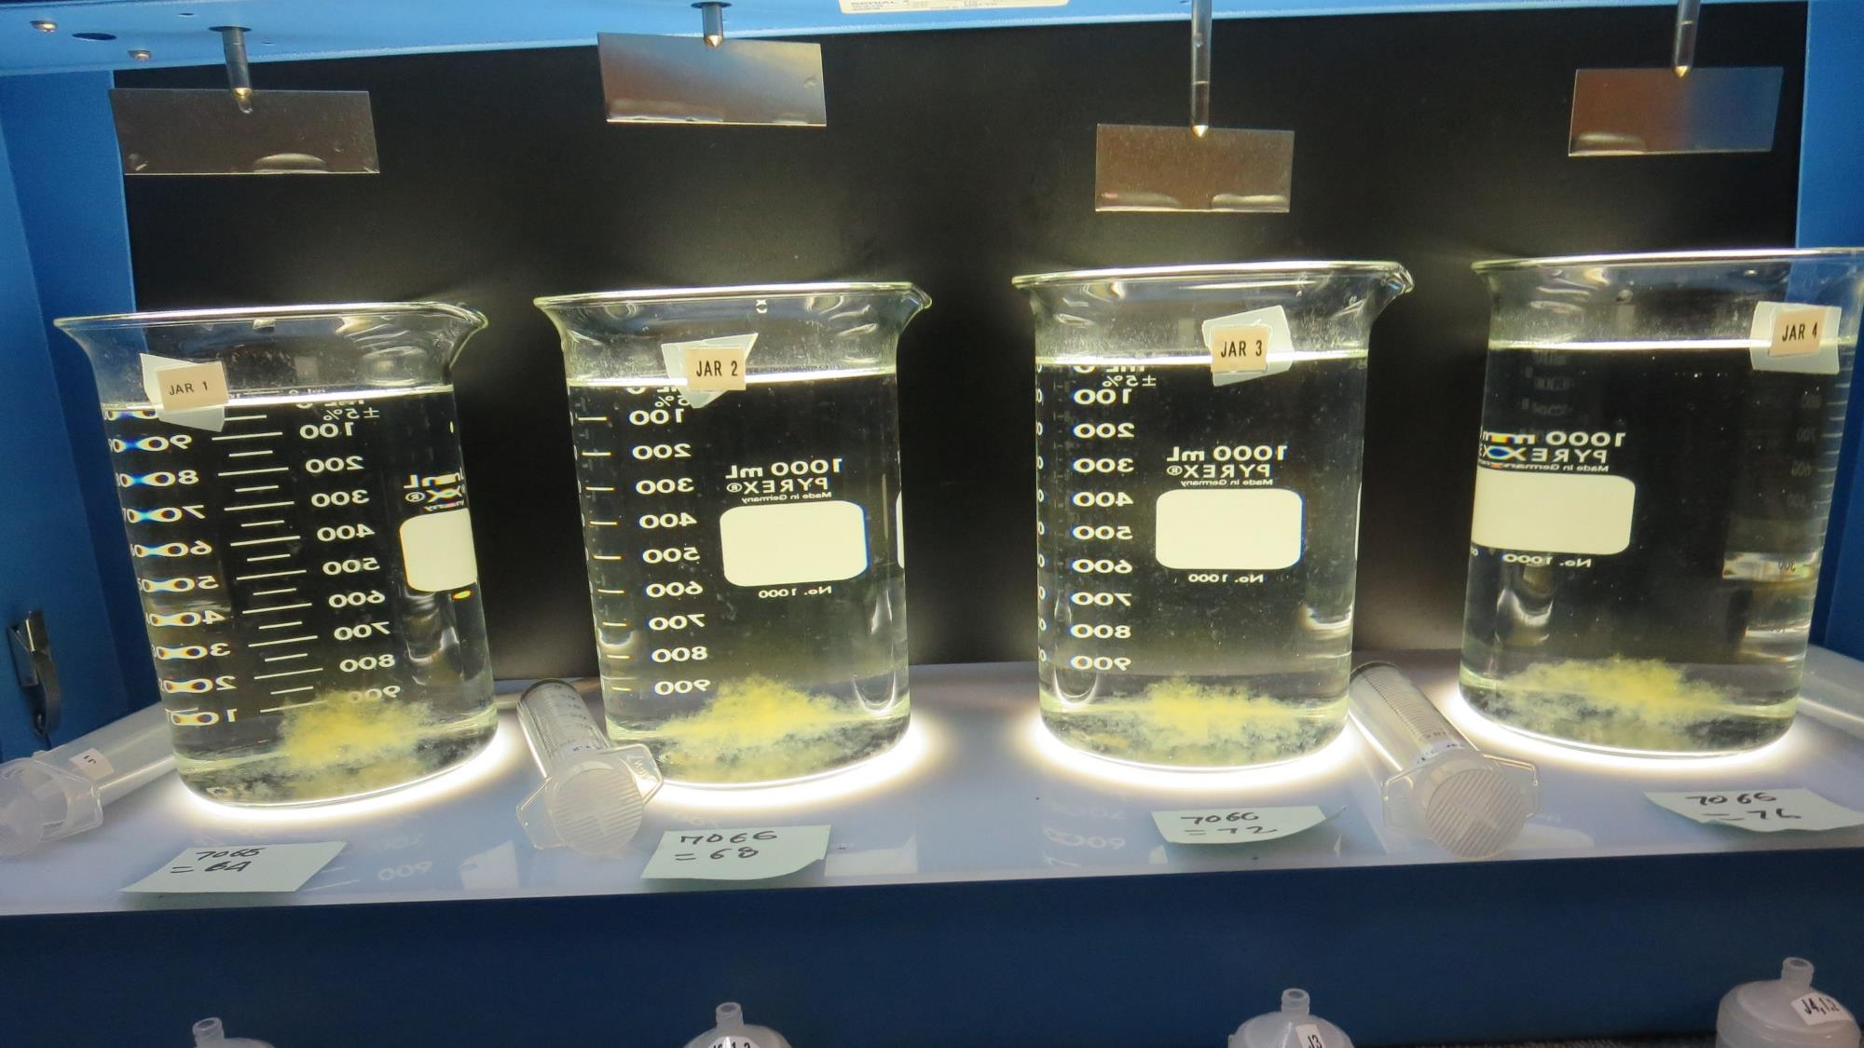
Jars 13-16: After 5 min of settling, 25 mL is syringed for filterability and %UVT/UVA.

Slide 30
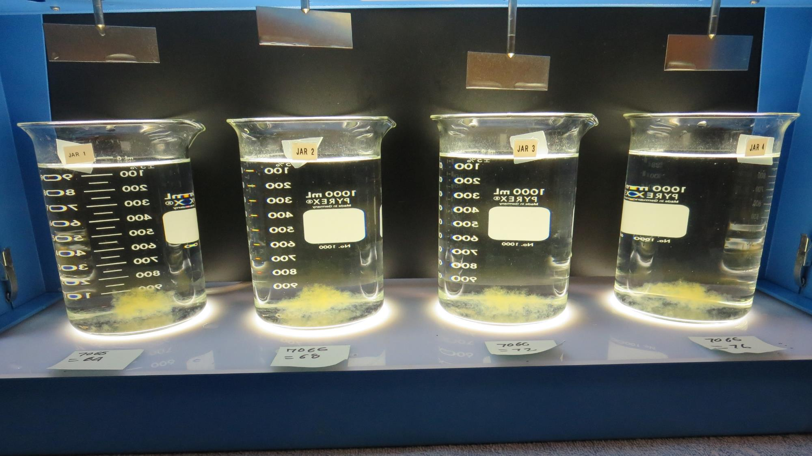
Jars 13-16: After 25-minutes of settling, settled water turbidity is taken.
64 mg/L 7066
Filtrate 0.07 NTU
UVT: 87.9%
UVA: 0.056/cm
Settled: 0.20 NTU
68 mg/L 7066
Filtrate 0.06 NTU
UVT: 88.4%
UVA: 0.054/cm
Settled: 0.22 NTU
72 mg/L 7066
Filtrate 0.05 NTU
UVT: 88.7%
UVA: 0.052/cm
Settled: 0.33 NTU
76 mg/L 7066
Filtrate 0.05 NTU
UVT: 89.0%
UVA: 0.051/cm
Settled: 0.28 NTU

Slide 31
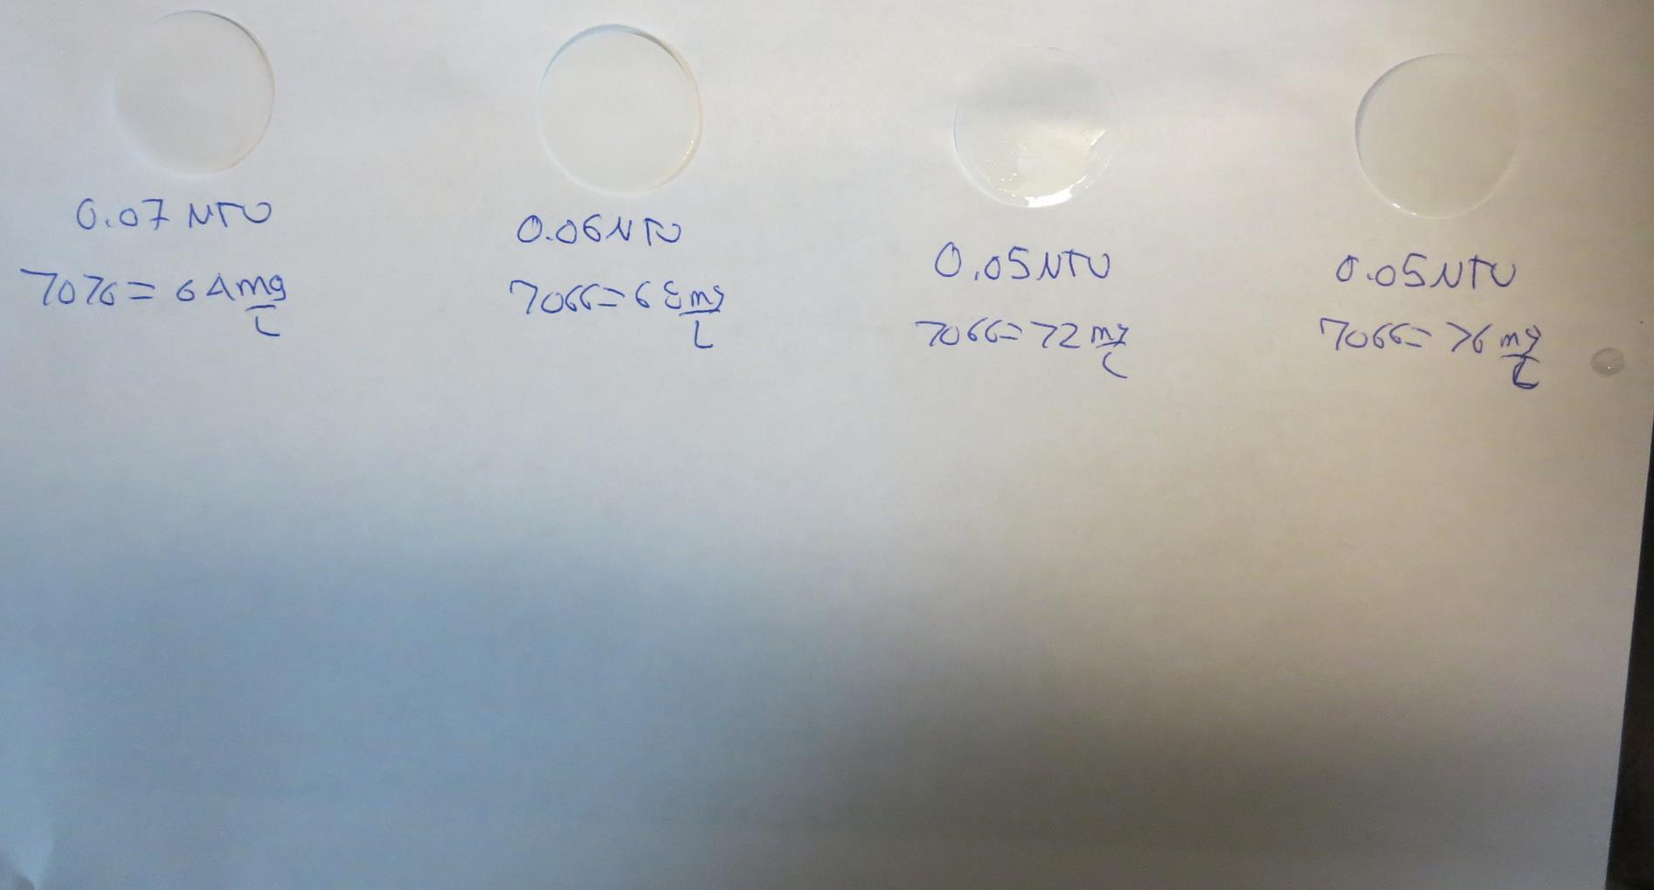
Visual of Filterability of Jars 13-16
64 mg/L 7066
Filtrate 0.07 NTU
UVT: 87.9%
UVA: 0.056/cm
Settled: 0.20 NTU
68 mg/L 7066
Filtrate 0.06 NTU
UVT: 88.4%
UVA: 0.054/cm
Settled: 0.22 NTU
72 mg/L 7066
Filtrate 0.05 NTU
UVT: 88.7%
UVA: 0.052/cm
Settled: 0.33 NTU
76 mg/L 7066
Filtrate 0.05 NTU
UVT: 89.0%
UVA: 0.051/cm
Settled: 0.28 NTU

Slide 32
Jars 17-20 Test Flash Mix 60 Sec (200 RPM) Floc Mix 5 min (30 RPM) Applied Coagulant 7066

Slide 33
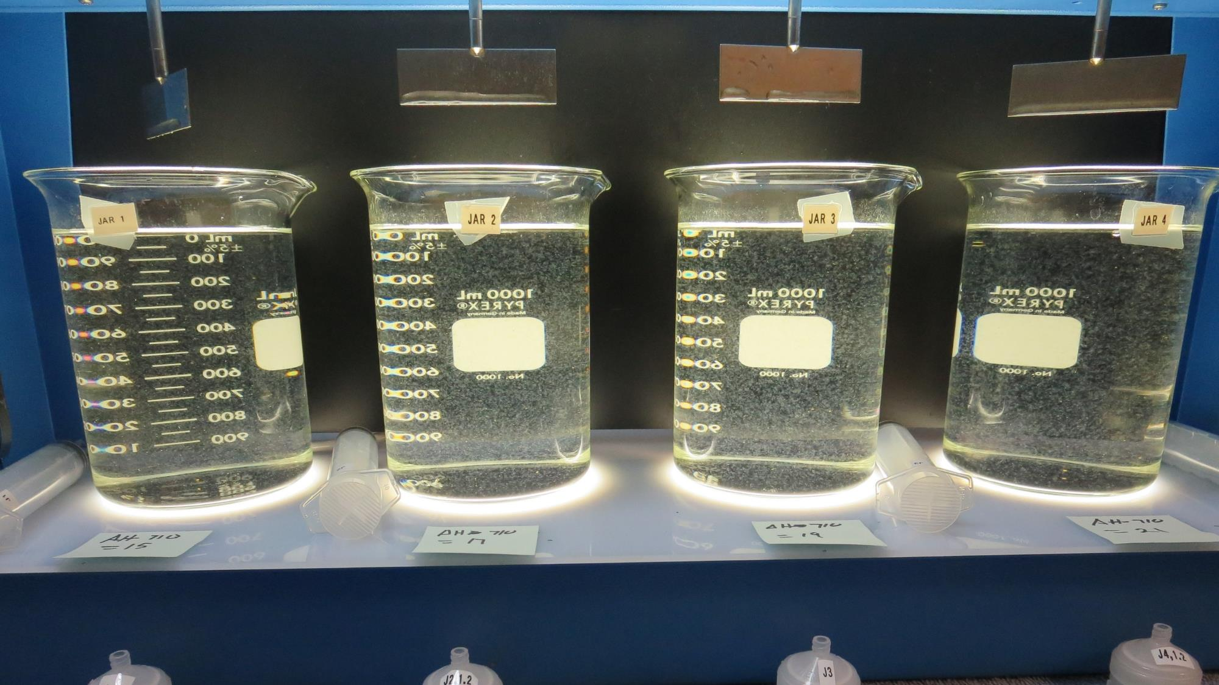
Jars 17-20: End of 5-minute flocculation (30 RPM) duration.
15 mg/L AH-710
Filtrate 0.09 NTU
UVT: 86.4%
UVA: 0.063/cm
Settled: 0.43 NTU
17 mg/L AH-710
Filtrate 0.07 NTU
UVT: 86.9%
UVA: 0.061/cm
Settled: 0.40 NTU
19 mg/L AH-710
Filtrate 0.07 NTU
UVT: 87.3%
UVA: 0.059/cm
Settled: 0.38 NTU
21 mg/L AH-710
Filtrate 0.08 NTU
UVT: 88.0%
UVA: 0.056/cm
Settled: 0.30 NTU

Slide 34
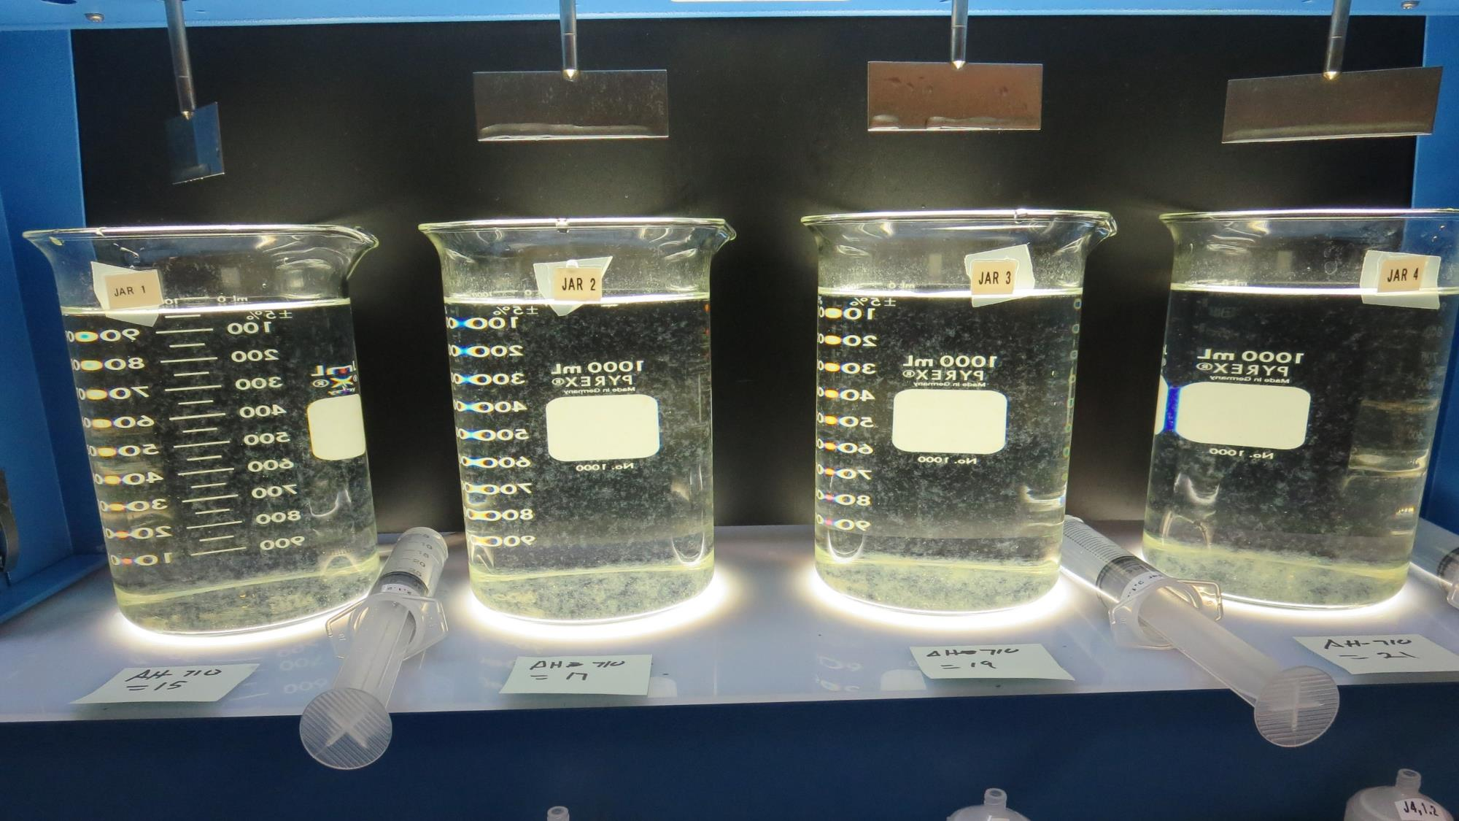
Jars 17-20: After 5 min of settling, 25 mL is syringed for filterability and %UVT/UVA.

Slide 35
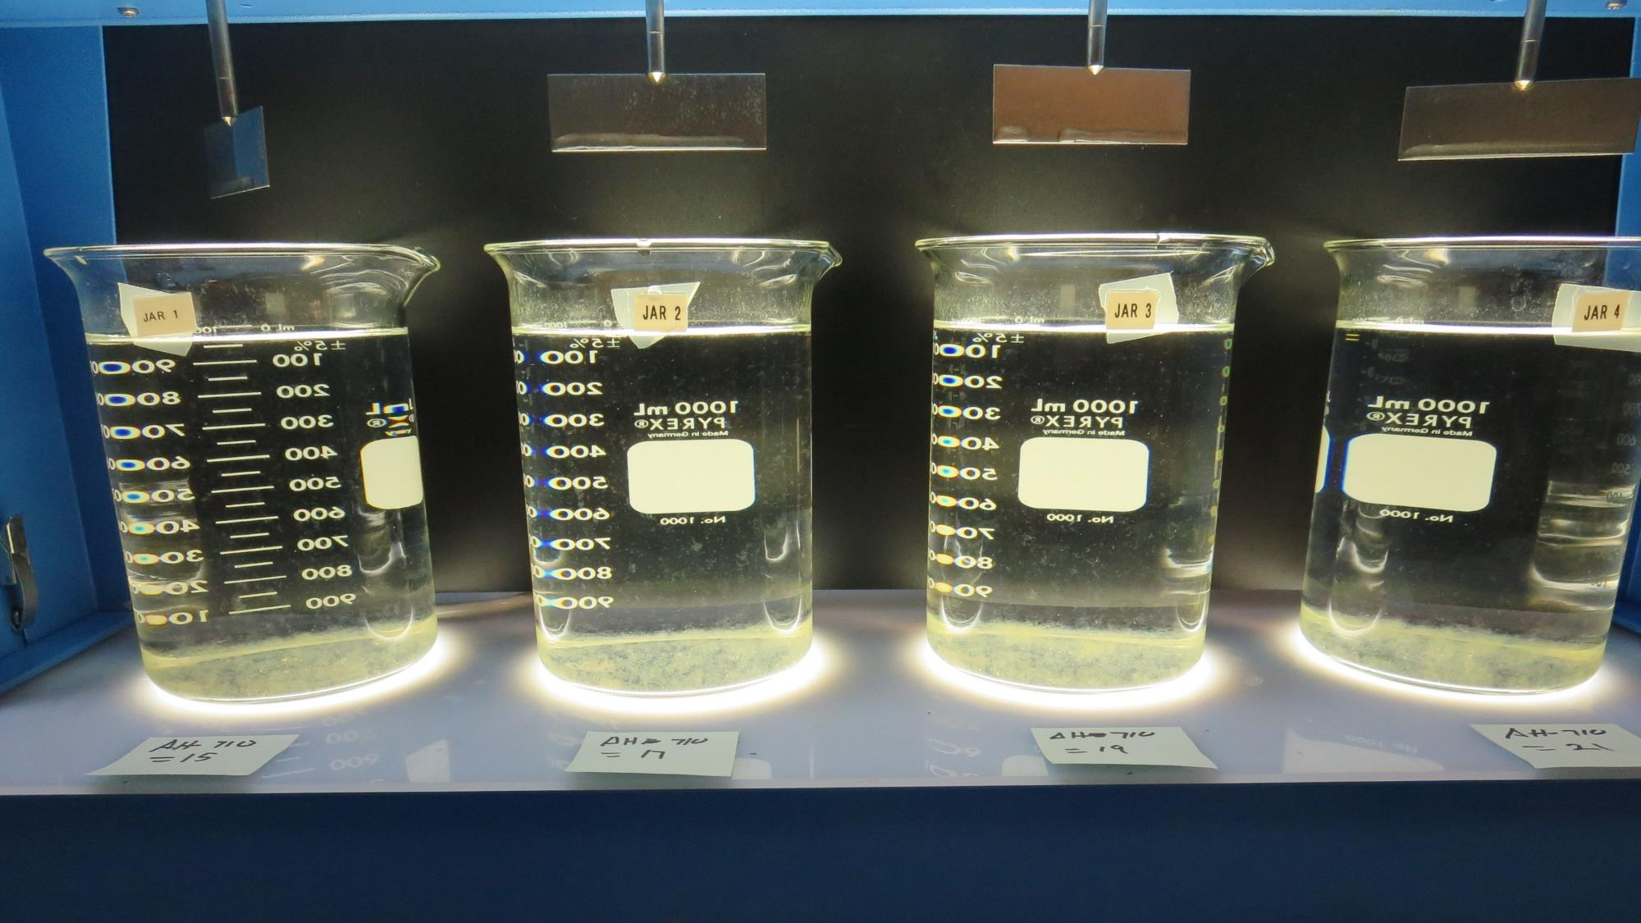
Jars 17-20: After 25-minutes of settling, settled water turbidity is taken.
15 mg/L AH-710
Filtrate 0.09 NTU
UVT: 86.4%
UVA: 0.063/cm
Settled: 0.43 NTU
17 mg/L AH-710
Filtrate 0.07 NTU
UVT: 86.9%
UVA: 0.061/cm
Settled: 0.40 NTU
19 mg/L AH-710
Filtrate 0.07 NTU
UVT: 87.3%
UVA: 0.059/cm
Settled: 0.38 NTU
21 mg/L AH-710
Filtrate 0.08 NTU
UVT: 88.0%
UVA: 0.056/cm
Settled: 0.30 NTU

Slide 36
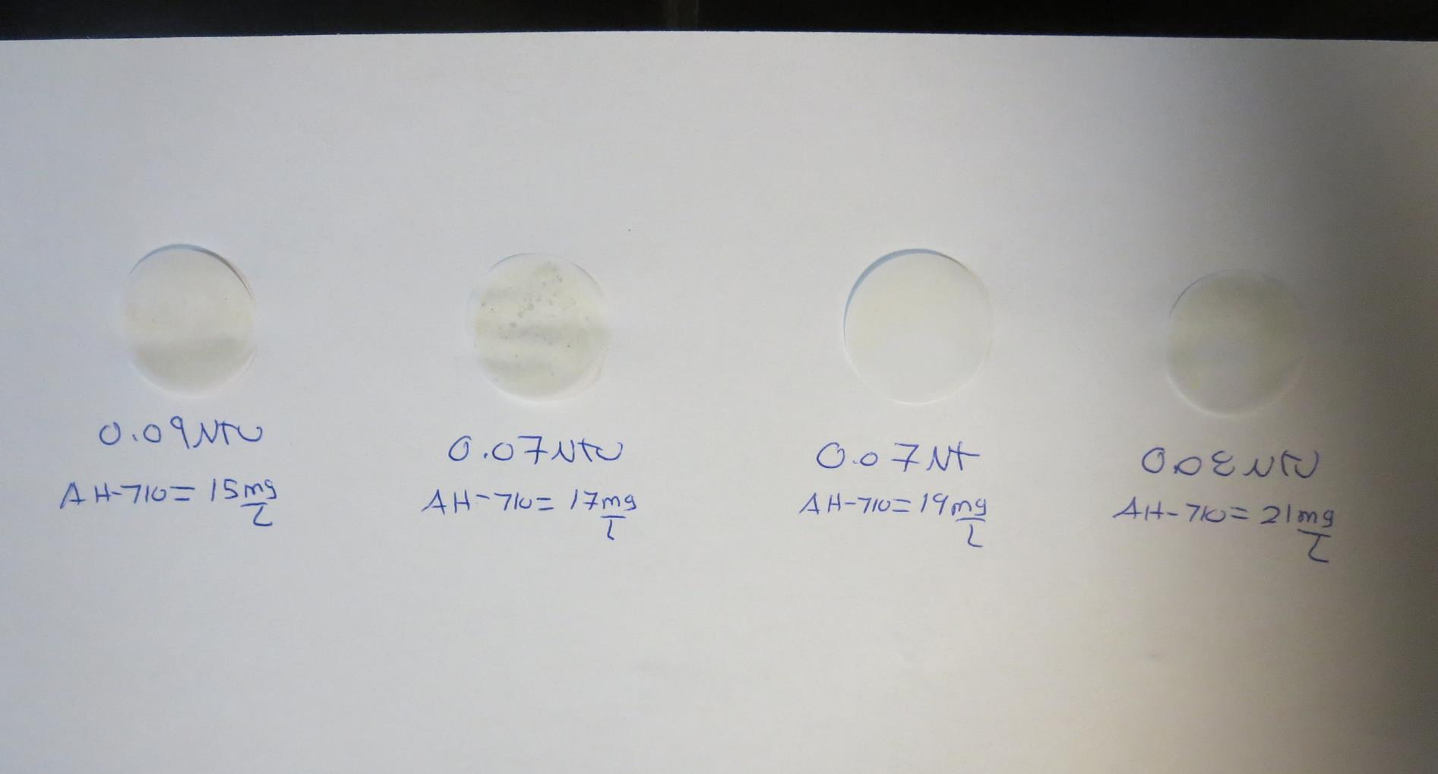
Visual of Filterability of Jars 17-20
15 mg/L AH-710
Filtrate 0.09 NTU
UVT: 86.4%
UVA: 0.063/cm
Settled: 0.43 NTU
17 mg/L AH-710
Filtrate 0.07 NTU
UVT: 86.9%
UVA: 0.061/cm
Settled: 0.40 NTU
19 mg/L AH-710
Filtrate 0.07 NTU
UVT: 87.3%
UVA: 0.059/cm
Settled: 0.38 NTU
21 mg/L AH-710
Filtrate 0.08 NTU
UVT: 88.0%
UVA: 0.056/cm
Settled: 0.30 NTU

Slide 37
Jars 21-24 Test Flash Mix 60 Sec (200 RPM) Floc Mix 5/10/15/20 min (30 RPM) Applied Coagulant 917

Slide 38
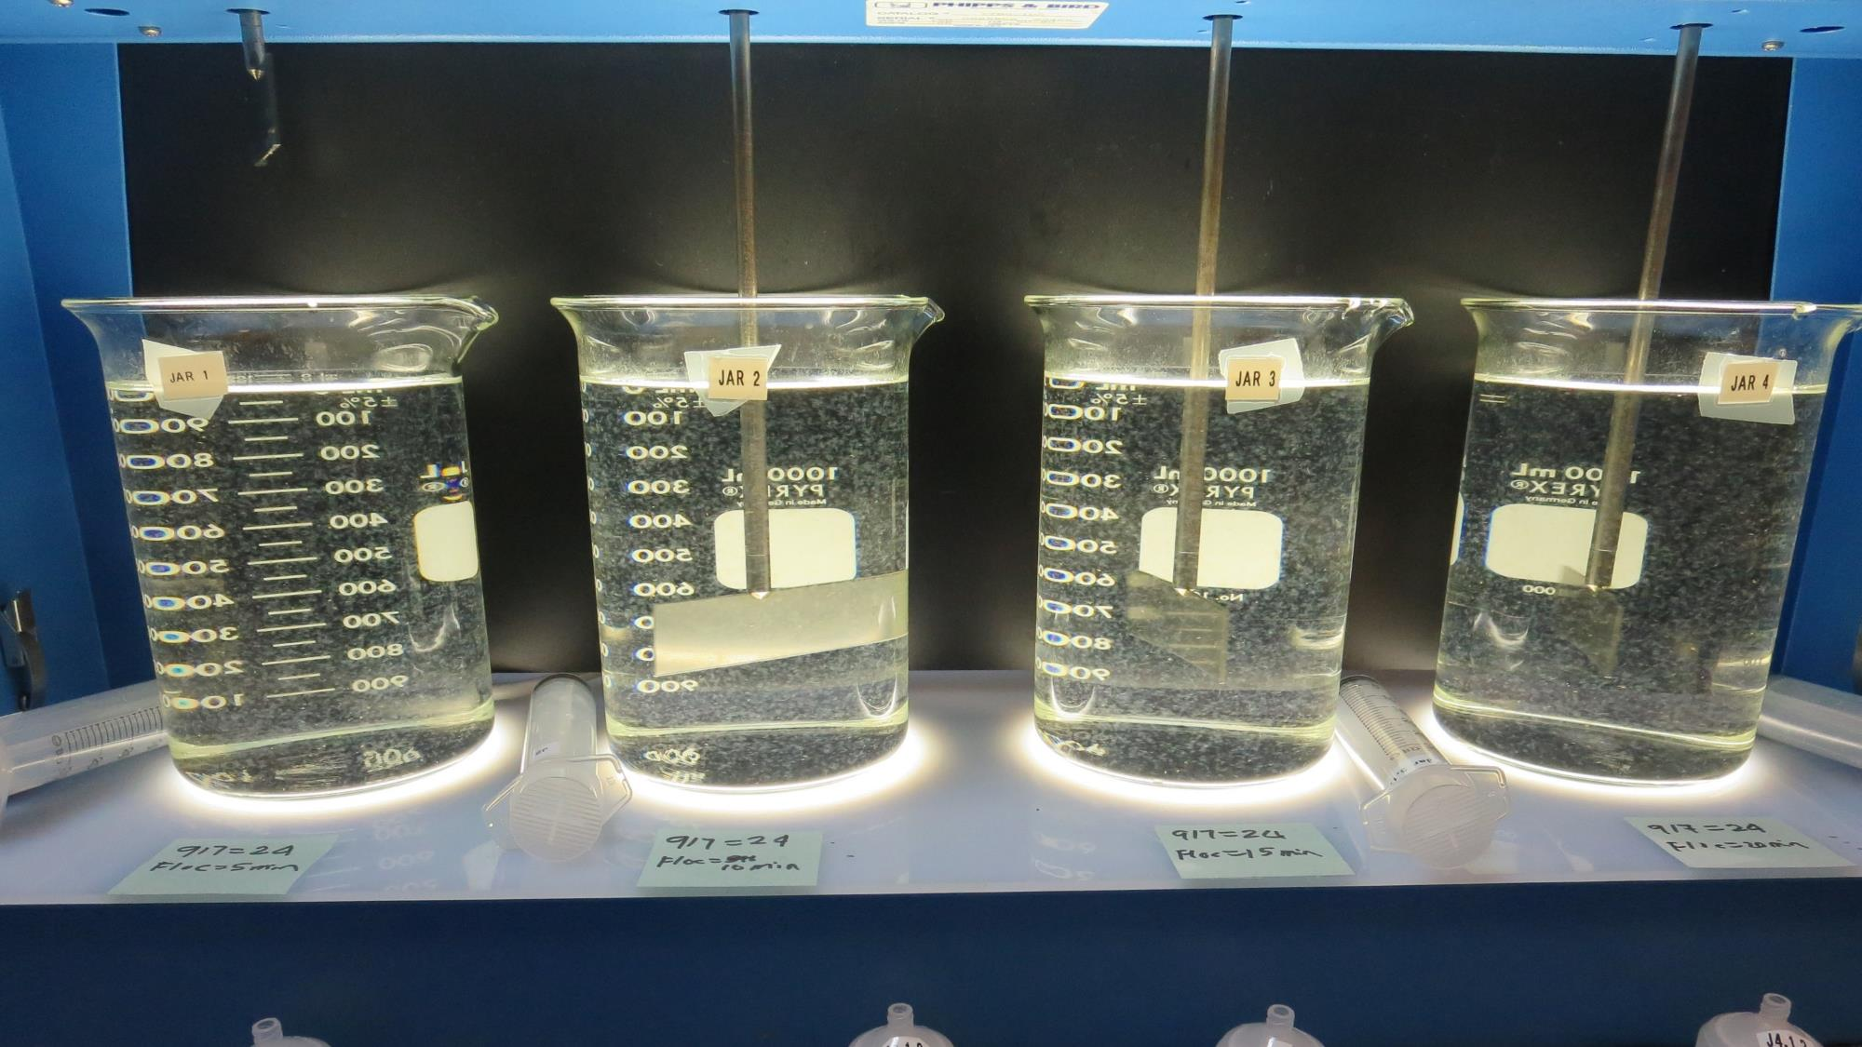
Jars 21-24: End of 5-minute flocculation (5 RPM) duration for Jar 21.
24 mg/L 917
Filtrate 0.07 NTU
UVT: 89.8%
UVA: 0.047/cm
Settled: 0.28 NTU

Slide 39
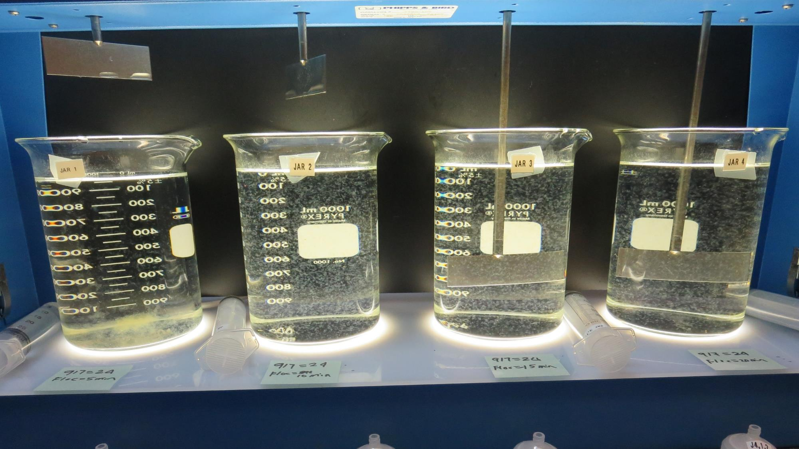
Jars 21-24: End of 5-minute flocculation (10 RPM) duration for Jar 22.
24 mg/L 917
Filtrate 0.07 NTU
UVT: 89.7%
UVA: 0.047/cm
Settled: 0.22 NTU

Slide 40
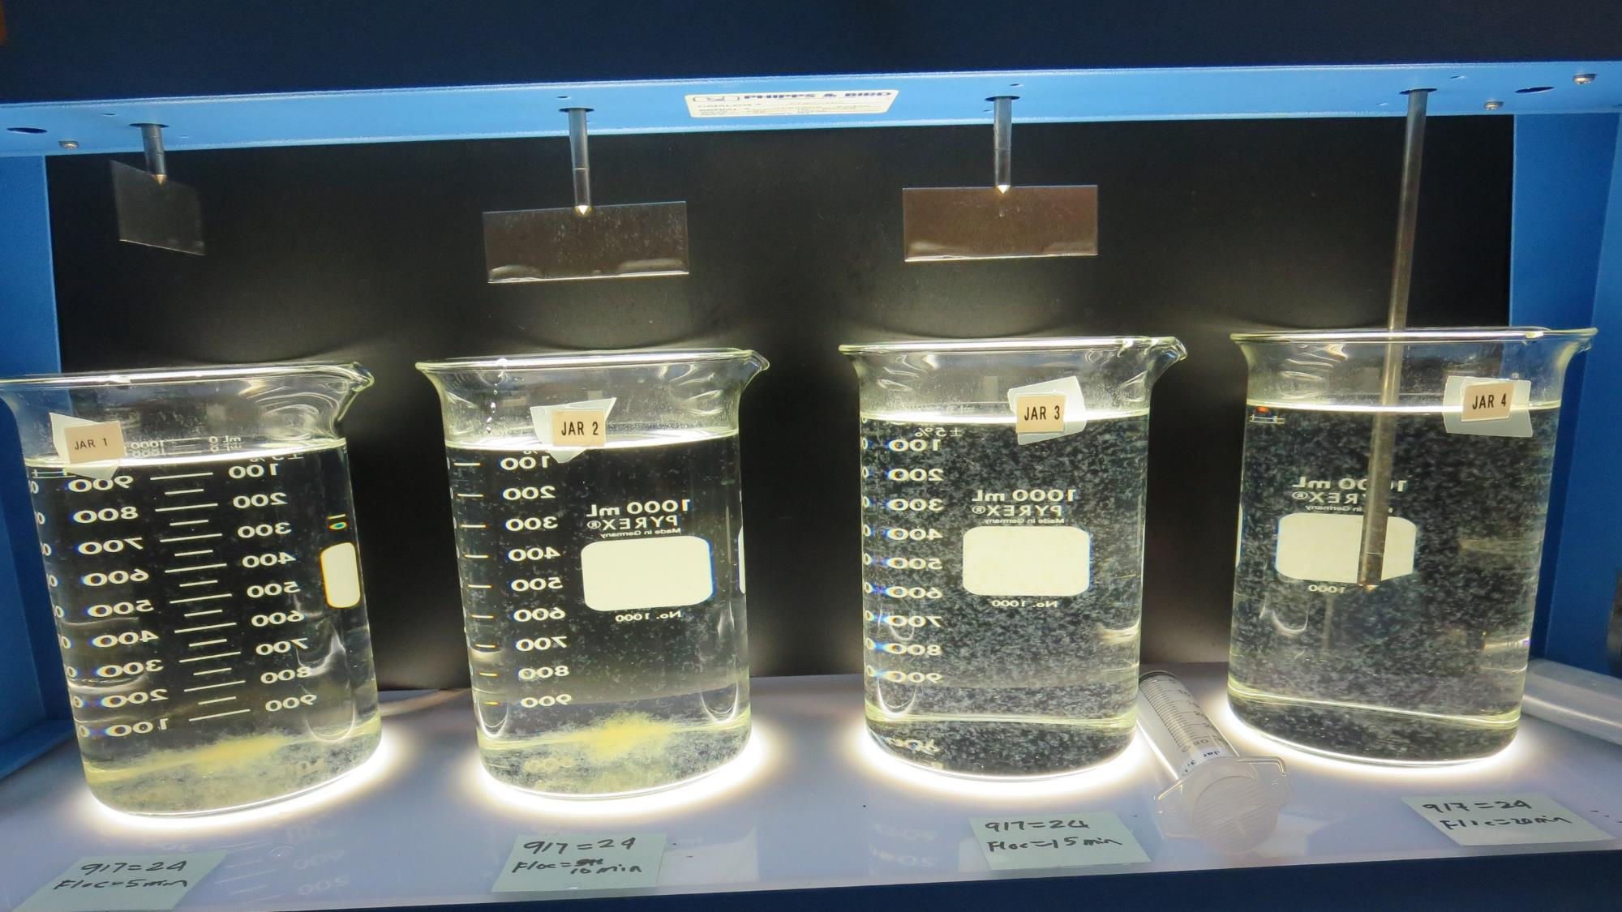
Jars 21-24: End of 5-minute flocculation (15 RPM) duration for Jar 23
24 mg/L 917
Filtrate 0.07 NTU
UVT: 89.6%
UVA: 0.048/cm
Settled: 0.22 NTU

Slide 41
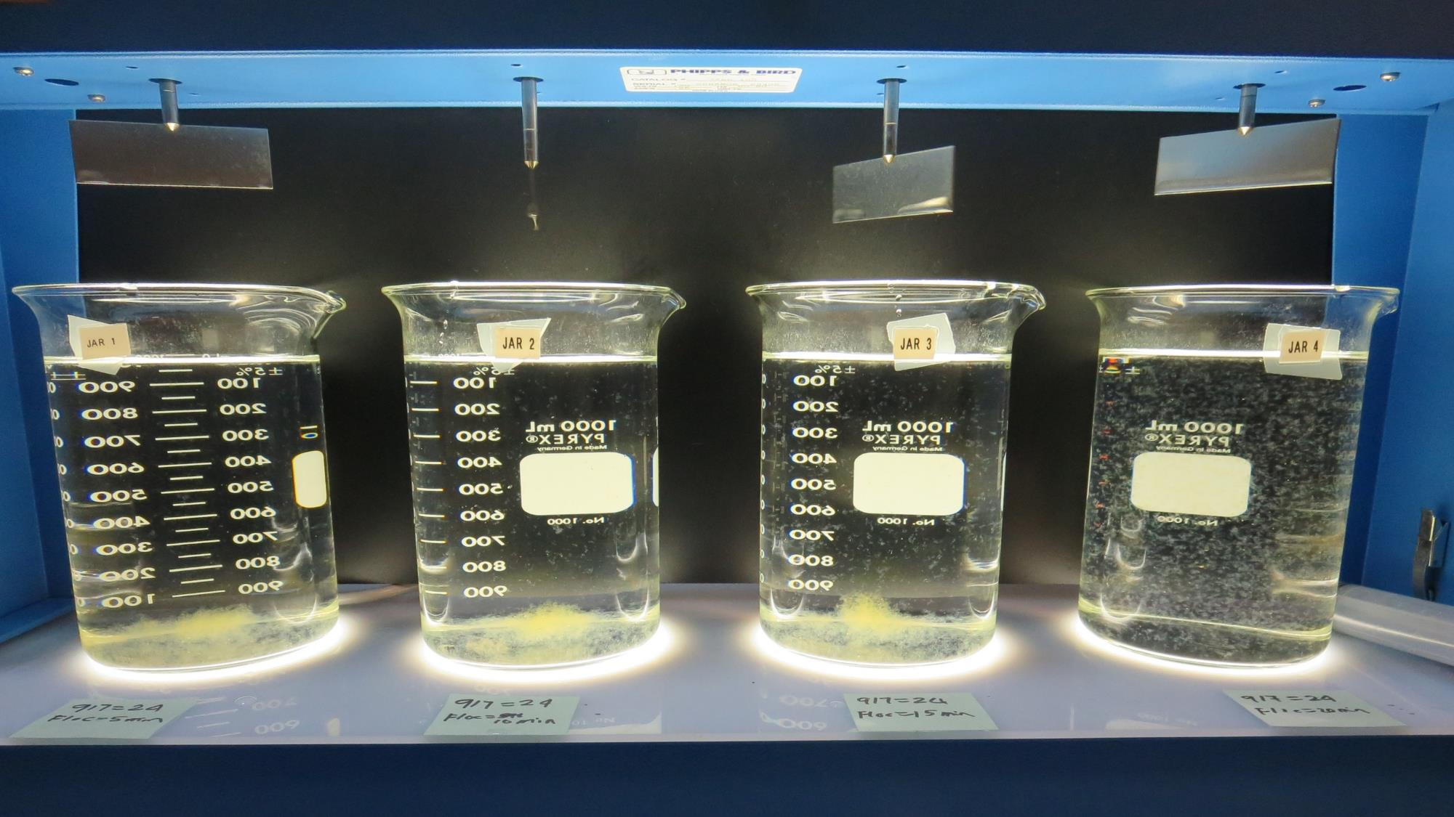
Jars 21-24: End of 5-minute flocculation (20 RPM) duration for Jar 24
24 mg/L 917
Filtrate 0.07 NTU
UVT: 89.9%
UVA: 0.047/cm
Settled: 0.21 NTU

Slide 42
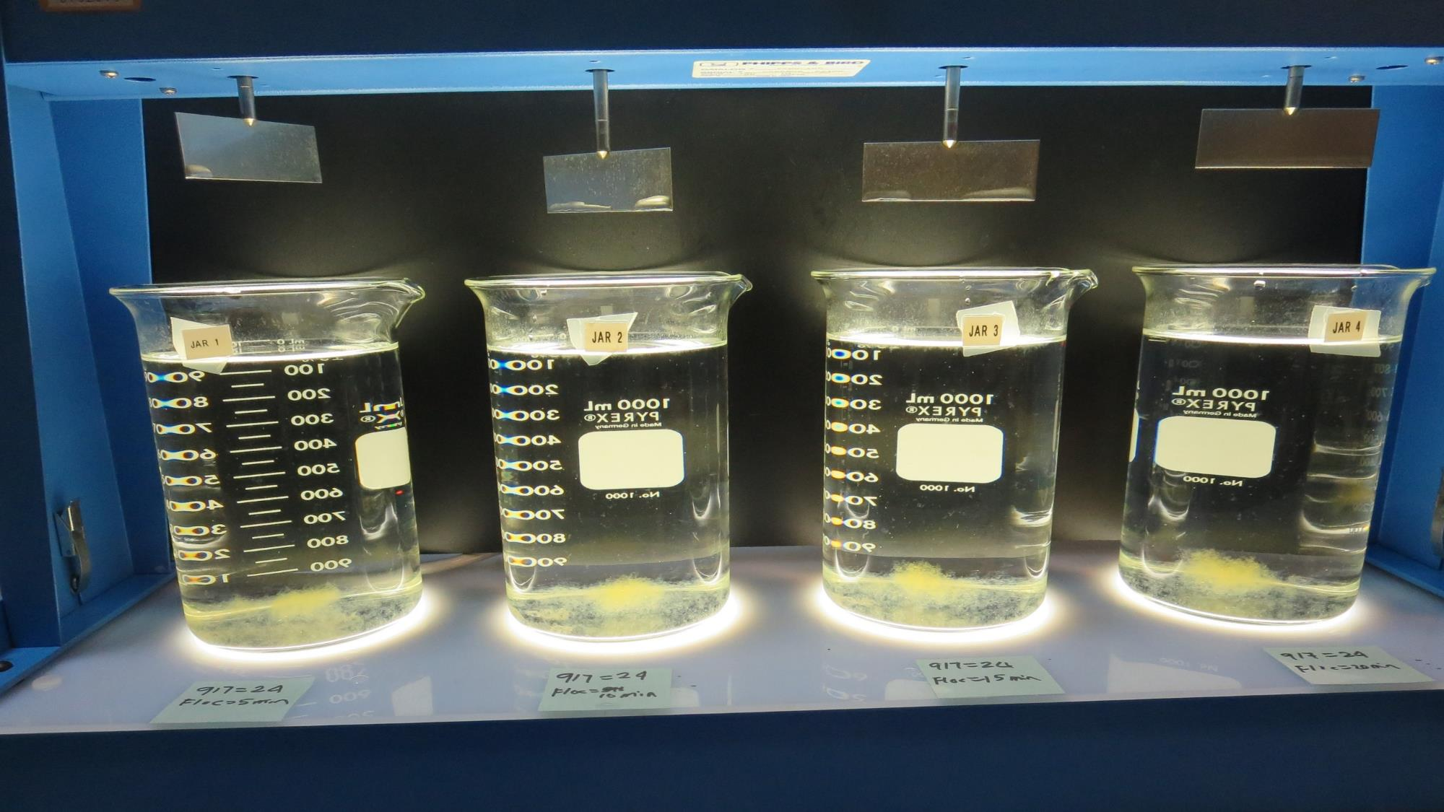
Jars 21-24: Visual look of settling, 25/20/15/10 minutes.
25 minute of setting
20 minute of setting
15 minute of setting
10 minute of setting

Slide 43
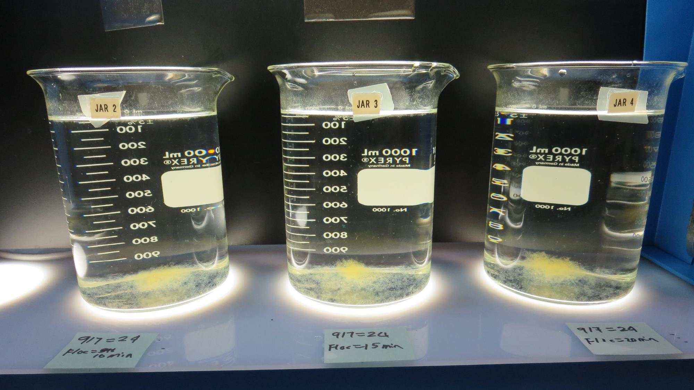
Jars 22-24: Visual look of settling, 25/20/15 minutes.
25 minute of setting
20 minute of setting
15 minute of setting

Slide 44
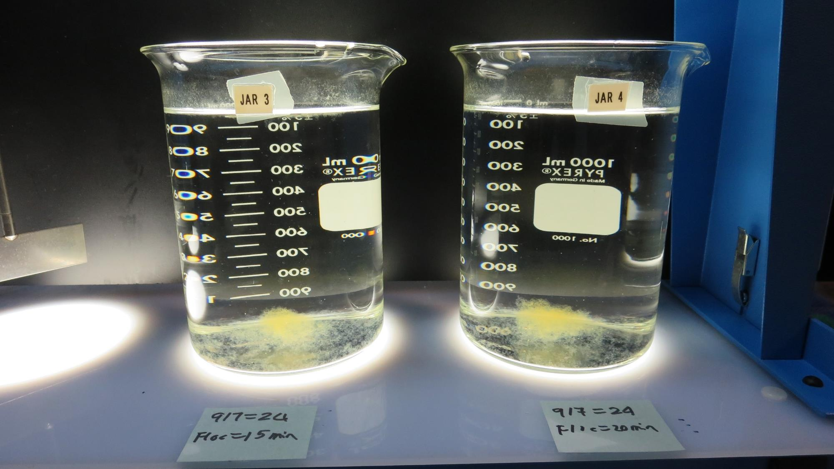
Jars 23-24: Visual look of settling, 25/20 minutes.
20 minute of setting
25 minute of setting

Slide 45
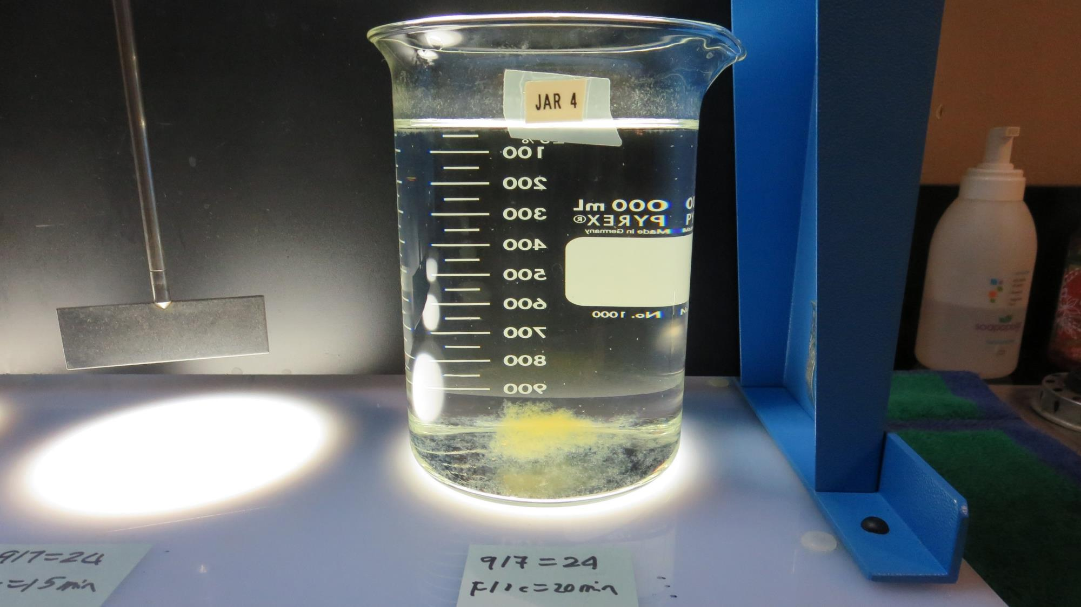
Jar 24: Visual look of settling, 25 minutes.
25 minute of setting

Slide 46
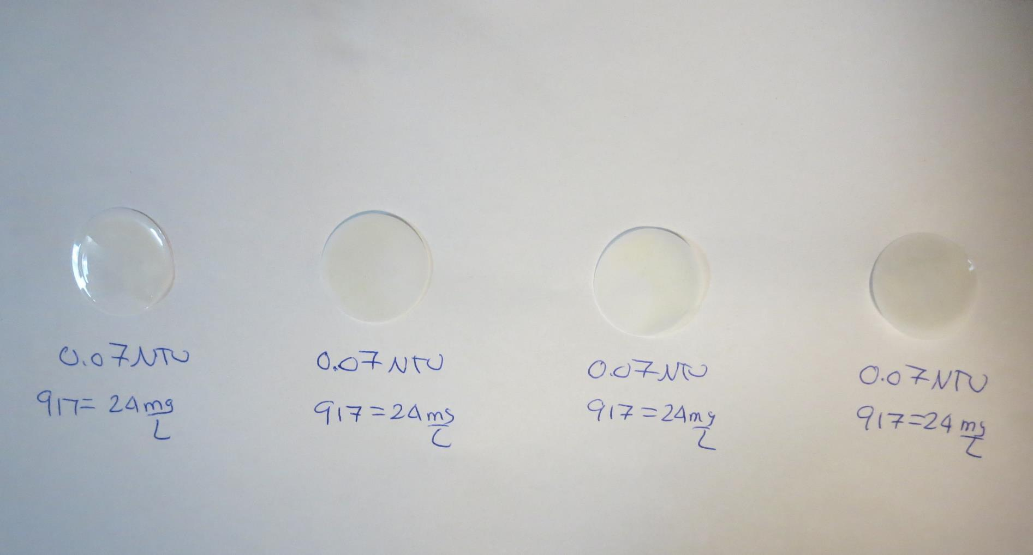
Visual of Filterability of Jars 21-24
24 mg/L 917
Filtrate 0.07 NTU
UVT: 89.8%
UVA: 0.047/cm
Settled: 0.28 NTU
24 mg/L 917
Filtrate 0.07 NTU
UVT: 89.7%
UVA: 0.047/cm
Settled: 0.22 NTU
24 mg/L 917
Filtrate 0.07 NTU
UVT: 89.6%
UVA: 0.048/cm
Settled: 0.22 NTU
24 mg/L 917
Filtrate 0.07 NTU
UVT: 89.8%
UVA: 0.047/cm
Settled: 0.21 NTU

Slide 47
Jars 24-28 Test No Flash Mix Floc Mix 5 min (10 RPM) Applied Coagulant 917

Slide 48
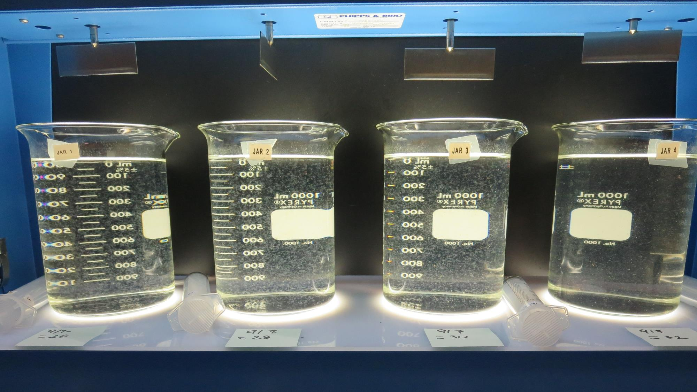
Jars 24-28: End of 5-minute flocculation (5 RPM) duration.
26 mg/L 917
Filtrate 0.07 NTU
UVT: 89.6%
UVA: 0.048/cm
Settled: 0.33 NTU
28 mg/L 917
Filtrate 0.08 NTU
UVT: 89.7%
UVA: 0.047/cm
Settled: 0.50 NTU
30 mg/L 917
Filtrate 0.08 NTU
UVT: 89.9%
UVA: 0.046/cm
Settled: 0.78 NTU
32 mg/L 917
Filtrate 0.07 NTU
UVT: 90.3%
UVA: 0.044/cm
Settled: 0.98 NTU

Slide 49
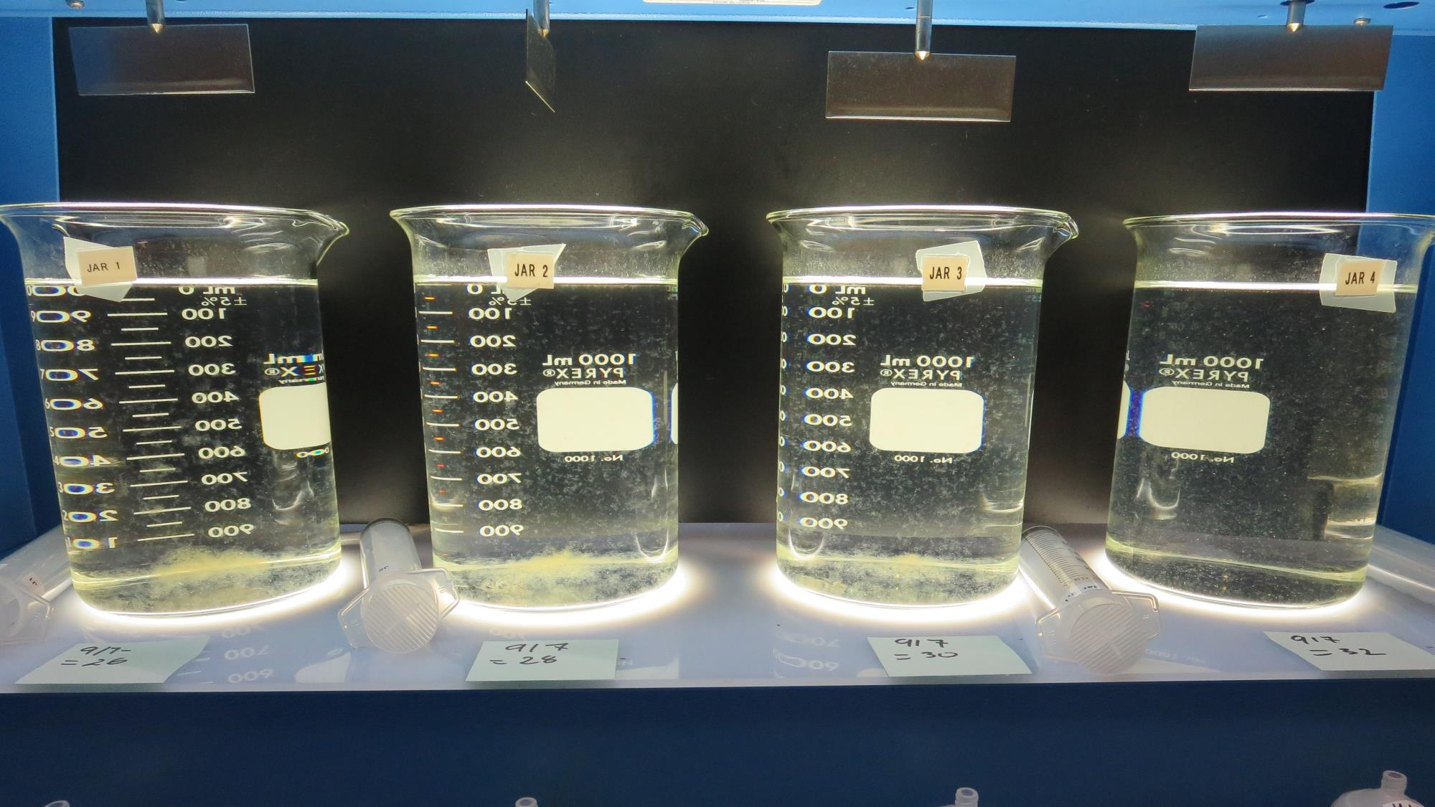
Jars 24-28: After 5 min of settling, 25 mL is syringed for filterability and %UVT/UVA.

Slide 50
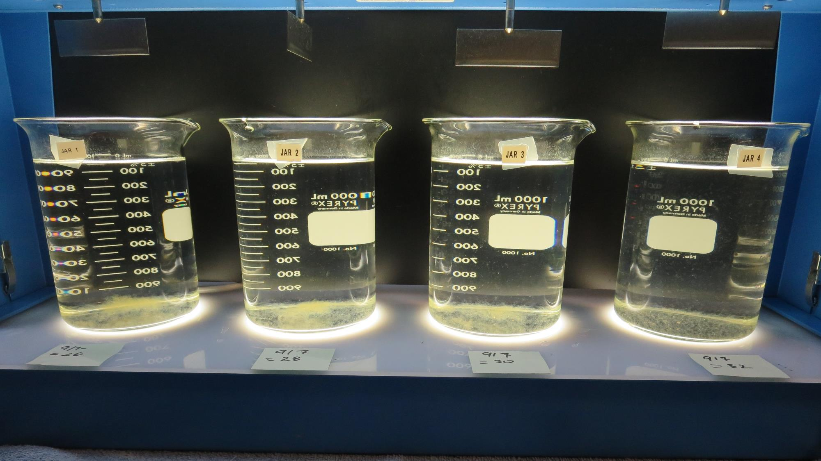
Jars 24-28: After 25-minutes of settling, settled water turbidity is taken.
26 mg/L 917
Filtrate 0.07 NTU
UVT: 89.6%
UVA: 0.048/cm
Settled: 0.33 NTU
28 mg/L 917
Filtrate 0.08 NTU
UVT: 89.7%
UVA: 0.047/cm
Settled: 0.50 NTU
30 mg/L 917
Filtrate 0.08 NTU
UVT: 89.9%
UVA: 0.046/cm
Settled: 0.78 NTU
32 mg/L 917
Filtrate 0.07 NTU
UVT: 90.3%
UVA: 0.044/cm
Settled: 0.98 NTU

Slide 51
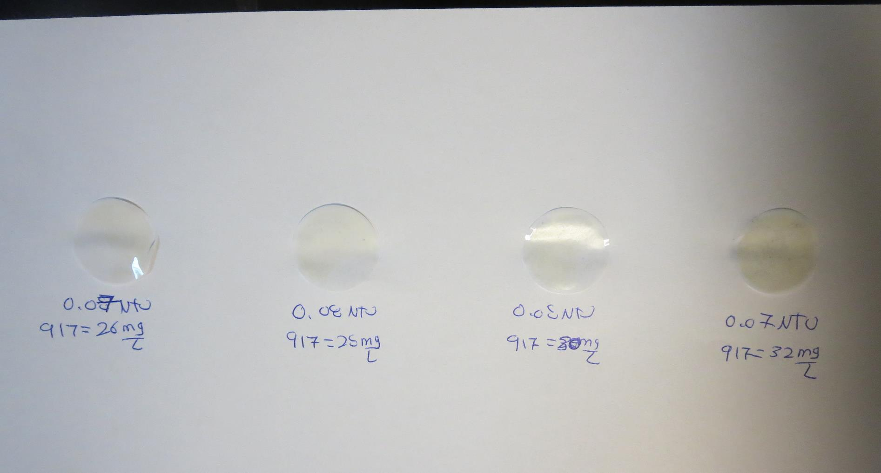
Visual of Filterability of Jars 24-28
26 mg/L 917
Filtrate 0.07 NTU
UVT: 89.6%
UVA: 0.048/cm
Settled: 0.33 NTU
28 mg/L 917
Filtrate 0.08 NTU
UVT: 89.7%
UVA: 0.047/cm
Settled: 0.50 NTU
30 mg/L 917
Filtrate 0.08 NTU
UVT: 89.9%
UVA: 0.046/cm
Settled: 0.78 NTU
32 mg/L 917
Filtrate 0.07 NTU
UVT: 90.3%
UVA: 0.044/cm
Settled: 0.98 NTU

Slide 52
Jars 29-32 Test No Flash Mix Floc Mix 5 min (10 RPM) Applied Coagulant 7066

Slide 53
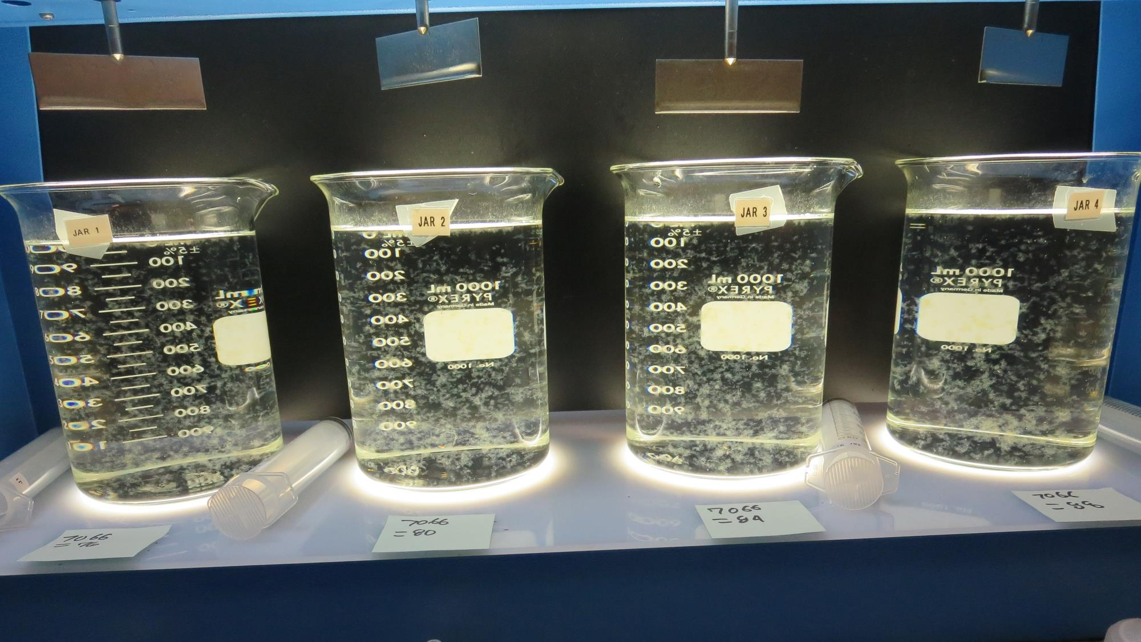
Jars 29-32: End of 5-minute flocculation (5 RPM) duration.
76 mg/L 7066
Filtrate 0.06 NTU
UVT: 89.3%
UVA: 0.049/cm
Settled: 0.17 NTU
80 mg/L 7066
Filtrate 0.06 NTU
UVT: 89.6%
UVA: 0.048/cm
Settled: 0.17 NTU
84 mg/L 7066
Filtrate 0.06 NTU
UVT: 89.8%
UVA: 0.047/cm
Settled: 0.28 NTU
88 mg/L 7066
Filtrate 0.06 NTU
UVT: 90.1%
UVA: 0.045/cm
Settled: 0.31 NTU

Slide 54
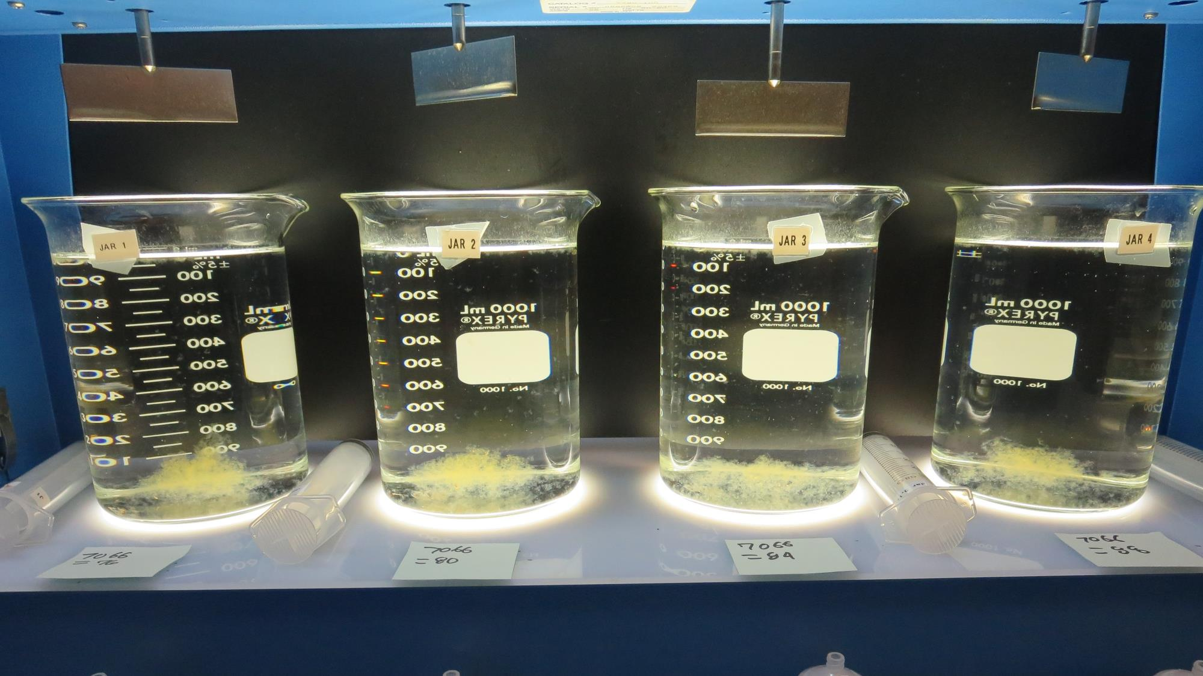
Jars 29-32: After 5 min of settling, 25 mL is syringed for filterability and %UVT/UVA.

Slide 55
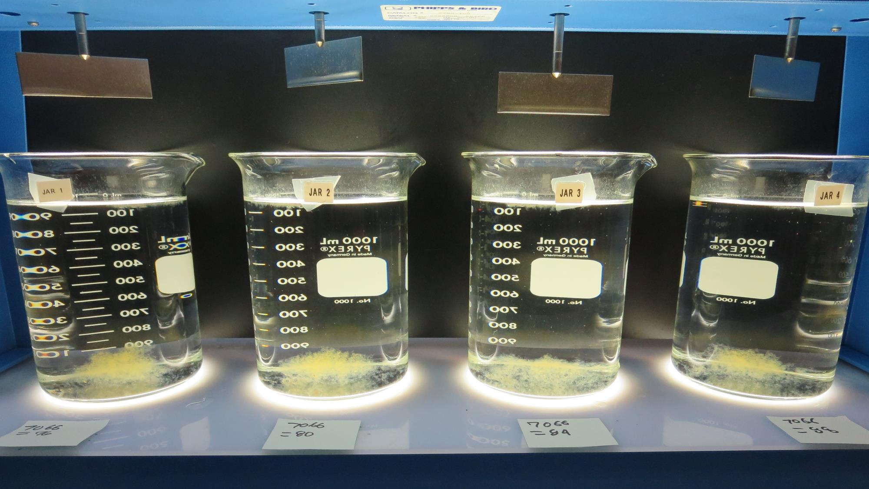
Jars 29-32: After 25-minutes of settling, settled water turbidity is taken.
76 mg/L 7066
Filtrate 0.06 NTU
UVT: 89.3%
UVA: 0.049/cm
Settled: 0.17 NTU
80 mg/L 7066
Filtrate 0.06 NTU
UVT: 89.6%
UVA: 0.048/cm
Settled: 0.17 NTU
84 mg/L 7066
Filtrate 0.06 NTU
UVT: 89.8%
UVA: 0.047/cm
Settled: 0.28 NTU
88 mg/L 7066
Filtrate 0.06 NTU
UVT: 90.1%
UVA: 0.045/cm
Settled: 0.31 NTU

Slide 56
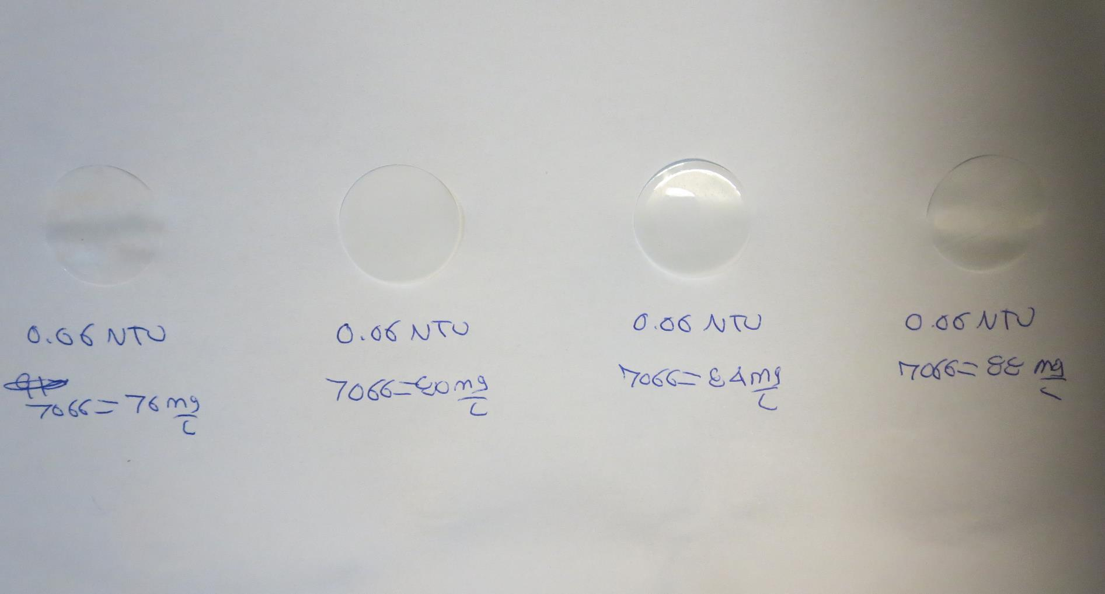
Visual of Filterability of Jars 29-32
76 mg/L 7066
Filtrate 0.06 NTU
UVT: 89.3%
UVA: 0.049/cm
Settled: 0.17 NTU
80 mg/L 7066
Filtrate 0.06 NTU
UVT: 89.6%
UVA: 0.048/cm
Settled: 0.17 NTU
84 mg/L 7066
Filtrate 0.06 NTU
UVT: 89.8%
UVA: 0.047/cm
Settled: 0.28 NTU
88 mg/L 7066
Filtrate 0.06 NTU
UVT: 90.1%
UVA: 0.045/cm
Settled: 0.31 NTU

Slide 57
Jar Testing for 1-Liter Jars: Procedures for Most Treatment Plants
Fill jars with source water prior to coagulant injection and set paddle speed at 30 rpm
Add chemicals (i.e., NaOCl, primary coagulant, coagulant aid) to each jar
Flash mix for 15-60 seconds (200 rpm)
Slow mix for 5 minutes (20-30 rpm)
Settled for 5 minutes. Syringe 25 mL from each jar taken 1-inch below surface (25 mL/12 sec rate)
Filtered through 1.2 um isopore membrane into cuvette drip rate, 15 mL/(50-90 sec)
Measure filtrate turbidity, chlorine residual and %UVT/UVA
Measure settled water turbidity after 25 minutes of total setting
Record all data

Slide 58
Jar Test Filterability Test Equipment
Turbidity Instrument
Syringe w/Luer-Lock Tip, 30 cc
(part#: 2225800, by Hach)
Swinnex Filter Holder, 25 mm (part#: SX0002500)
Isopore Membrane Filter, 1.2 um absolute
pore size,
Φ= 25 mm , thickness: 24 um,
hydrophilic polycarbonate membrane
(part #: RTTP02500)
Go to Sigma-Aldrich for laboratory supplies http://www.sigmaaldrich.com/united-states.html

Slide 59
Isopore Membrane Information
Categories | Information
trade name | Isopore
filter color | White
chemistry | Polycarbonate (PC)
water flow rate | Avg. 175 mL/min x cm² (typical results @ 10 psi)
media | Isopore®
wettability | Hydrophilic
porosity | 14.7%
pore size | 1.2 µm
bubble point at 23 °C | 1.0 bar, air with water
thickness | 24 µm
filter diameter (ø) | 25 mm
material size | polycarbonate, Hydrophilic, 1.2 µm, 25 mm, white, plain, 100

Slide 60
Isopore Membrane Background Information
The Isopore membrane is a polycarbonate, track-etched screen filter recommended for all analyses in which the sample is viewed on the surface of the membrane. The Isopore membrane is composed of polycarbonate film, which has a smooth, glass-like surface for clearer sample observation. The unique manufacturing process of the membrane ensures a precise pore diameter and a consistent pore size for accurate separation of samples by size. Matched-weight filters are not usually required because of low, constant tar and ash weights. Features & Benefits: Membrane structure retains particles on the surface, simplifying counting and analysis

Slide 61
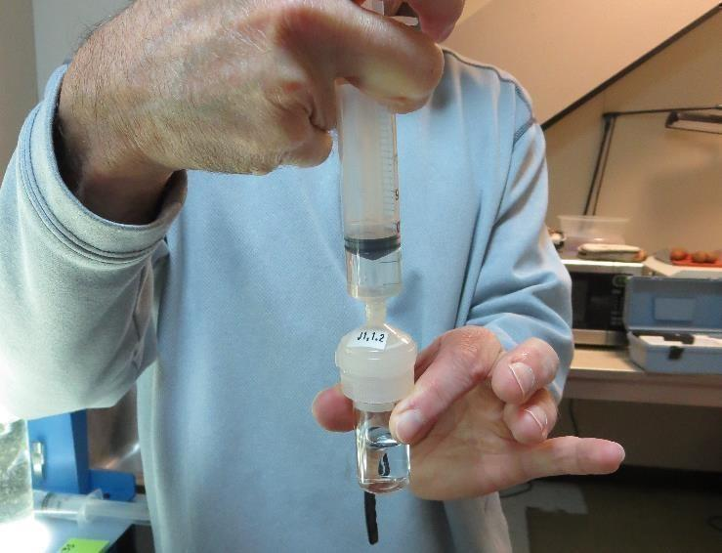
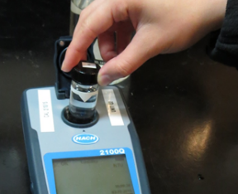
Jar Test - Filterability Test
Syringe ~ 25 mL from jar (after 5-minutes of settling)
Filter-to-waste 3-5 mL
Filter directly into clean cuvette
Measure turbidity
Note: Take several readings before recording final NTU results. Micro bubbles can adhere to glass causing false NTU readings. To remove bubbles, tilt cuvette up to 90 degrees.

Slide 62
Contact
Guy Schott, P.E.
State Water Resources Control Board
Division of Drinking Water
Santa Rosa, CA
Go to Stock Solution/Dose calculations/Jar Test Results for tools to download
www.waterboards.ca.gov/drinking_water/programs/districts/mendocino_district.html
Email: Guy Schott - Guy.Schott@waterboards.ca.gov
Office Number: 707-576-2732

