Slide 1
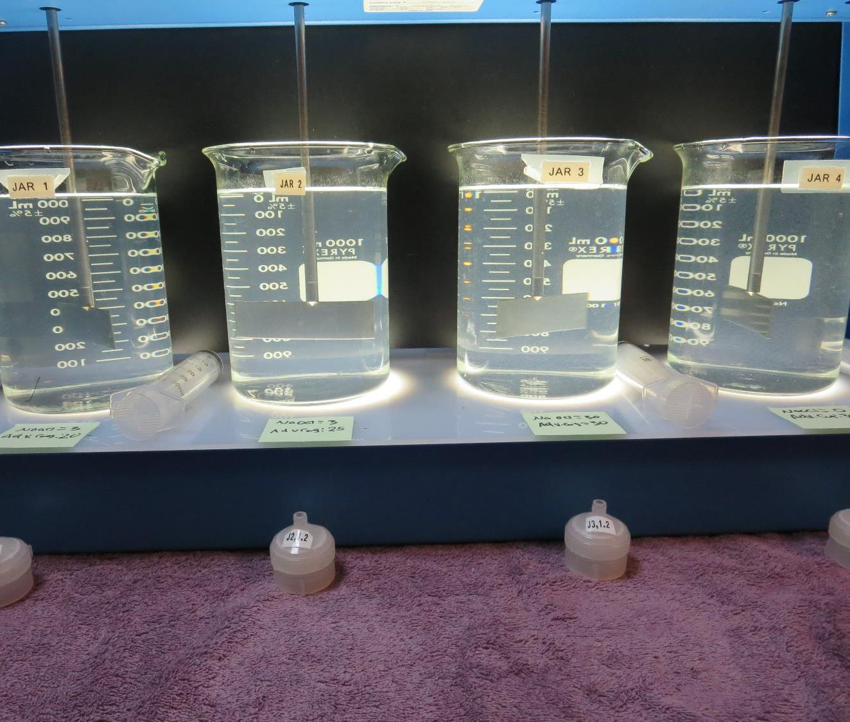
Cobb Area – Branding Iron CA1700542, Lake County, Jar Test, Fe Removal
by Guy Schott, P.E.
August 20, 2020

Slide 2
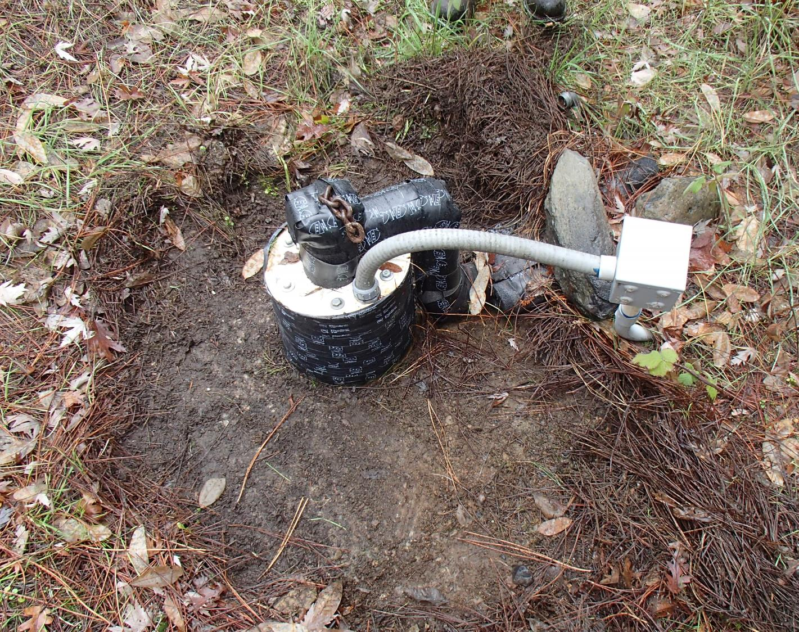
Cobb Area – Branding Iron Well Source: pH: 7.10 Fe: 0.965 mg/L

Slide 3
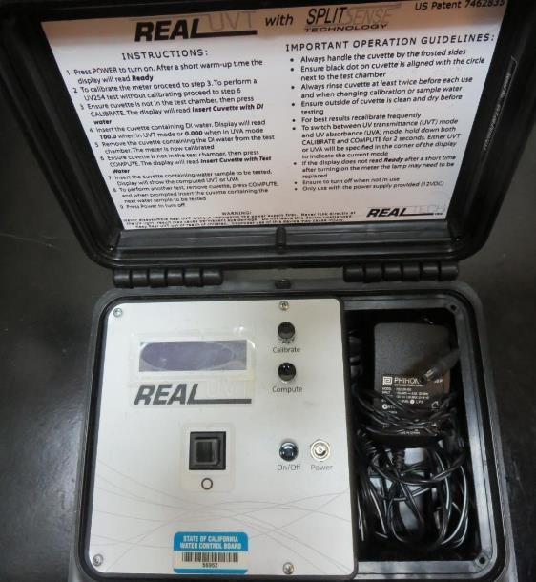
UVT/UVA, pathlength 10 mm
UV transmittance (UVT) is a measurement of the amount of ultraviolet light (commonly at 254 nm due to its germicidal effect) that passes through a water sample compared to the amount of light that passes through a pure water sample. The measurement is expressed as a percentage, % UVT.
%UVT = 10^{(-UVA)} x 100%
UV absorbance (UVA) is calculated as a relative measure of the amount of light absorbed by a water sample compared with the amount of light absorbed by a pure water sample.
UVA = -log(%UVT/100)

Slide 4
Applied Coagulants for Jar Testing
FeCl₃
BWS, Inc.
Advanced Coagulant
AdvFloc-CTC-00011
12.55% Al₂O₃
64.9% Basicity
SG = 1.299
Gregory F. Nieckarz, Ph.D.
Principal Consultant
SWS Consulting, LLC.
+1.541.953.5112
gregn.swsc@gmail.com

Slide 5
Branding Iron: Jar Test 1-4 Results, Well Flash Mix 200 RPM (20 sec); Floc Mix 20 RPM (2 minutes)
Jar # | NaOCl mg/L | FeCl₃ Coag. mg/L | Filtrate NTU | Filtrate %UVT | Filtrate UVA/cm | Fe mg/L | Free Cl₂ Residual mg/L
J1 | 2.0 | 0 | 2.26 | 89.9 | 0.046 | 0.551 | 0.93
J2 | 3.0 | 0 | 2.11 | 92.2 | 0.034 | 0.363 | 1.67
J3 | 2.0 | 2.0 | 2.41 | 86.0 | 0.065 | 0.848 | 0.94
J4 | 2.0 | 2.0 | 1.89 | 89.6 | 0.047 | 0.632 | 1.40

Slide 6
Branding Iron: Jar Test 5-12 Results, Well Flash Mix 200 RPM (20 sec); Floc Mix 20 RPM (2 minutes)
Jar # | NaOCl mg/L | Adv. Coag. mg/L | Filtrate NTU | Filtrate %UVT | Filtrate UVA/cm | Fe mg/L | Free Cl₂ Residual mg/L
J5 | 4.0 | 0 | 0.73 | 95.9 | 0.018 | 0.096 | 2.8
J6 | 3.0 | 5 | 1.24 | 93.8 | 0.027 | 0.225 | 1.80
J7 | 3.0 | 10 | 0.79 | 95.5 | 0.019 | 0.099 | 1.75
J8 | 2.0 | 15 | 0.34 | 97.2 | 0.012 | 0.044 | 1.48
J9 | 3.0 | 20 | 0.09 | 98.0 | 0.008 | 0.011 | 1.40
J10 | 3.0 | 25 | 0.19 | 97.9 | 0.008 | 0.009 | 1.72
J11 | 3.0 | 30 | 0.17 | 97.7 | 0.010 | 0.006 | 1.67
J12 | 0.0 | 30 | 0.16 | 98.4 | 0.006 | 0.012 | 0.0

Slide 7
Branding Iron: Jar Test 13-16 Results, Well Flash Mix 200 RPM (20 sec); Floc Mix 20 RPM (2 minutes)
Jar # | NaOCl mg/L | Adv. Coag. mg/L | Filtrate NTU | Filtrate %UVT | Filtrate UVA/cm | Fe mg/L | Free Cl₂ Residual mg/L
J13 | 0 | 20 | 0.12 | 98.9 | 0.004 | 0.019 | 0
J14 | 3.0 | 20 | 0.14 | 98.0 | 0.008 | 0.018 | 1.65
J15 | 0 | 25 | 0.13 | 98.5 | 0.006 | 0.017 | 0
J16 | 3.0 | 25 | 0.08 | 98.5 | 0.006 | 0.004 | 1.57

Slide 8
Jars 1-4 Test Flash Mix 20 Sec (200 RPM) Floc Mix 2 min (20 RPM) w/NaOCl Applied Coagulant FeCl₃

Slide 9
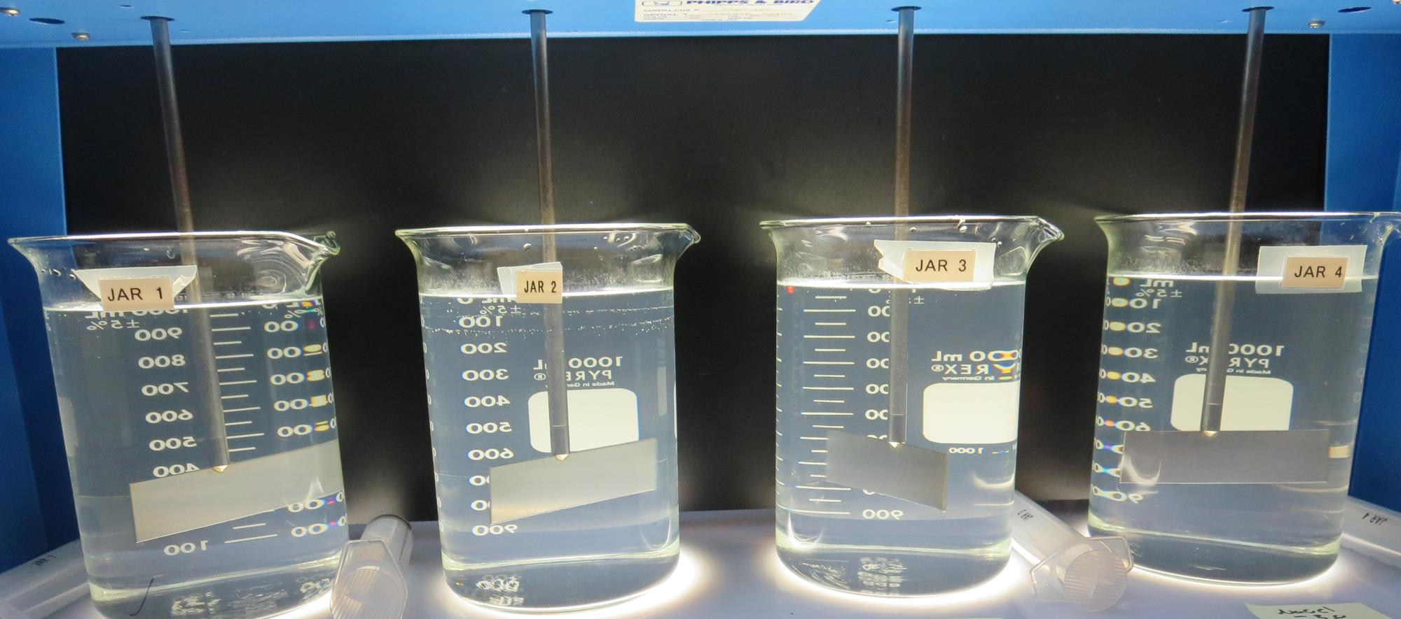
Jars 1-4: End of 2-minute flocculation (20 RPM) duration.
3.0 mg/L NaOCl
2.0 mg/L FeCl₃
Filtrate: 2.41 NTU
UVT: 86.0%
UVA: 0.065/cm
Cl₂: 0.94 mg/L
Fe: 0.848 mg/L
2.0 mg/L NaOCl
2.0 mg/L FeCl₃
Filtrate: 1.89 NTU
UVT: 89.6%
UVA: 0.047/cm
Cl₂: 1.4 mg/L
Fe: 0.632 mg/L
2.0 mg/L NaOCl
Filtrate: 2.26 NTU
UVT: 89.9%
UVA: 0.046/cm
Cl₂: 0.93 mg/L
Fe: 0.551 mg/L
3.0 mg/L NaOCl
Filtrate: 2.11 NTU
UVT: 92.2%
UVA: 0.034/cm
Cl₂: 1.62 mg/L
Fe: 0.363 mg/L

Slide 10
Jars 5-8 Test Flash Mix 20 Sec (200 RPM) Floc Mix 2 min (20 RPM) w/NaOCl Applied Coagulant Advanced Coagulant

Slide 11
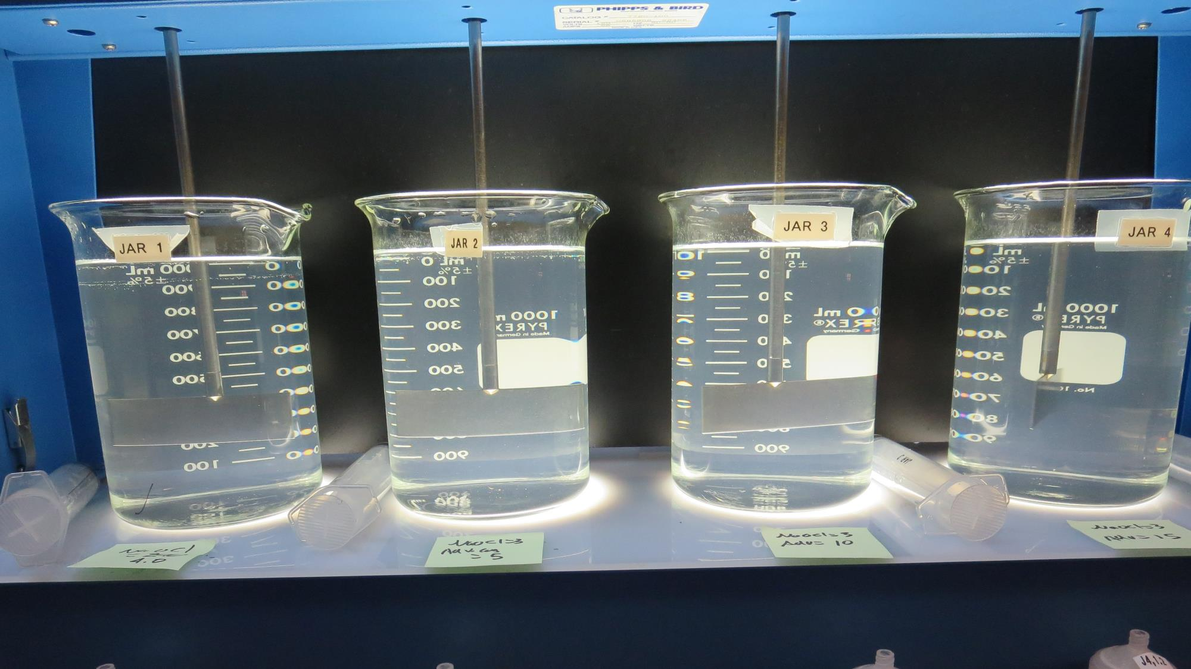
Jars 5-8: End of 2-minute flocculation (20 RPM) duration.
3.0 mg/L NaOCl
5 mg/L Adv Coag
Filtrate: 1.24 NTU
UVT: 93.8%
UVA: 0.027/cm
Cl₂: 1.8 mg/L
Fe: 0.225 mg/L
3.0 mg/L NaOCl
10 mg/L Adv Coag
Filtrate: 0.79 NTU
UVT: 95.5%
UVA: 0.019/cm
Cl₂: 1.75 mg/L
Fe: 0.099 mg/L
3.0 mg/L NaOCl
15 mg/L Adv Coag
Filtrate: 0.34 NTU
UVT: 97.2%
UVA: 0.012/cm
Cl₂: 1.48 mg/L
Fe: 0.044 mg/L
4.0 mg/L NaOCl
Filtrate: 0.73 NTU
UVT: 95.9%
UVA: 0.018/cm
Cl₂: 2.8 mg/L
Fe: 0.091 mg/L

Slide 12
Jars 9-12 Test Flash Mix 20 Sec (200 RPM) Floc Mix 2 min (20 RPM) w/NaOCl Applied Coagulant Advanced Coagulant

Slide 13
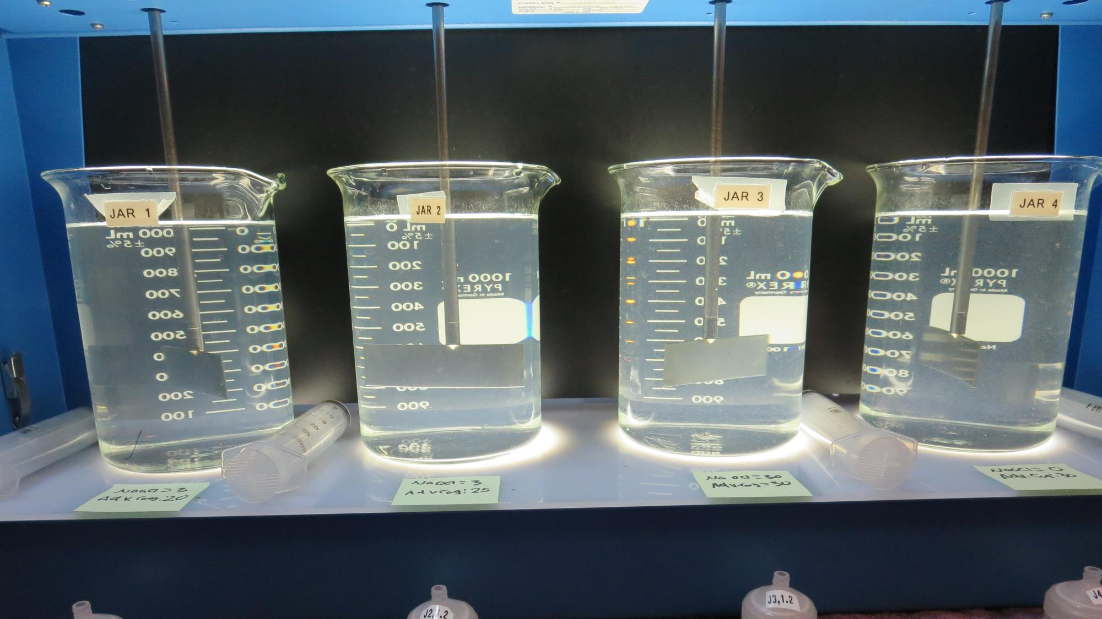
Jars 9-12: End of 2-minute flocculation (20 RPM) duration.
3.0 mg/L NaOCl
20 mg/L Adv Coag
Filtrate: 0.09 NTU
UVT: 98%
UVA: 0.008/cm
Cl₂: 1.4 mg/L
Fe: 0.011 mg/L
3.0 mg/L NaOCl
25 mg/L Adv Coag
Filtrate: 0.19 NTU
UVT: 97.9%
UVA: 0.008/cm
Cl₂: 1.72 mg/L
Fe: 0.009 mg/L
3.0 mg/L NaOCl
30 mg/L Adv Coag
Filtrate: 0.17 NTU
UVT: 97.7%
UVA: 0.010/cm
Cl₂: 1.67 mg/L
Fe: 0.006 mg/L
0 mg/L NaOCl
30 mg/L Adv Coag
Filtrate: 0.16 NTU
UVT: 98.4%
UVA: 0.006/cm
Cl₂: 0 mg/L
Fe: 0.012 mg/L

Slide 14
Jars 13-16 Test Flash Mix 20 Sec (200 RPM) Floc Mix 2 min (20 RPM) w/NaOCl Applied Coagulant Advanced Coagulant

Slide 15
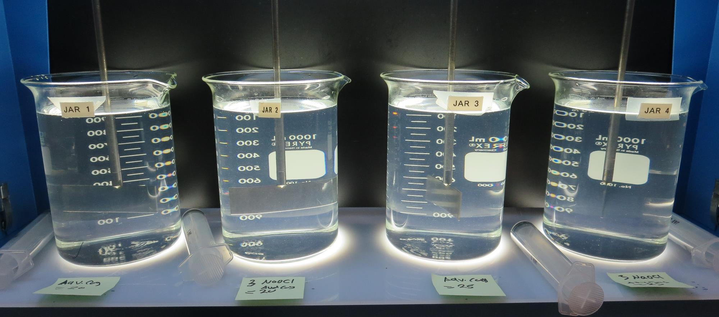
Jars 13-16: End of 2-minute flocculation (20 RPM) duration.
0 mg/L NaOCl
20 mg/L Adv Coag
Filtrate: 0.12 NTU
UVT: 98.9%
UVA: 0.004/cm
Cl₂: 0 mg/L
Fe: 0.019 mg/L
3.0 mg/L NaOCl
20 mg/L Adv Coag
Filtrate: 0.14 NTU
UVT: 98.0%
UVA: 0.008/cm
Cl₂: 1.65 mg/L
Fe: 0.018 mg/L
0 mg/L NaOCl
25 mg/L Adv Coag
Filtrate: 0.13 NTU
UVT: 98.5%
UVA: 0.006/cm
Cl₂: 0 mg/L
Fe: 0.017 mg/L
0 mg/L NaOCl
25 mg/L Adv Coag
Filtrate: 0.08 NTU
UVT: 98.5%
UVA: 0.006/cm
Cl₂: 1.57 mg/L
Fe: 0.004 mg/L

Slide 16
Jar Testing for 1-Liter Jars: Procedures for Iron Removal
Fill jars with source water prior to coagulant injection and set paddle speed at 30 rpm
Add chemicals (i.e., NaOCl, primary coagulant, coagulant aid) to each jar
Flash mix for 20 seconds (200 rpm)
Slow mix for 2 minutes (20 rpm).
Syringe 25 mL from each jar taken 1-inch below surface (25 mL/12 sec rate).
Filtered through 1.2 um isopore membrane into cuvette drip rate, 15 mL/(50-90 sec)
Measure filtrate turbidity, chlorine residual, %UVT/UVA and Fe.
Record all data

Slide 17
Jar Test Filterability Test Equipment
Turbidity Instrument
Syringe w/Luer-Lock Tip, 30 cc
(part#: 2225800, by Hach)
Swinnex Filter Holder, 25 mm (part#: SX0002500)
Isopore Membrane Filter, 1.2 um absolute
pore size,
Φ= 25 mm , thickness: 24 um,
hydrophilic polycarbonate membrane
(part #: RTTP02500)
Go to Sigma-Aldrich for laboratory supplies http://www.sigmaaldrich.com/united-states.html

Slide 18
Isopore Membrane Information
Categories | Information
trade name | Isopore
filter color | White
chemistry | Polycarbonate (PC)
water flow rate | Avg. 175 mL/min x cm² (typical results @ 10 psi)
media | Isopore®
wettability | Hydrophilic
porosity | 14.7%
pore size | 1.2 µm
bubble point at 23 °C | 1.0 bar, air with water
thickness | 24 µm
filter diameter (ø) | 25 mm
material size | polycarbonate, Hydrophilic, 1.2 µm, 25 mm, white, plain, 100

Slide 19
Isopore Membrane Background Information
The Isopore membrane is a polycarbonate, track-etched screen filter recommended for all analyses in which the sample is viewed on the surface of the membrane. The Isopore membrane is composed of polycarbonate film, which has a smooth, glass-like surface for clearer sample observation. The unique manufacturing process of the membrane ensures a precise pore diameter and a consistent pore size for accurate separation of samples by size. Matched-weight filters are not usually required because of low, constant tar and ash weights. Features & Benefits: Membrane structure retains particles on the surface, simplifying counting and analysis

Slide 20
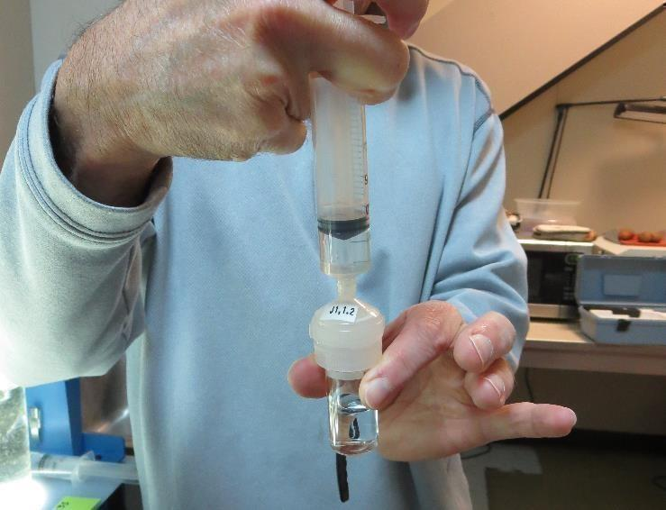
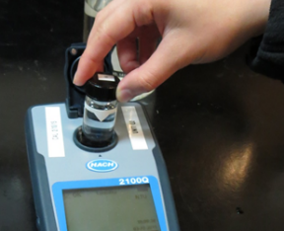
Jar Test - Filterability Test
Syringe ~ 25 mL from jar (after 5-minutes of settling)
Filter-to-waste 3-5 mL
Filter directly into clean cuvette
Measure turbidity
Note: Take several readings before recording final NTU results. Micro bubbles can adhere to glass causing false NTU readings. To remove bubbles, tilt cuvette up to 90 degrees.

Slide 21
Contact
Guy Schott, P.E.
State Water Resources Control Board
Division of Drinking Water
Santa Rosa, CA
Go to Stock Solution/Dose calculations/Jar Test Results for tools to download
www.waterboards.ca.gov/drinking_water/programs/districts/mendocino_district.html
Email: Guy Schott - Guy.Schott@waterboards.ca.gov
Office Number: 707-576-2732

